Slide 1
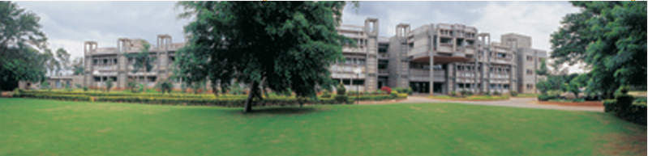
Recording from the Nervous System
MK Mathew
NCBS, TIFR
UAS – GKVK Campus
Bangalore
IBRO Course in Neuroscience
Center for Cognitive Neuroscience & Semantics, University of Latvia
Riga, Latvia
August 21-August 29, 2013

Slide 2
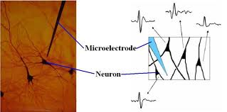

Slide 3
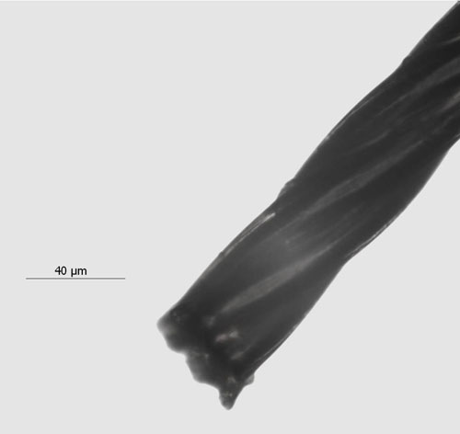

Slide 4
A
1
4
2
B
3
 | 1 | 2 | 3 | 4
A | +++ | ++ | +/- | ++
B | + | + | ++ | +++

Slide 5
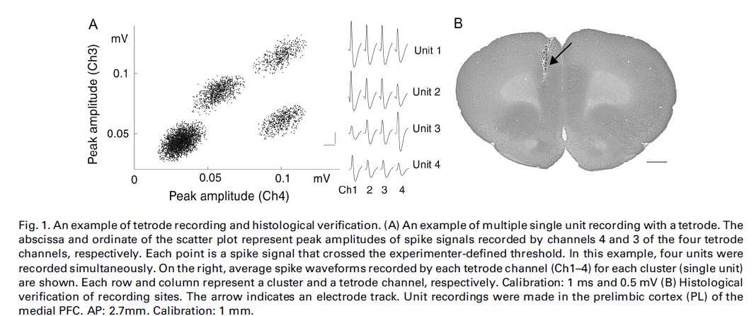
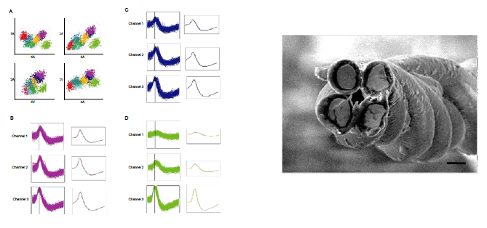
Kim et al (2001) Neuroscience Letters 298: 217 - 221

Slide 6
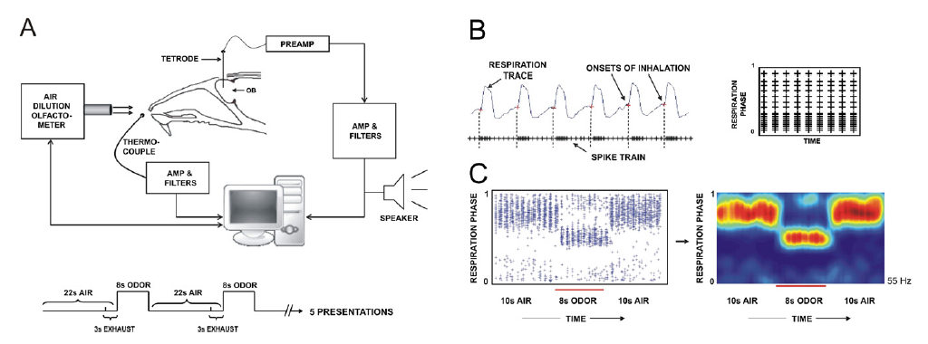

1,4 cineol
Isoamyl alcohol
Khan Thattai Bhalla (2008) Neuron 57, 571–585

Slide 7
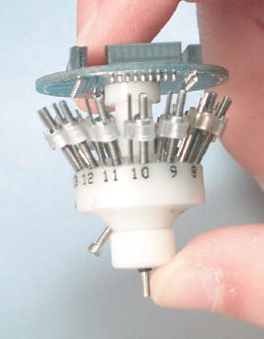
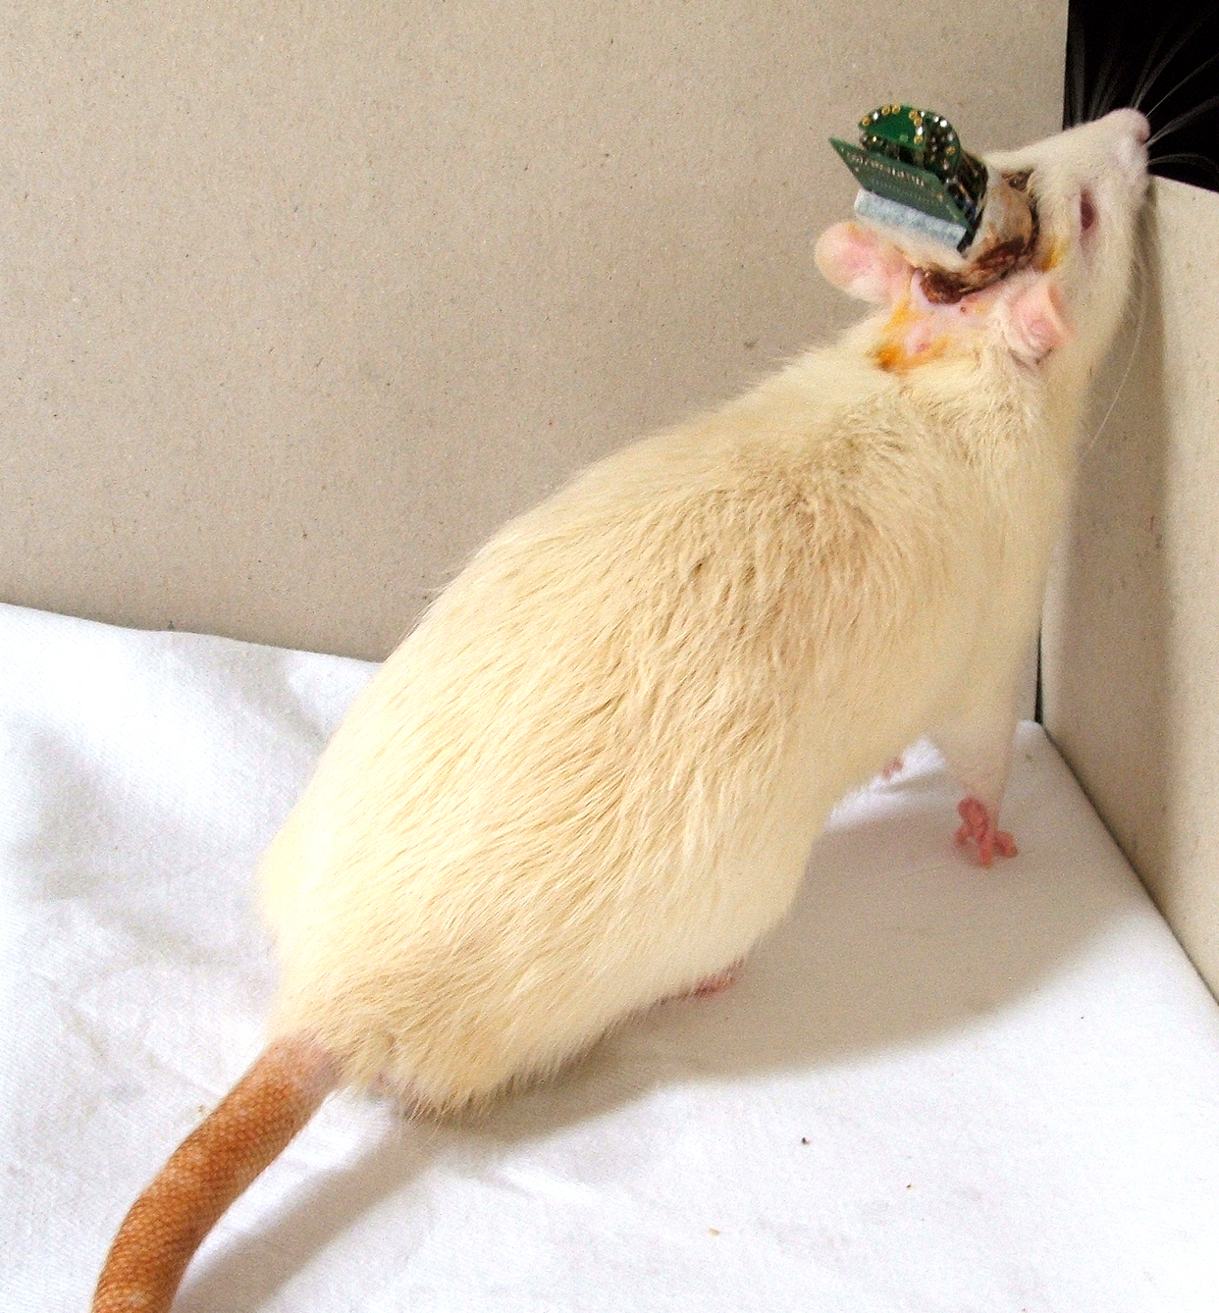

Slide 8
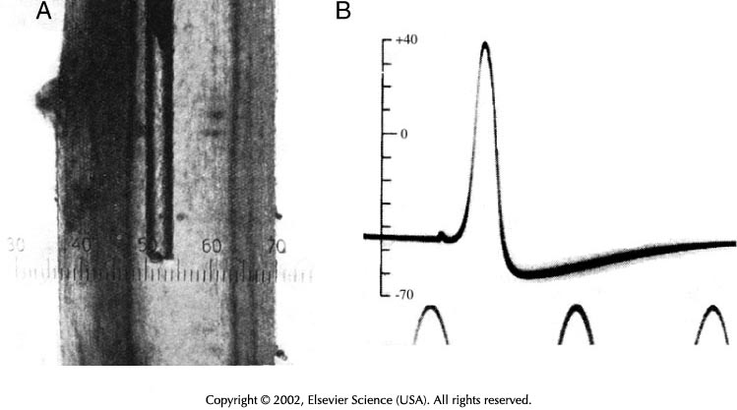

Slide 9
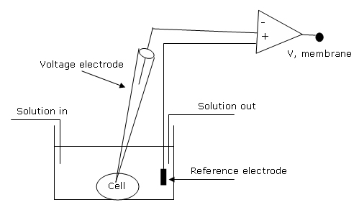

Slide 10
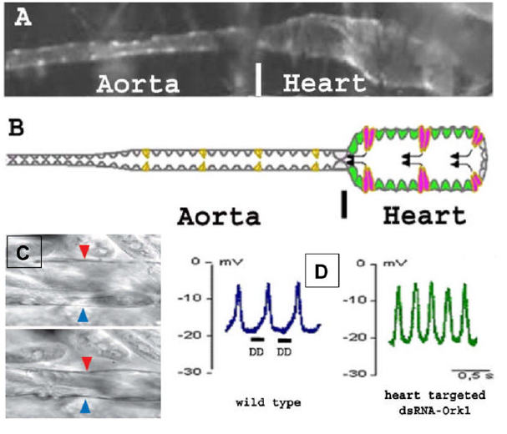
Ocorr etal (2007) Trends Cardiovasc Med; 17(5): 177–182

Slide 11
Ocorr etal (2007) Trends Cardiovasc Med; 17(5): 177–182

Slide 12
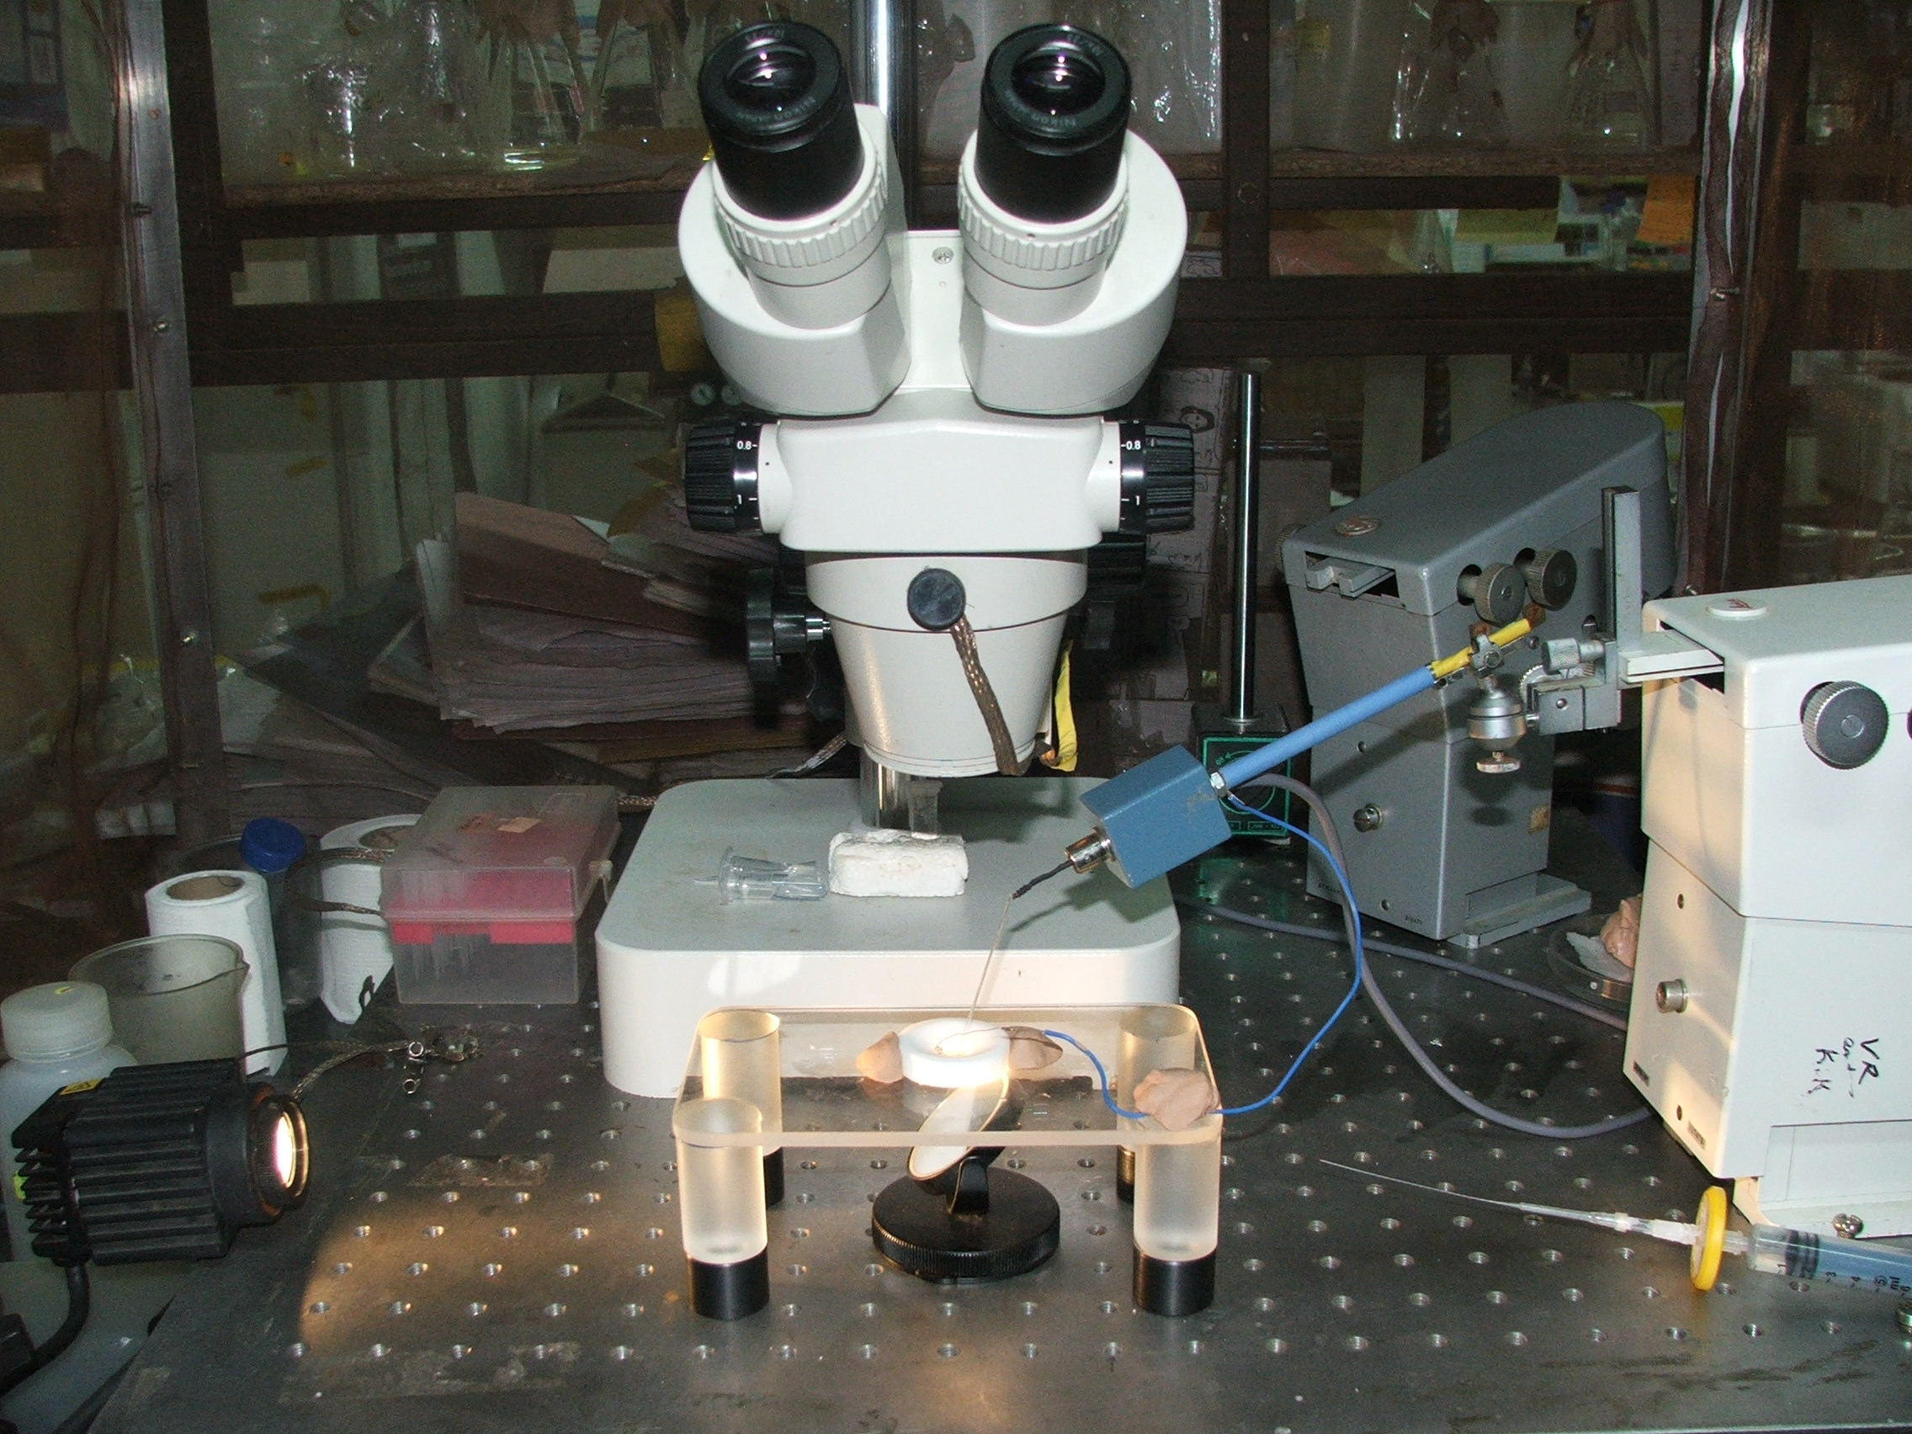

Slide 15
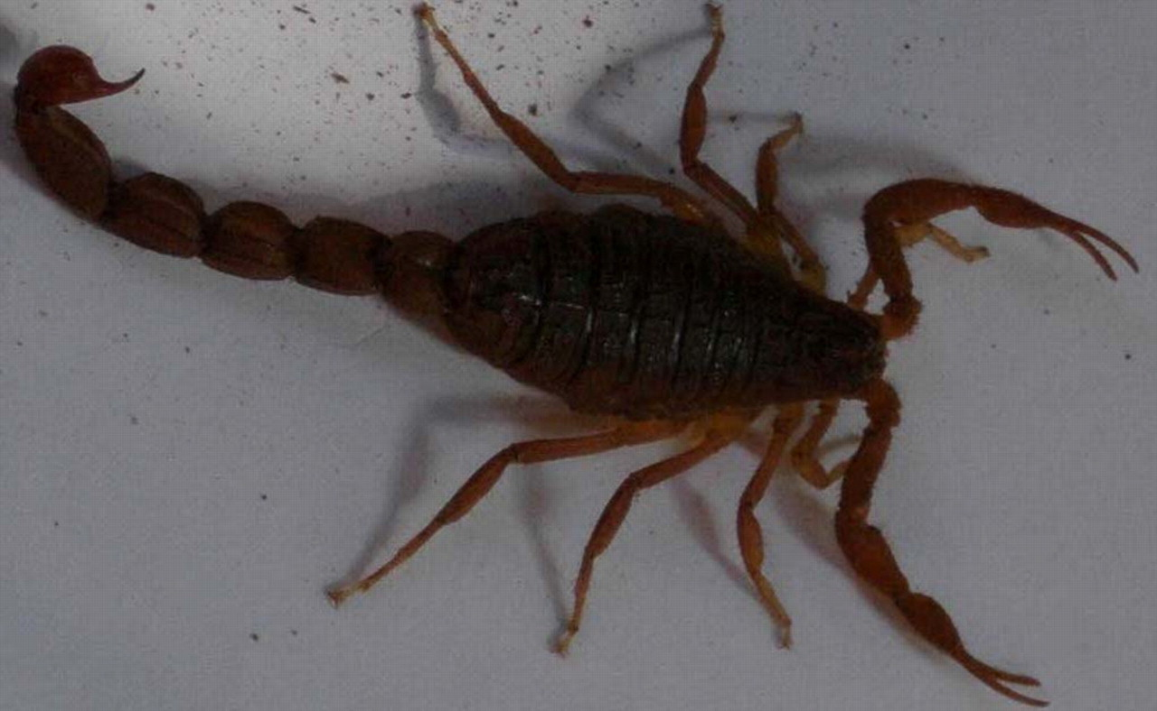

Slide 16
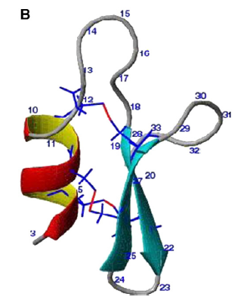
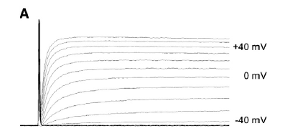
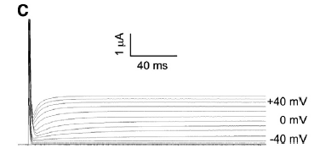
Btk-2 block of hKv1.1
Btk-2 NMR Structure
Siddhartha Sarma, IISc

Slide 17
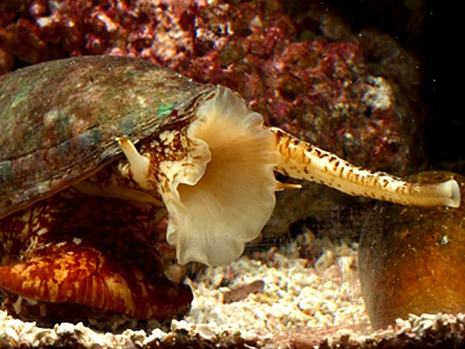

Slide 18
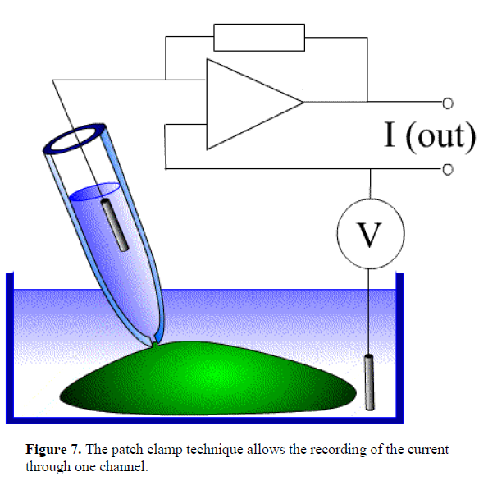
Pnacho Bezanilla “Nerve Impulse”

Slide 19
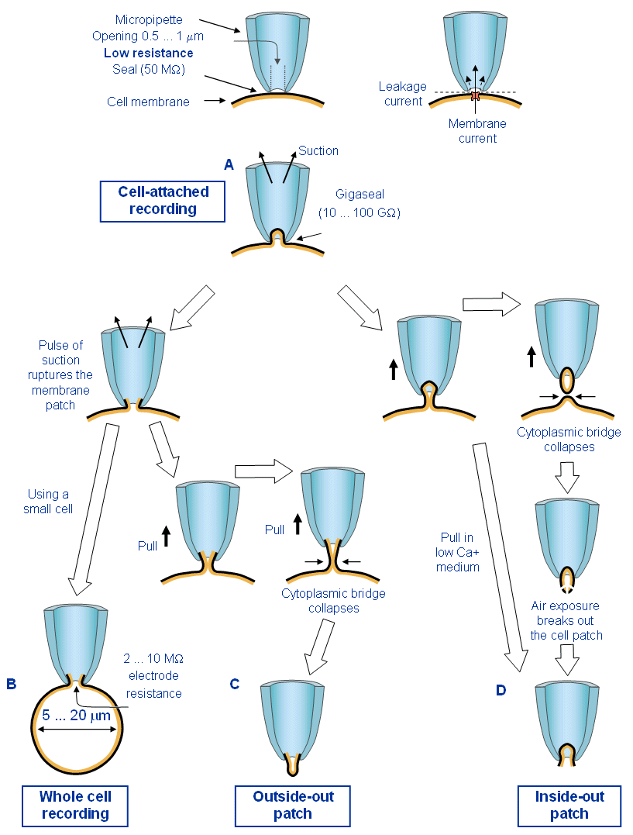

Slide 20
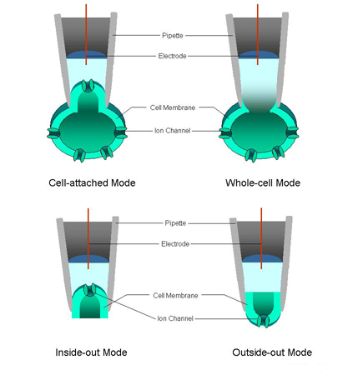
Patch Clamp configurations

Slide 21
Charge on an electron = charge on a Na⁺ ion = 1.6022 X 10⁻¹⁹ C
Current = dQ/dt
1 pA = 1pC/sec
= 6.24X10⁶ ions/sec

Slide 22
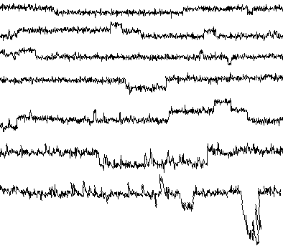
Rice (Pokkali) Inside-Out Patch symmetric KCl
>
-10
>
-20
>
-40
>
7
-50
-60
>
>
-80
>
-100
10pA
100 msec

Slide 23
1979 Villegas Villegas .. Racker BBRC Lobster Na channel reconstituted into liposomes
1980 .. Popot & Changeux Eur J Biochem AChR reconstt liposomes
Lindstrom .. Montal JBC AChR liposomes
1980 Nelson Lindstrom Montal PNAS AChR in BLM
1981 Boeheim..Barrantes..Sakmann PNAS AChR in BLM
1983 Krueger et al Nature Na channel in BLM
1984 Hanke Boheim .. Lazdunski EMBO J Na channel in BLM

Slide 24
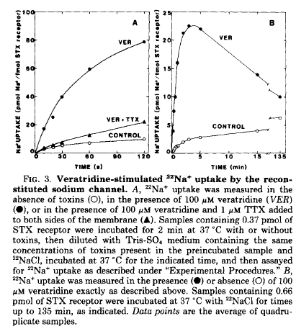
Tamkun .. Catterall (84) JBC

Slide 25
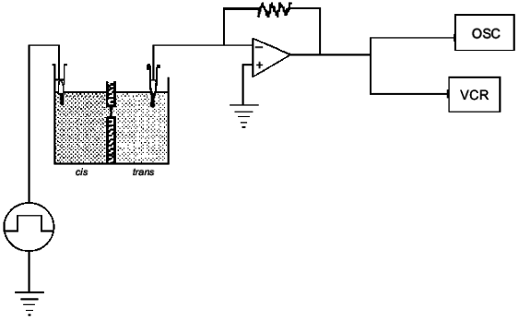
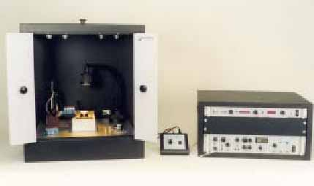

Slide 26
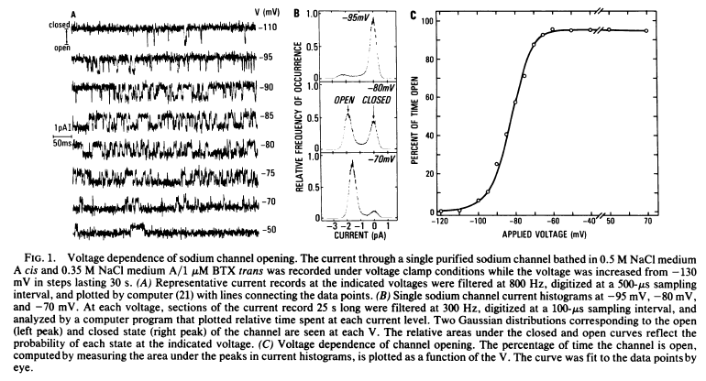
…Catterall .. Montal (85) PNAS 82: 240-244

Slide 27
FIG. 4. Oscilloscope recordings of membrane current at an applied voltage of +10 mV from a symmetric planar lipid bilayer containing purified AcChoR. An upward deflection of the trace indicates the opening of a single channel. The record was obtained after addition of 25 nM CbmCho. the lipid-to-protein ratio was 100-fold larger than indicated in-Materials and Methods. The bilayer was formed in 0.5 M NaCl instead of 0.1 M NaCl;
Nelson .. Lindstrom Montal (1980) PNAS 77, 3057-3061

Slide 28
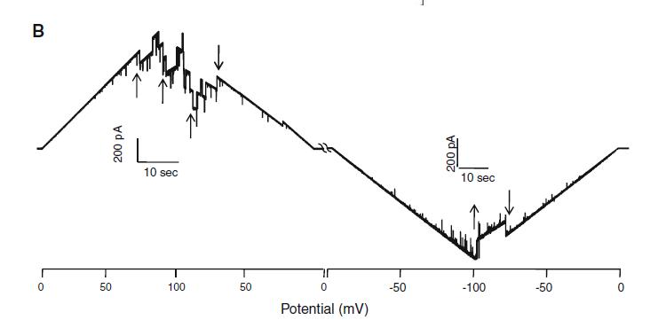
OsVDAC4 in BLM
Godbole et al (2012) J Membrane Biol.

Slide 29
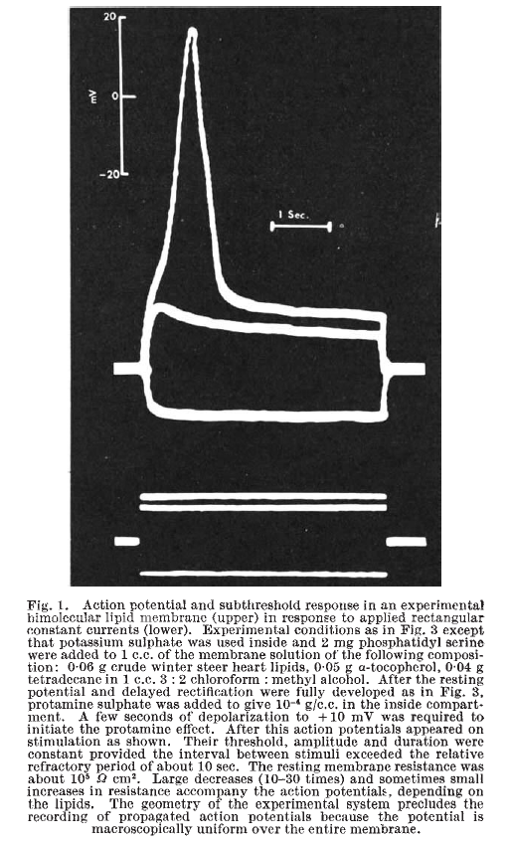
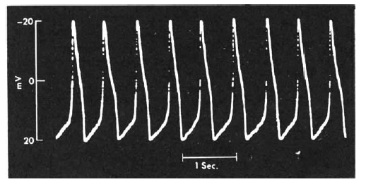
Mueller & Rudin (67) Nature 213, 603 - 04
Notes:
Data from BLM reconstituted with EIM from Aerobacter cloacae. Say that similar results obtained with EIM from rbc ghosts, brewer’s yeast, Chara and Nitella.

Slide 30
1982 Noda … Numa Nature AChR α-subunit cloned from peptide information
1983 Noda … Numa Nature All AChR subunits cloned
1984 Noda … Numa Nature Na channel α-subunit cloned
1987 Stuhmer .. Numa Eur J Biophys Xenopus oocyte expression Na channel

Slide 31
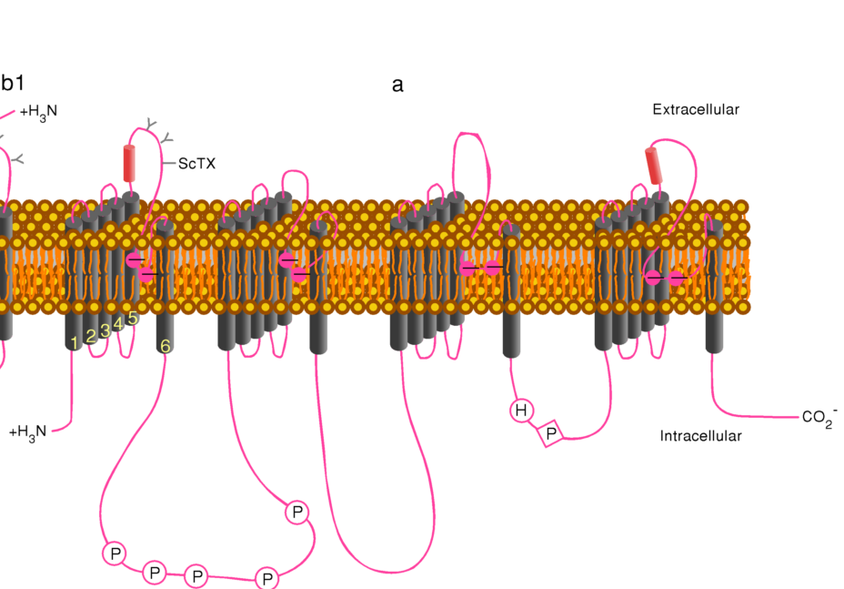
Sodium Channel

Slide 32
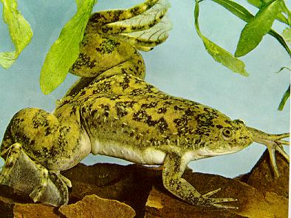
Xenopus laevis

Slide 33
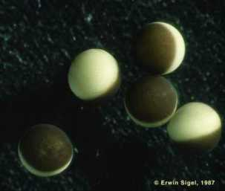
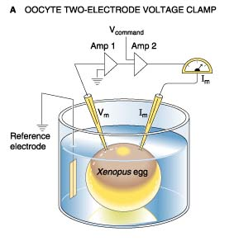
Xenopus oocytes
Two Electrode Voltage clamp

Slide 34
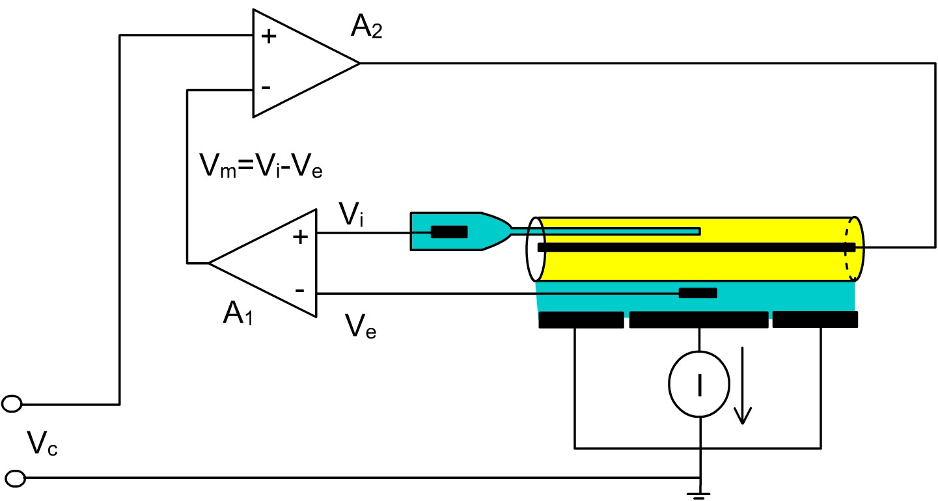
Voltage clamp of the squid axon. Vi is the internal potential measured with a pipette inserted in the axon. Ve is the external potential measured by an external electrode. Vm=Vi-Ve as computed by amplifier A1. A2 compares Vm with Vc (which is the command desired voltage) to inject current I, which maintains Vm at Vc. The current injected by the axial wire crosses the axonal membrane as it is drained by the chamber plates and measured by a current measuring device.
Bezanilla web page

Slide 35
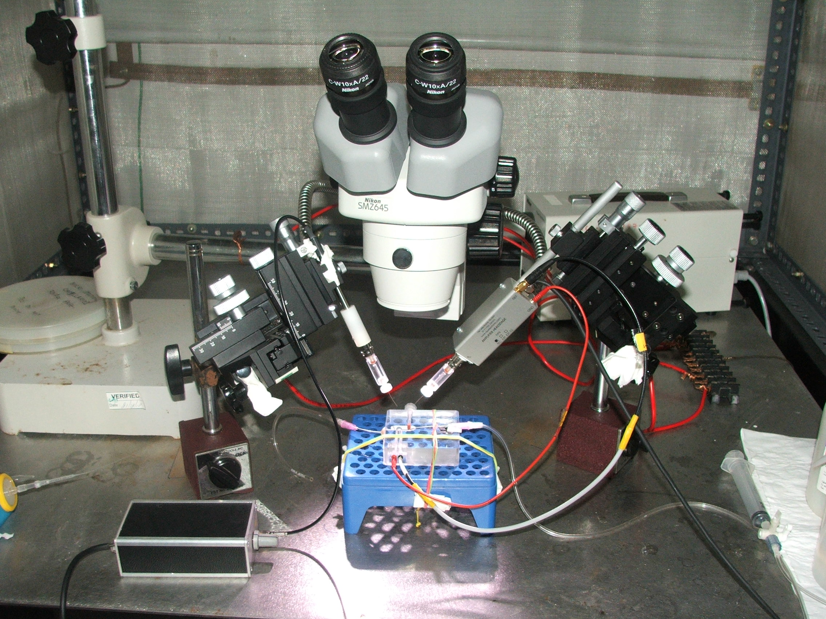

Slide 36
+40 mV
0 mV
-40 mV
-80 mV

Slide 37
Piston & Kremers (2007) TIBS 32(9)

Slide 38
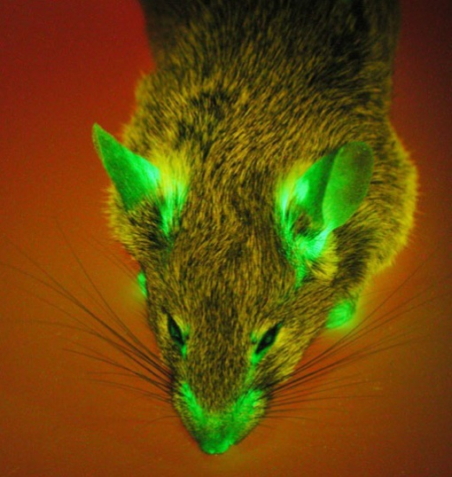

Slide 39
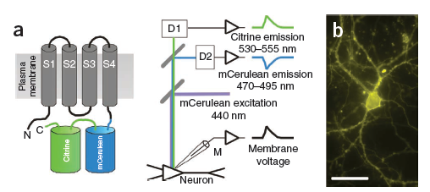
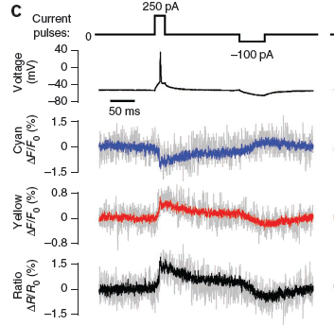
Figure 1 | VSFP2.3 reports membrane voltage transients through differential two-color fluorescence. (a) VSFP2.3 comprises a voltage-sensor domain with four transmembrane segments (S1–S4) fused to mCerulean and Citrine in tandem (left). Experimental configuration: a neuron expressing the probe is patch-clamped with a microelectrode (M) and illuminated at 440 nm. mCerulean and Citrine signals are recorded by detectors (D1 and D2). (b) Fluorescence image (yellow fluorescence channel) of a VSFP2.3-expressing cultured hippocampal pyramidal cell. (c) Schematic of current pulses injected into a pyramidal neuron (+250 pA and 100 pA), membrane voltage response, individual cyan and yellow fluorescence signals, and cyan/yellow fluorescence ratio for a 10-trial average with single trials plotted in gray (left).
Akemann et al (2010 Aug) Nature Methods

Slide 40
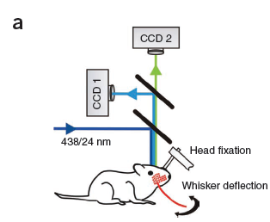
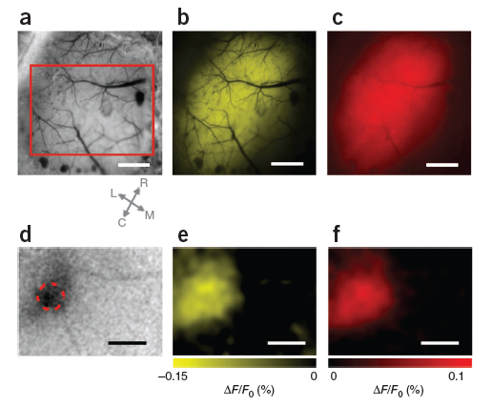
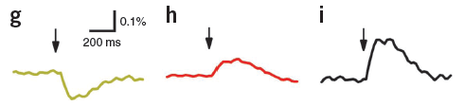
Figure 4 | VSFP2.3 imaging in the somatosensory cortex of living mice. (a) Schematic of the experimental configuration for in vivo dual-emission imaging.
(a) Brightfield image of the somatosensory cortex through the thinned cranial bone. Arrows below indicate rostral (R), caudal (C), lateral (L) and medial (M) directions. (b) Yellow fluorescence channel image of the same field as in a. (c) Fluorescence image analogous to b in the band of mKate2 emission. (d) Intrinsic signal evoked by 20 deflections at 10 Hz of the C1 whisker (from 50 averaged trials). (e,f) Maps of mCitrine (e) and mKate2 (f) emission changes evoked by a single C1 deflection at the time of maximal fluorescence response (average of 50 trials). Boxed area in a indicates field of view shown in d–f. (g–i) Time course of the mCitrine (g), mKate2 (h) and mKate2/mCitrine signal ratio (i) in the region marked in red (d) at 20 ms time resolution after averaging 50 trials
Akemann et al (2010 Aug) Nature Methods

Slide 41
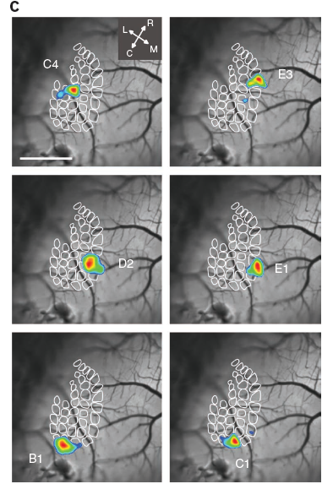
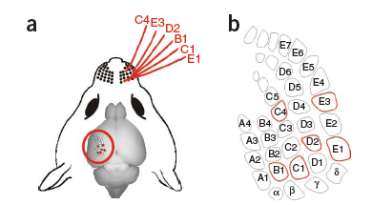
Figure 6 | Construction of receptive field maps using in vivo VSFP2 imaging. (a) Selection of six whiskers (C4, E3, D2, E1, B1 and C1) for sequential stimulation and receptive field imaging. (b) Identification of selected whisker in schematic representation of cortical barrel field. (c) Composite images showing responsive areas for each of the six whiskers from a single VSFP2.3 mouse. Responsive areas (shown in color) were determined by superimposing ΔR/R0 values greater than a threshold value of 90% peak amplitude on the baseline cyan/yellow fluorescence image (shown in grayscale). Arrows below indicate rostral (R), caudal (C), lateral (L) and medial (M) directions. Scale bar, 1 mm.
Akemann et al (2010 Aug) Nature Methods

Slide 42
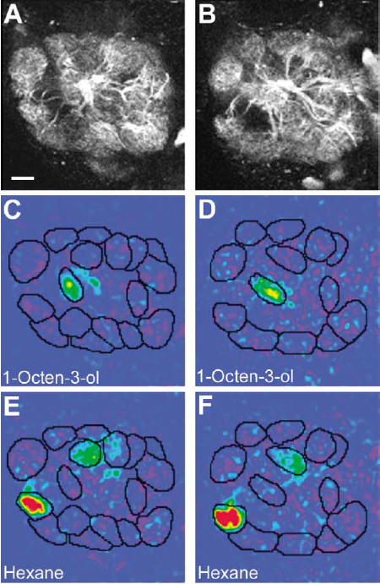
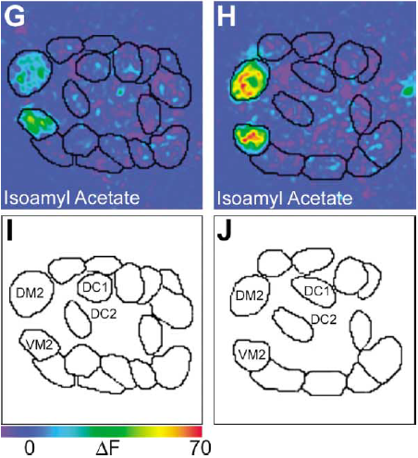
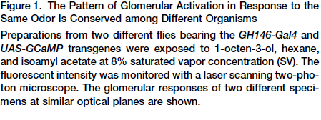
Wang … Axel (2003) Cell 112, 271–282

Slide 43
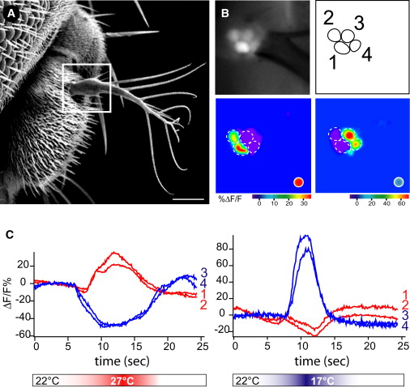
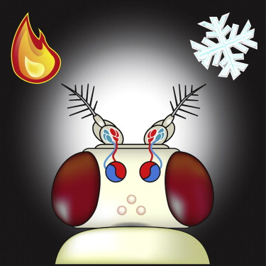
Gallio … Zucker (2011) Cell 144: 614–624
Notes:
Highlights
► The antenna houses the Drosophila HOT and COLD temperature-sensing neurons ► The hot and cold cells project to separate brain targets in the Protocerebrum (PAP) ► Two-photon calcium imaging reveals a spatial map of temperature in the PAP ► Functional studies show labeled lines for processing thermal signals in the fly brain
Figure 3. Hot and Cold temperature Receptors in the Drosophila Antenna(A) Scanning electron micrograph of theDrosophila antenna. The arista (white box) houses six neurons, four of which are visible on the focal plane shown in (B).(B) Basal fluorescence and maximal response images of 4 neurons expressing G-CaMP under the control of elav-Gal4. Functional imaging reveals that these cells respond to either hot (cells 1 and 2) or cold (cells 3 and 4) thermal stimuli (Stimuli are Δt∼5°C from 22°C; red dot: hot stimulus; blue dot: cold stimulus).(C) Response profile of the two hot- (cells 1 and 2 in panel [B]) and the two cold-sensing neurons (cells 3 and 4 in panel [B]) to a stimulus of Δt∼5°C; red traces denote responses of hot cells, and blue traces depict the cold cells. Note that cold sensing neurons display a drop in intracellular calcium in response to hot stimuli, and the hot-sensing neurons display a decrease in intracellular calcium in response to warming (scale bar represents 20 μm, see also Figure S3).

Slide 44
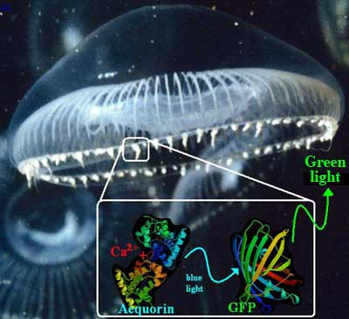

Slide 45
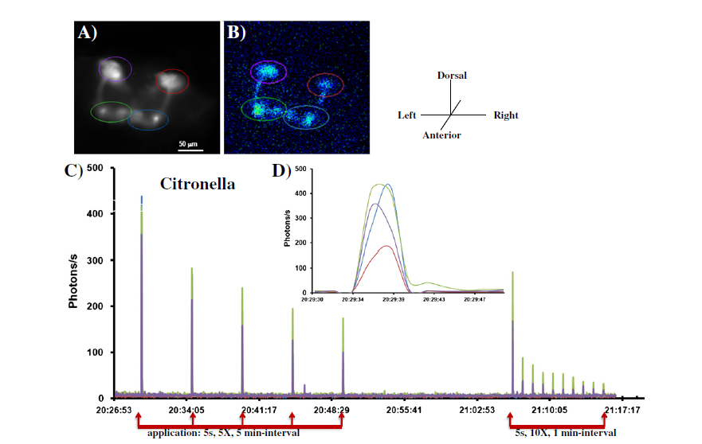
Minocci et al (2013) BBA 1833 ,1632–1640
Notes:
Fig. 1. Citronella-induced Ca2+-responses in the mushroom-bodies. (A) Fluorescence image (frontal view) of the MBs (GFP-aequorin driven by the P[GAL4]OK107 line) (GA/CS;
OK107/CS) taken at the beginning of the experiment and used as a reference image. The colored-circles represent the ROIs (regions of interest) from which the light emission
was quantified (Scale bar=50 μm). The mauve and red circles are the right and left calyx/cell-bodies, respectively, and the green and blue circles are the right and left medial
lobes, respectively. (B) A bioluminescence image (accumulation time: 60 s) of the first application (5 s) of citronella odor. All parts of the MBs (calyx/cell-bodies, peduncles,
and the lobes) are activated. (C) A representative bioluminescent Ca2+-activity profile evoked by 5 applications of 5 s odor duration (red arrows) at 5 min-interval of citronella,
followed ~15 min later, by a second schedule of odor-application; 5 s odor duration, 10 times at 1 min-interval. In both schedules, the response of the MBs adapts to repeated
odor stimulation (see also the Movie S1). (D) Magnification of the first odor application (from C) showing the responses of the four ROIs. We observe that for a 5 s
odor-application, the response stands for 7 s. [Notice that since it is a frontal view of the fly, the real left and right sides of the fly are inverted according to the schema of the
axis displayed] (similar for other figures).

Slide 46
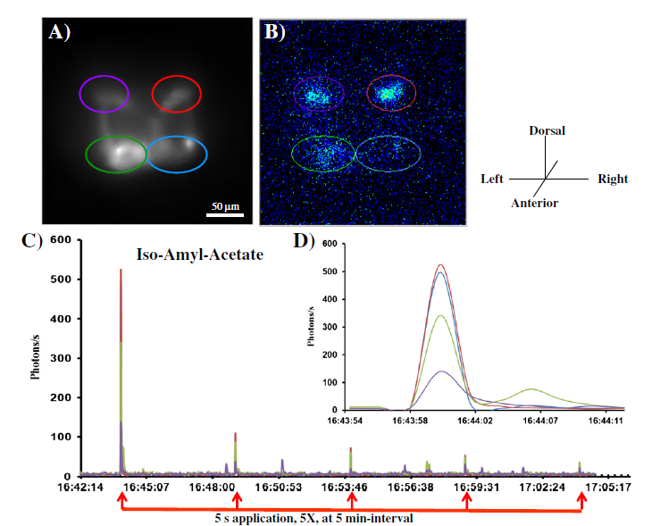
Minocci et al (2013) BBA 1833 ,1632–1640
Notes:
Fig. 2. Iso-amyl-acetate-induced Ca2+-responses in the mushroom-bodies. (A) Fluorescence image (frontal view) of the MBs (GA/CS; OK107/CS) taken at the beginning of the
experiment and used as a reference image. The colored-circles represent the ROIs from which light emission was quantified (Scale bar=50 μm). The mauve and red circles are right
and left calyx/cell-bodies, respectively, and green and blue circles are right and left medial lobes, respectively. (B) A bioluminescence image (accumulation time: 60 s) of the first odor
application (5 s) (iso-amyl-acetate). The odor-induced activity pattern looks different from that generated with citronella, for example, the lobes are only faintly activated. (C) A representative
bioluminescent Ca2+-activity profile evoked by 5 applications of 5 s odor duration (red arrows) at 5 min-interval. As for citronella, we can remark that the MBs' response adapts
to repeated odor stimulation. (D)Magnification of the first odor application (fromC) showing the responses of the four ROIs.We notice that for a 5 s odor-application, the response stands
for 4 s (on the left MB of the fly).

Slide 47

Notes:
Figure 1 shows a neuron in the left anterior hippocampus that fired selectively to three pictures of the television host Oprah Winfrey and to her written (stimulus 56) and spoken (stimulus 73) name. From a nearly silent baseline (mean, 0.06 Hz; SD, 0.21 Hz), it responded with up to 50 Hz almost exclusively to the presentations of Oprah Winfrey, a nearly 1000-fold increase in its firing rate. To a lesser degree, the neuron also fired to the actress Whoopi Goldberg. None of the other responses were significant, including other text and sound presentations.
Quiroga .. Koch, Fried (2009) Current Biology Volume 19, 1308–1313

