Slide 1
Diversity of barley mutants. A case of necrotic mutants
Dr. biol. Nils Rostoks
University of Latvia, Faculty of Biology

Slide 2
Outline of the talk
Plant molecular genetics group at the UoL
Plant mutants for research
Barley mutants – germplasm resources and characterization
Barley lesion mimic (necrotic) mutants
Defence and hormone signaling in the plant CNGC4 mutants
Notes:
Mutations (heritable variation in genome sequence) have always been important for genetic studies, exemplified by seminal studies in Pisum sativum and Drosophila melanogaster. Collections of phenotypically characterized mutants have allowed to study developmental and biochemical pathways in many organisms. Barley is a valuable model for temperate zone crop plants due to its inbreeding diploid nature and well-developed genetic and genomic resources. Importantly, there are several collections of well-characterized and publicly available barley mutants. Here I will introduce the available barley mutant resources, and provide examples of some of the most important barley mutants. Finally, I will briefly introduce our work with barley necrotic (lesion mimic) mutants that traditionally have served for studies of disease resistance, but recently have also provided insights into plant hormone signaling.
examples of some of the most important barley mutants (mlo, Vrs, Int-C, PpdH1)

Slide 3
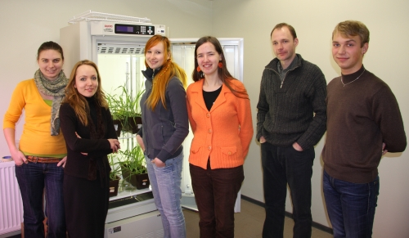
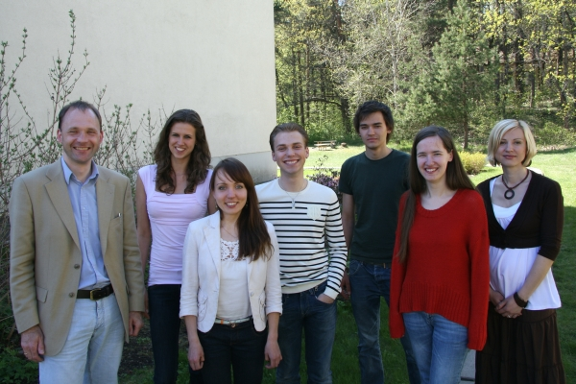
http://plantgenetics.lu.lv/

Slide 4
Mutants are useful!
Mutation (variation) is one-side of the genetics (the other is inheritance)
Domestication (co-evolution of humans and other living organisms) usually involved selection of mutant forms

Slide 5
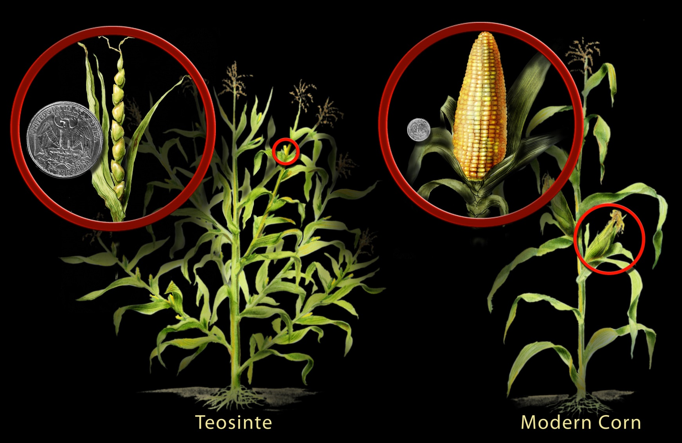
Mutants (Zea mays story)

Slide 6
Mutants (Hordeum vulgare story)
Wild barley domesticated ca. 10,000 years ago
Still grows in wild in Israel and other Near Eastern countries
One of the main domestication traits is mutation in the brittle rachis locus
Further adaptation to different climate conditions were cause by mutations in vernalization requirement and photoperiod genes (adaptation for spring and winter growth habit and photoperiod sensitivity)

Slide 7
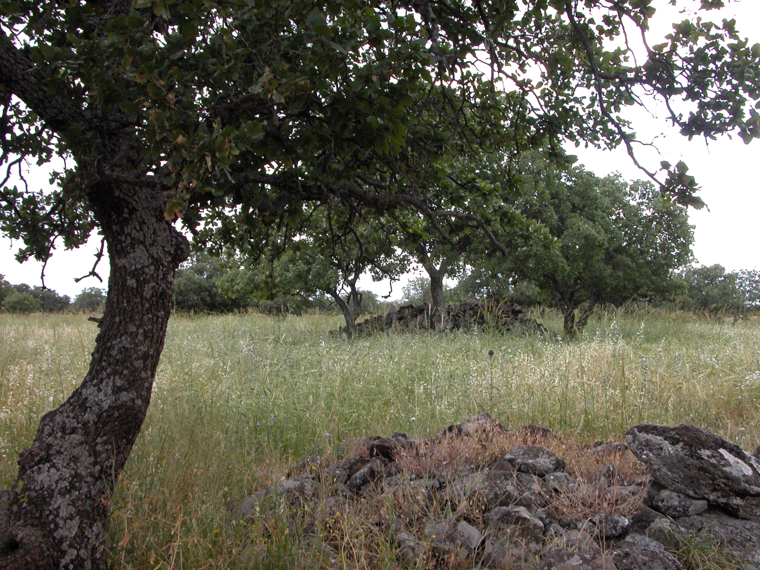
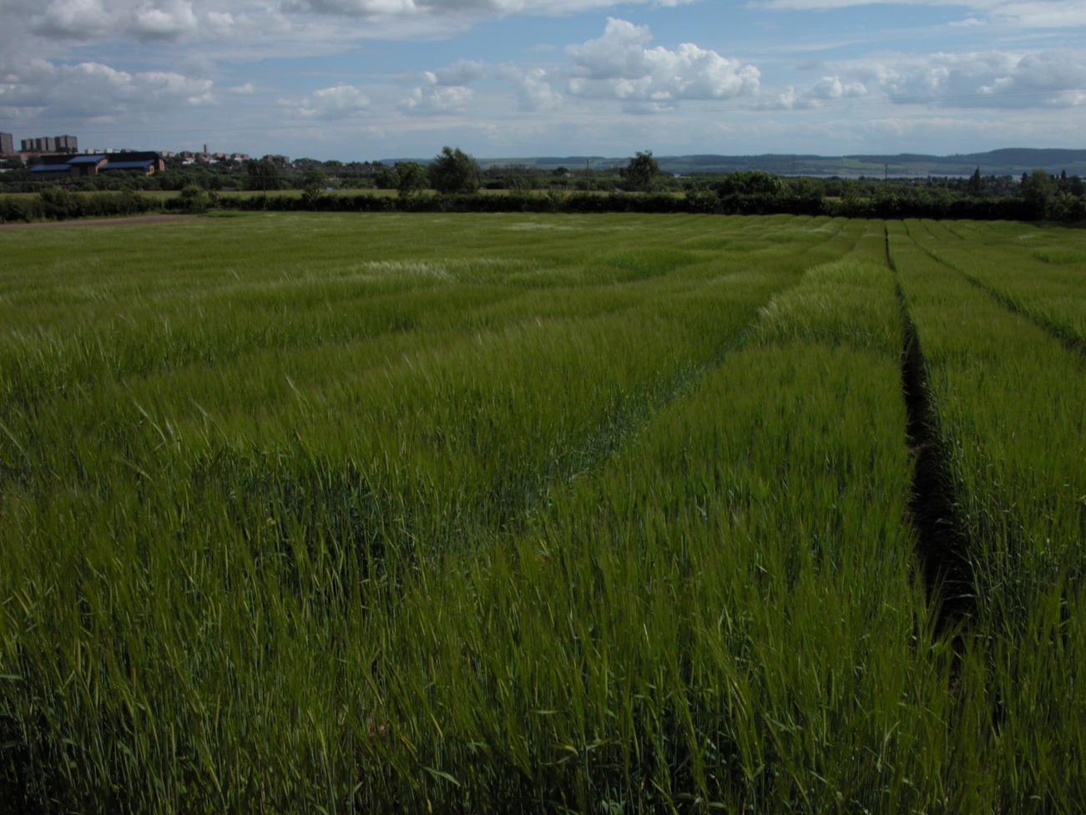

Slide 8
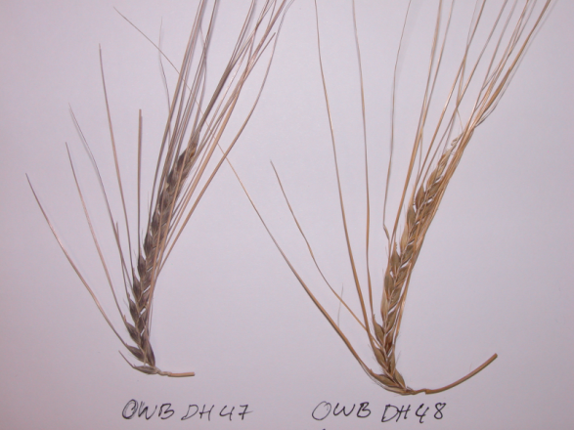
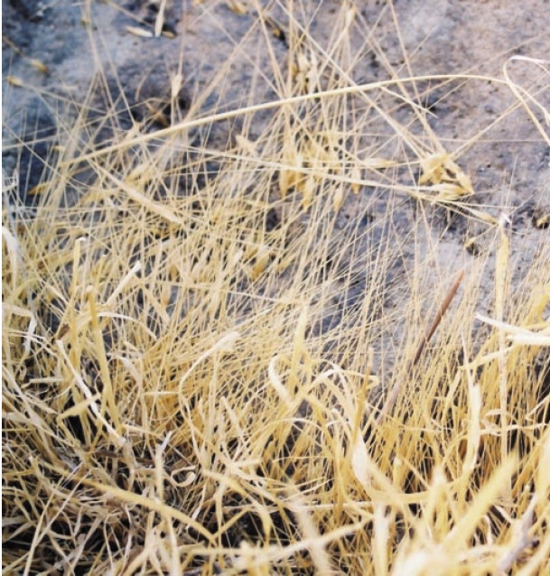
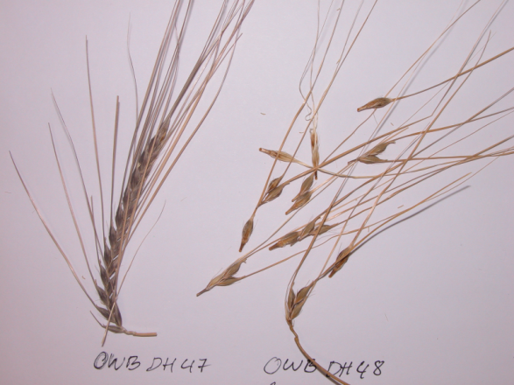
Brittle rachis
btr1btr1 Btr2Btr2
Non-brittle rachis
Btr1Btr1 Btr2Btr2
Brittle rachis
Kislev et al. (2004) PNAS 101: 2692

Slide 9
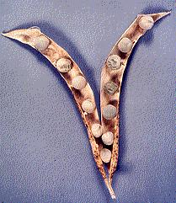
Mutants in research
Georg Mendel and Pisum sativum (recessive mutation in the R (Rugosus) gene results in wrinkled seed, http://www.mendelweb.org)
Thomas H. Morgan, Drosophila melanogaster mutants and the first linkage maps
Natural and induced mutations
Bhattacharyya et al. (1990) The wrinkled-seed character of pea described by Mendel is caused by a transposon-like insertion in a gene encoding starch-branching enzyme. Cell, 60:115-122
Notes:
Šo pazīmi nosaka r (rugosus) lokuss. RR un Rr genotipi nosaka gludas sēklas, bet rr genotips nosaka krokotas sēklas.
rr sēklās trūkst cietes zarošanās enzīms I (starch-branching enzyme –SBEI). r lokusā ir Ac/Ds transposona insercija, kas noved pie nefunkcionālas mRNS sintēzes un cietes, lipīdu un proteīnu biosintēzes traucējumiem.

Slide 10
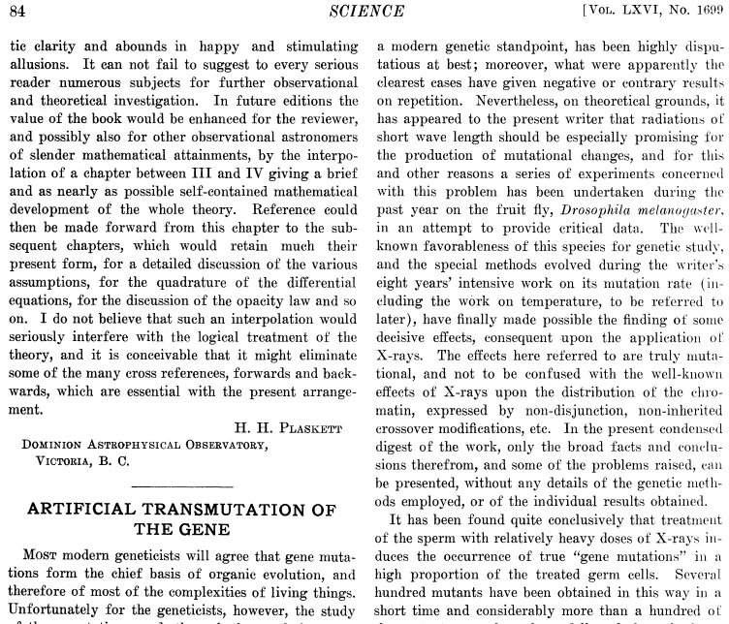
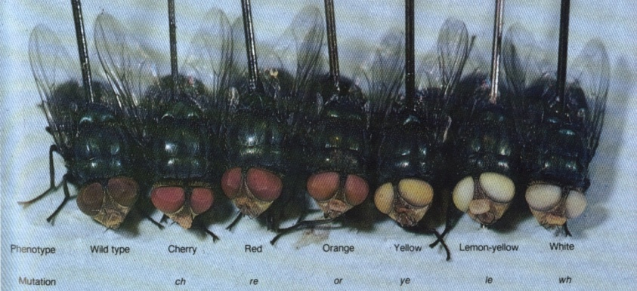
Muller drosophila
Muller, H. J. (1927). Artificial transmutation of the gene. Science 66, 84-87.

Slide 11
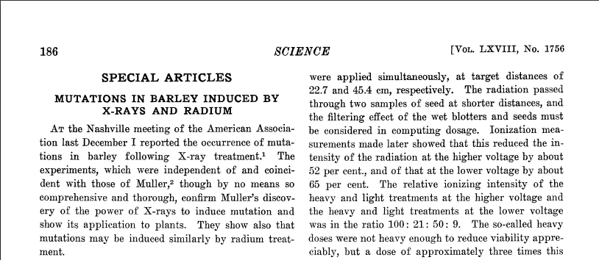
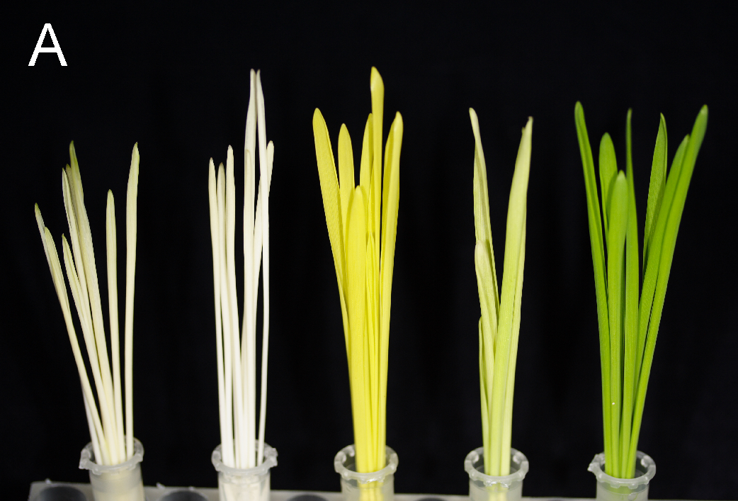
Stadler LJ (1928) Science 68, 186-187
http://www.carlsberglab.dk/professors/Hansson/Research/Pages/default.aspx

Slide 12
History of barley mutant research
Scandinavian barley mutant collections (Sweden and Denmark)
H. Nilsson-Ehle, A. Gustafsson (nordgen.org)
U. Lundqvist, D. von Wettstein, M. Hansson (Carlsberg Labs)
North American barley mutant collections
J. Franckowiak (Bowman lines) - >800 different mutant alleles backcrossed into Bowman
R. Warner, A. Kleinhofs

Slide 13
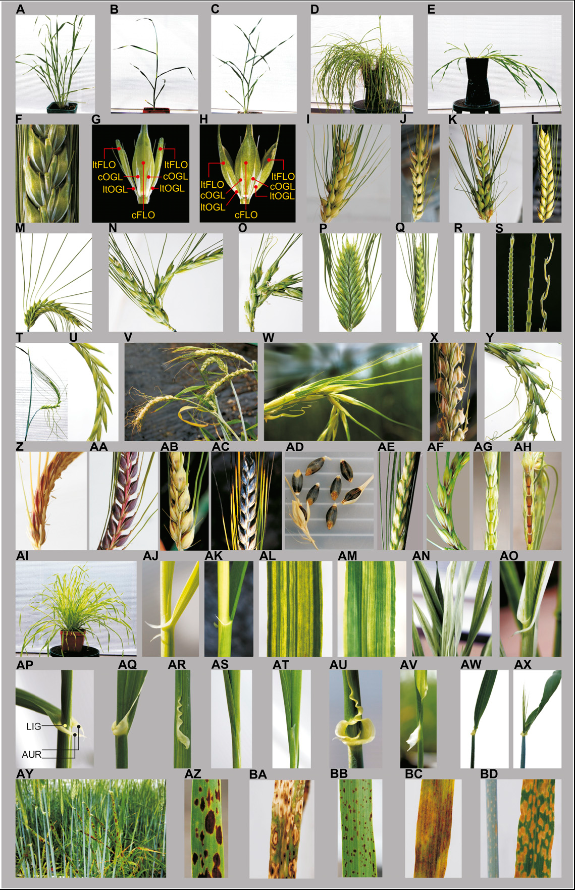
Bowman BC lines
Developed by Jerome Franckowiak by collecting alleles of different morphological barley mutants and backcrossing those to a single barley variety ‘Bowman’
Franckowiak et al. (2000). In Proceedings of the 8th International Barley Genetics Symposium (Logue, S., ed.), Vol. III., pp. 148-150 Australia
Druka et al. (2011). Plant Physiol 155: 617

Slide 14
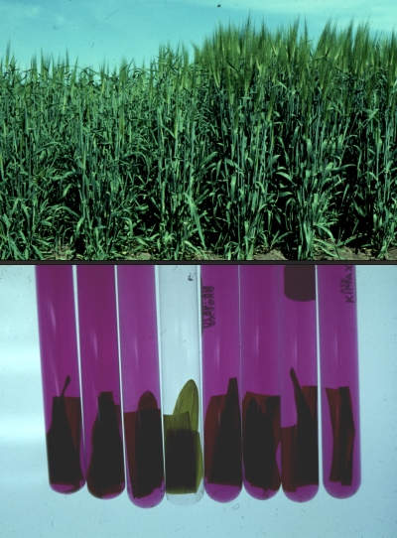
Nitrate reductase mutant Az34
Obtained by R. Warner and A. Kleinhofs at the Washington State University by NaN₃ mutagenesis
Deficient in gene for molybdenium cofactor, therefore all molybdoenzymes are impaired including nitrate reductase and aldehyde oxidase
ABA aldehyde is a precursor of ABA and therefore Az34 has a lower level of ABA
http://barleygenomics.wsu.edu

Slide 15
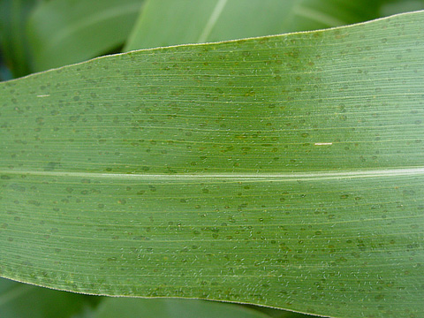
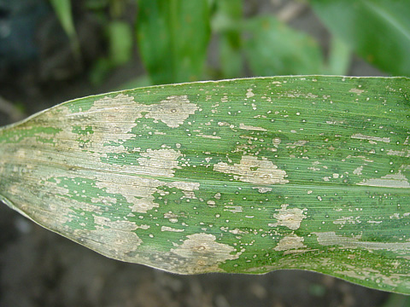
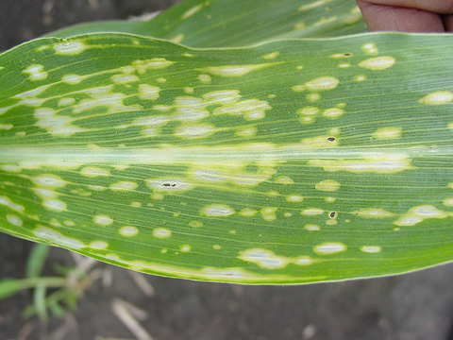
Plant necrotic (lesion mimic) mutants
Maize – Les / les mutants
Some dominant or partially dominant
Phenotypically different and affected by environmental conditions
Sometimes more resistant to biotrophic pathogens
Some Les mutants have impaired chlorophyll biosynthesis
http://www.apsnet.org/publications/apsnetfeatures/Pages/MutantsofMaize.aspx

Slide 16
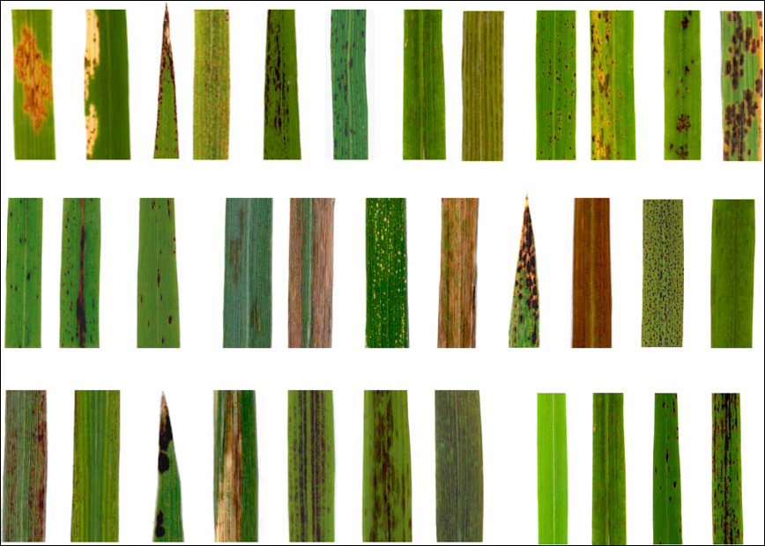
Plant necrotic (lesion mimic) mutants
Rice – spl mutants
Wu et al. (2008) Rice lesion mimic mutants with enhanced resistance to diseases. MGG, 279:605
Notes:
Spl – spotted leaf

Slide 17
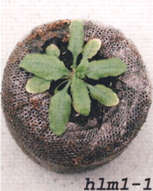
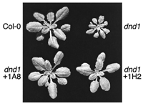
Plant necrotic (lesion mimic) mutants
Arabidopsis hlm1 (dnd2) and dnd1 – «defense-no-death»
Arabidopsis lsd1 – «lesions simulating disease»
Clough et al. (2000) PNAS, 97: 9323
Balague et al. (2003) Plant Cell, 15:365
Dietrich et al. (1997). Cell 88, 685-694.
Notes:
Hlm - HR-like lesion mimic

Slide 18
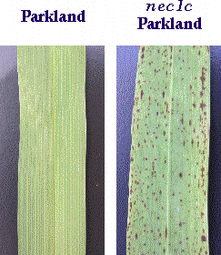
Plant necrotic (lesion mimic) mutants
Barley– nec mutants
Barley Genetics Newsletter 1996, Vol 26
Rostoks et al. (2003) Barley putative hypersensitive induced reaction genes: genetic mapping, sequence analyses and differential expression in disease lesion mimic mutants. TAG, 107:1094

Slide 19
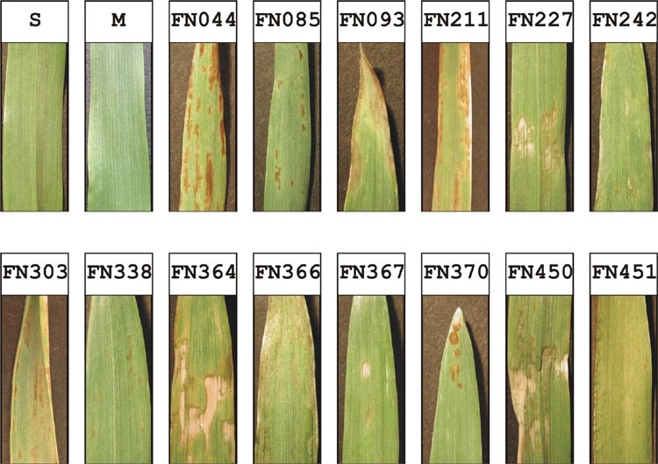
Barley fast neutron (FN) mutants

Slide 20
Hipersensitive response (HR)
HR is a plant regulated (programmed) cell death in the vicinity of the infection site
HR is first described by Stakman (1915) for cereal and cereal rust (Puccinia graminis) interactions (Stakman 1915, J Agr Res, 4: 193)
HR provides protection against different biotrophic pathogens, e.g., viruses, bacteria, fungi and nematodes, by means of restricting spread of the pathogen

Slide 21
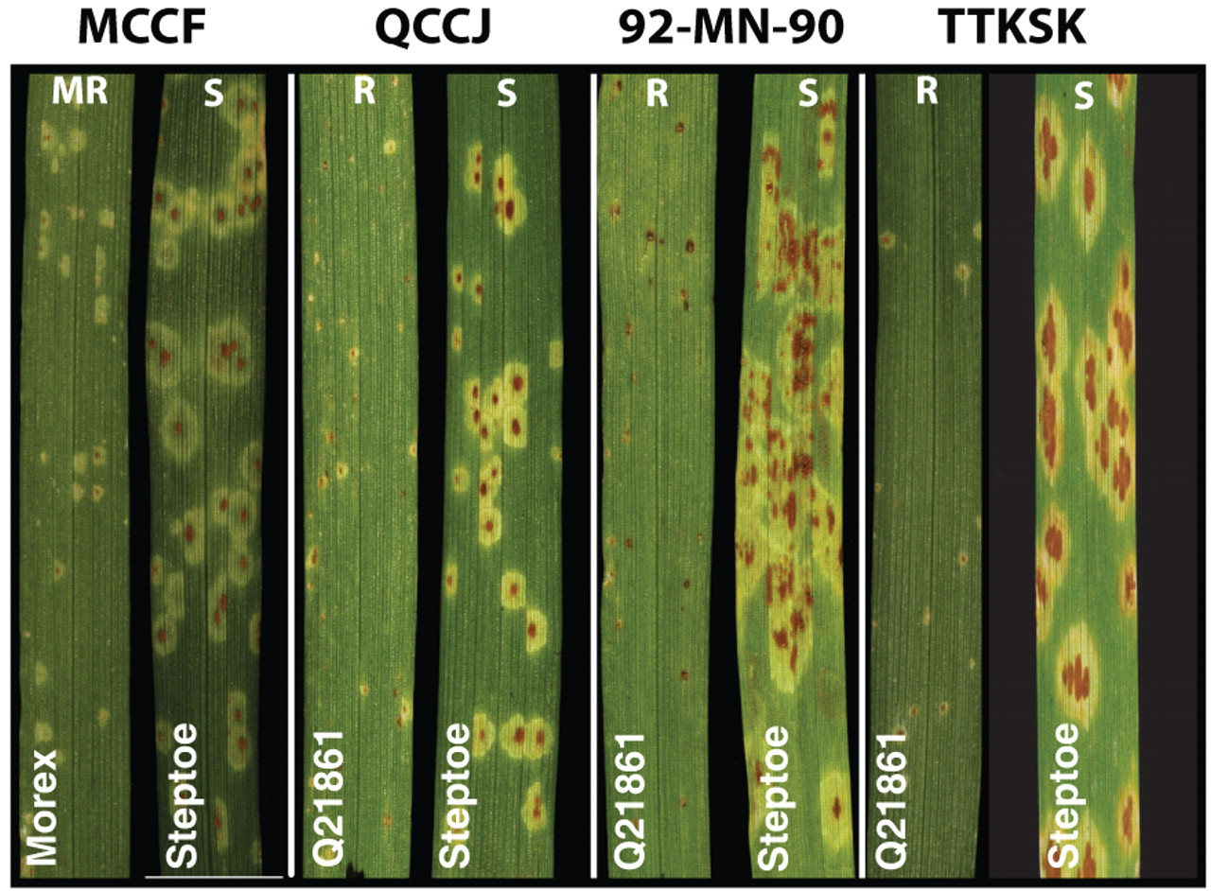
Barley stem rust (Puccinia graminis)
Kleinhofs et al. (2009) Barley stem rust resistance genes: structure and function. Plant Genome, 2:109

Slide 22
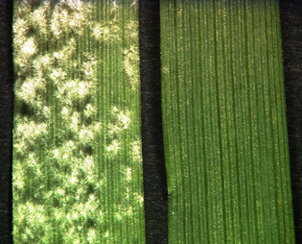
Barley necrotic mutants
Bowman backcross lines incorporating many natural and induced mutations
Examples of characterized barley necrotic mutants:
mlo – recessive mutation in MLO gene provides resistance to powdery mildew in barley, but also gives necrotic phenotype under field conditions (still very useful for barley breeders, particularly with non-null allele mlo-11)
necS1 (stem rust resistance)
nec1
http://www.bio1.rwth-aachen.de/PlantMolCellBiology/research.html

Slide 23
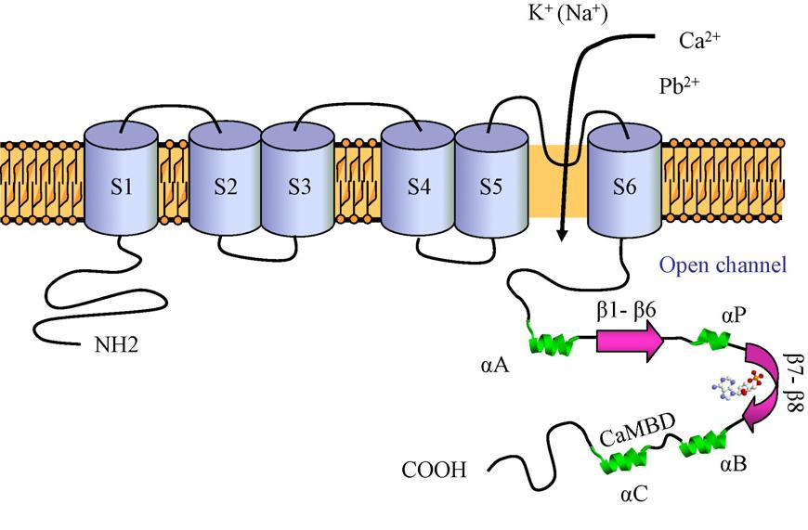
Barley nec1
Barley nec1 and Arabidopsis thaliana dnd2/hlm1 mutants have a mutation in a cyclic nucleotide-gated ion channel 4
Cation channel regulated by cyclic nucleotides and calmodulin – cAMP and cGMP binding allows influx of cations including Ca²⁺, while cytosolic Ca²⁺ increase results in Ca²⁺ - calmodulin-mediated inhibition of CNGC4

Slide 24
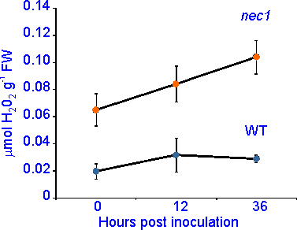
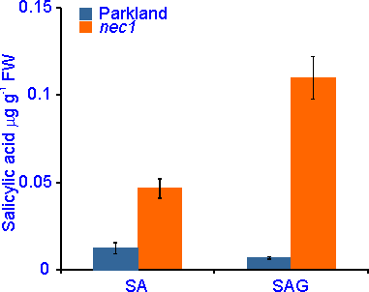
Defense responses in barley nec1
Increased H₂O₂
Increased salicylic acid
Keisa et al. (2011) BMC Plant Biol, 11:66

Slide 25
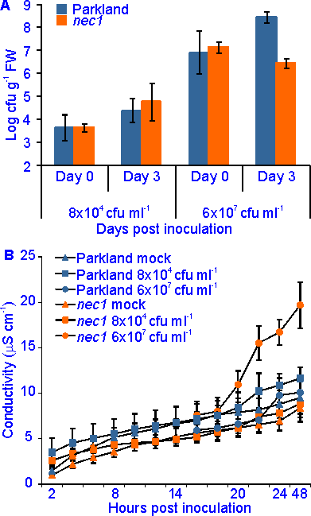
Defense responses in barley nec1
Decreased growth of non-host pathogen Pseudomonas syringae pv. tomato in infected leaves
Slightly increased electrolyte leakage after infection with Pseudomonas syringae pv. tomato
Conductivity values are much lower than reported for typical hypersensitive response
Thus, barley nec1 shows typical “defense, no death” phenotype

Slide 26
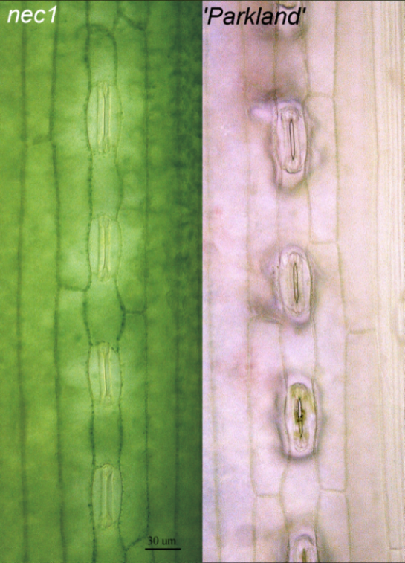
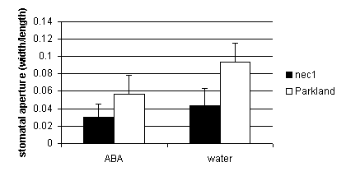
Changes in hormonal signalling in nec1
Closed stomata
Altered stomatal response to externally applied auxin
Increased coleoptile growth in response to exogenous auxin
Keisa et al. (2013). In Advance in Barley Sciences (Zhang, G., Li, C. & Liu, X., eds.), pp. 229-241. Springer

Slide 27
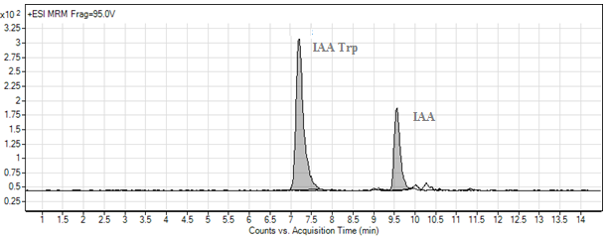
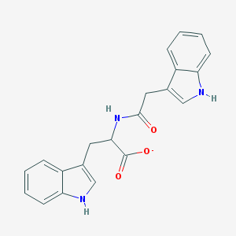
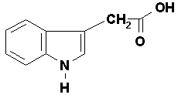
Analysis of auxin and its metabolites
Agilent 1100 HPLC and triple quadrupole mass spectrometer (LC/MS)
Five auxin precursors (Trp, IAN, IAM, Ox IAA, IBA) and IAA
Eight auxin – amino acid conjugates (IAA Ala, IAA Val, IAA Glu, IAA Trp, IAA Phe, IAA Asp, IAA Leu, IAA Gly)
Shoots, roots in barley and Arabidopsis parental and mutant plants

Slide 28
IAA and IAA Trp concentration in barley nec1 and Arabidopsis dnd2
Nakurte et al. (2012). JAMC, 2012: 6

Slide 29
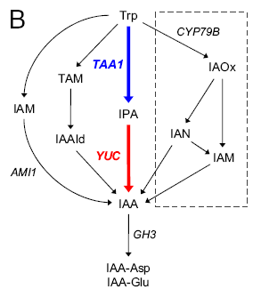
Auxin biosynthesis in Arabidopsis
Four Trp-dependent and an Trp-independent pathway
Most of cellular IAA is in conjugated form (glucosinolates and amino acids)
Mashiguchi et al. (2011). PNAS, 108: 18512

Slide 30
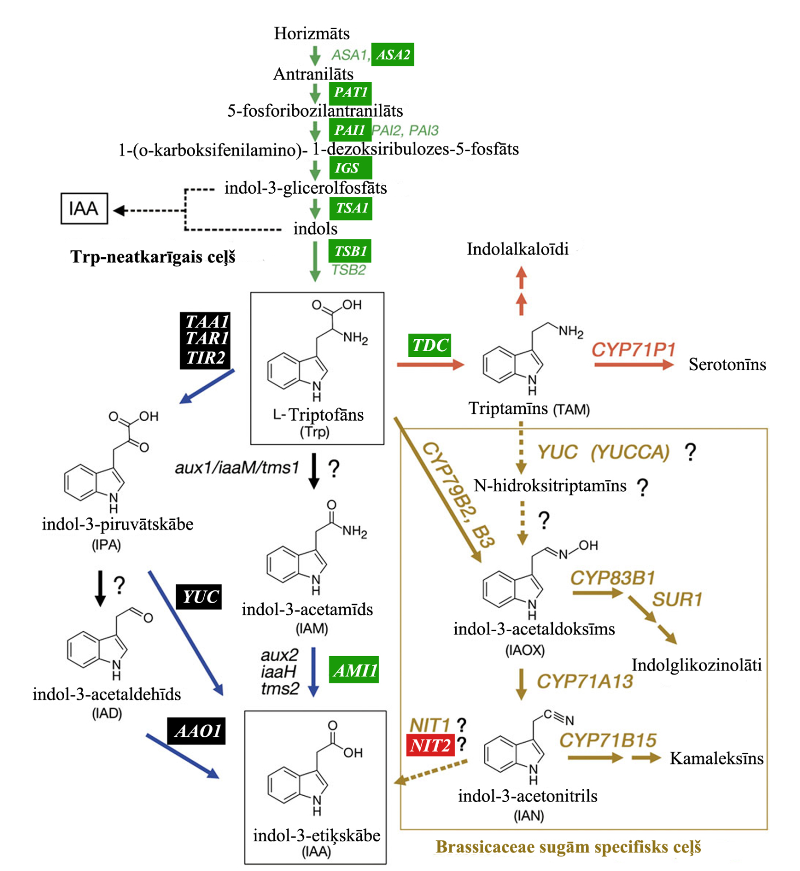
Green – genes overexpressed in nec1
Red – genes repressed in nec1
Black – genes not expressed in nec1
Adapted from Mano and Nemoto
(2012) J Exp Bot 63, 2853

Slide 31
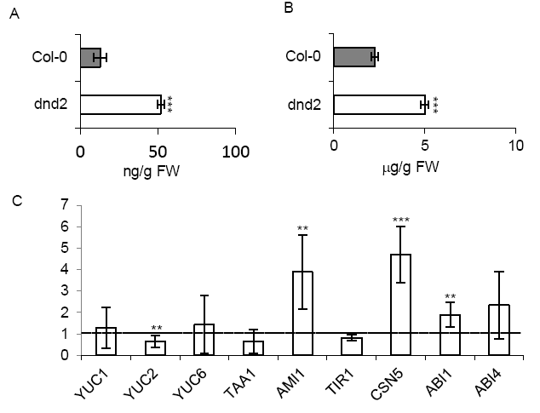
IAA and ABA in dnd2
Content of IAA (A) and ABA (B) in Arabidopsis Col-0 and dnd2 leaves as determined by HPLC. Quantitative real-time PCR analysis of selected genes involved in IAA biosynthesis and IAA and ABA signaling (C).

Slide 32
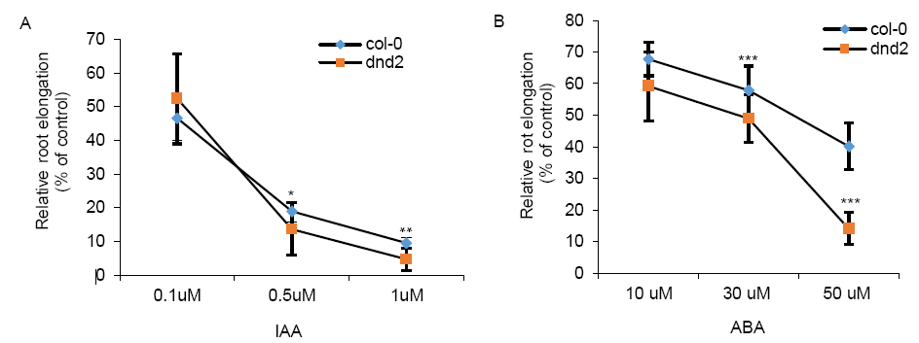
Response of dnd2 to IAA and ABA
Root elongation of Col-0 and dnd2 plants in response to ABA and IAA treatment relative to growth without hormone

Slide 33
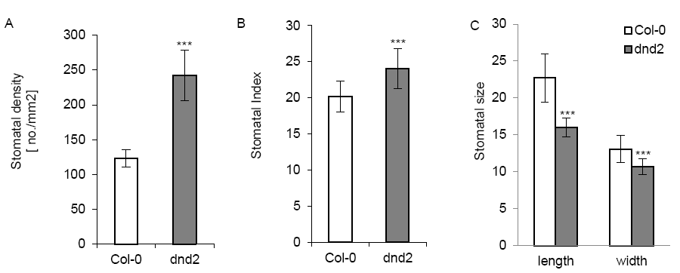
Stomatal phenotypes in dnd2
Comparison of stomatal density (A), stomatal index (B) and stomatal size (C) between Col-0 and dnd2.

Slide 34
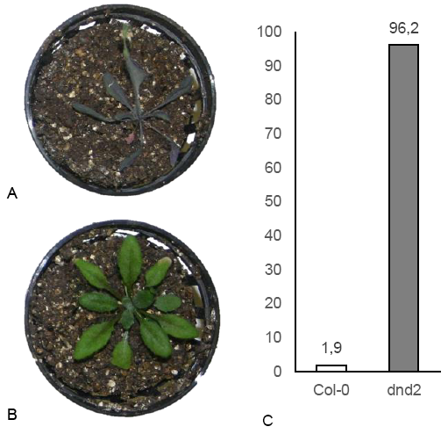
Drought stress analysis of dnd2
Three weeks old Col-0 (A) and dnd2 (B) plants after nine day drought stress. Recovery of Arabidopsis Col-0 and dnd2 plants (C)

Slide 35
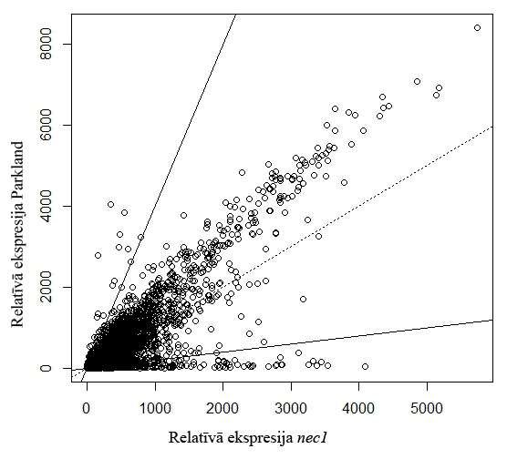
Transcriptome analysis of barley nec1
Simultaneous analysis of ca. 22,000 genes in Parkland and nec1 using Affymetrix Barley1 GeneChip
Identified 774 genes 4-fold overexpressed in nec1 and 67 4-fold down-regulated
in nec1 compared to ‘Parkland’

Slide 36
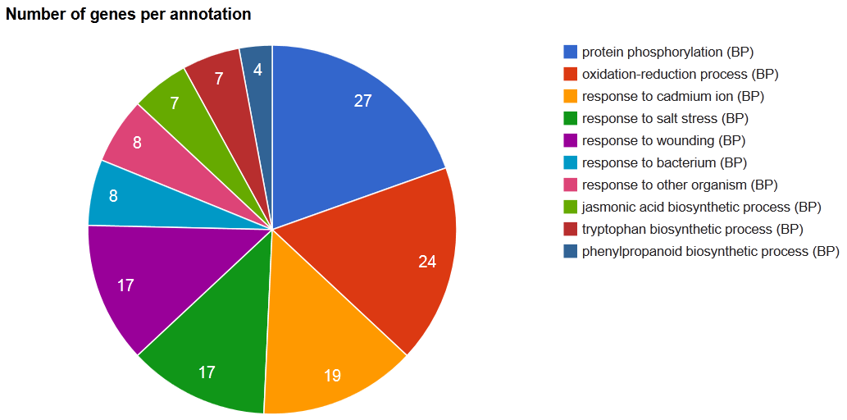
The main categories of overexpressed genes in nec1
4-fold overexpressed genes in nec1. Biological process, GeneCodis

Slide 37
Hormone-related functional categories overrepresented in nec1
Gene Ontology category | P-value | Frequency in nec1 transcriptome
GO:0009850 auxin metabolism | 1.64E-03 | (1.4%)
GO:0009737 response to ABA | 4.73E-13 | (5.0%)
GO:0009738 ABA-dependent signaling pathway | 2.18E-03 | (2.0%)
GO:0009694 jasmonic acid metabolism | 1.84E-12 | (2.2%)
GO:0009753 response to jasmonic acid | 1.29E-07 | (3.6%)
GO:0009867 jasmonic acid-dependent signaling pathway | 1.17E-06 | (2.5%)
GO:0009695 JA biosynthesis | 6.13E-13 | (2.0%)
GO:0009696 Salicylic acid metabolism | 5.38E-10 | (2.4%)
GO:0009697 SA biosynthesis | 8.86E-10 | (2.3%)
GO:0009751 Response to SA | 2.46E-08 | (3.7%)
GO:0009863 SA-dependent signaling pathway | 4.88E-08 | (3.1%)
GO:0009862 Systemic aquired resistance, SA-dependent | 9.26E-05 | (2.2%)

Slide 38
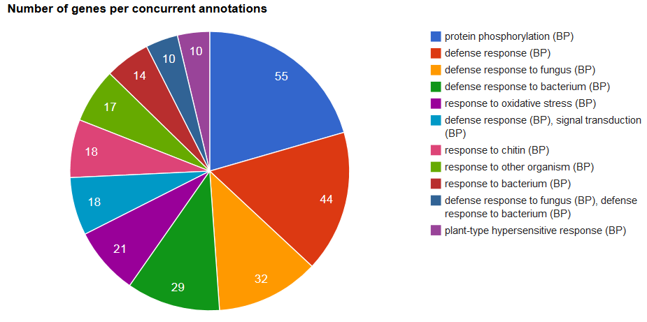
Affymetrix microarray analysis of dnd2
645 probesets (676 genes) differentially expressed in dnd2 (137 downregulated)
2-fold overexpressed genes in dnd2. Biological process, GeneCodis

Slide 39
Affymetrix microarray analysis of dnd2
2-fold overexpressed genes in dnd2. Biological process, GeneCodis

Slide 40
Conclusions
Mutants are essential tools in plant genetics
Studies of even well-characterized mutants can lead to important and unexpected discoveries
There is always potential for plant breeding, either directly by using mutants in breeding programs, or by new knowledge of plant genetics and physiology

Slide 41
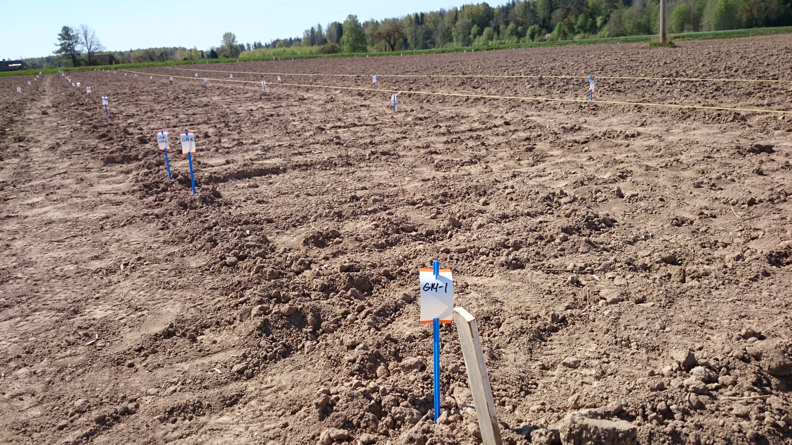
~300 Bowman mutants planted 2014

Slide 42
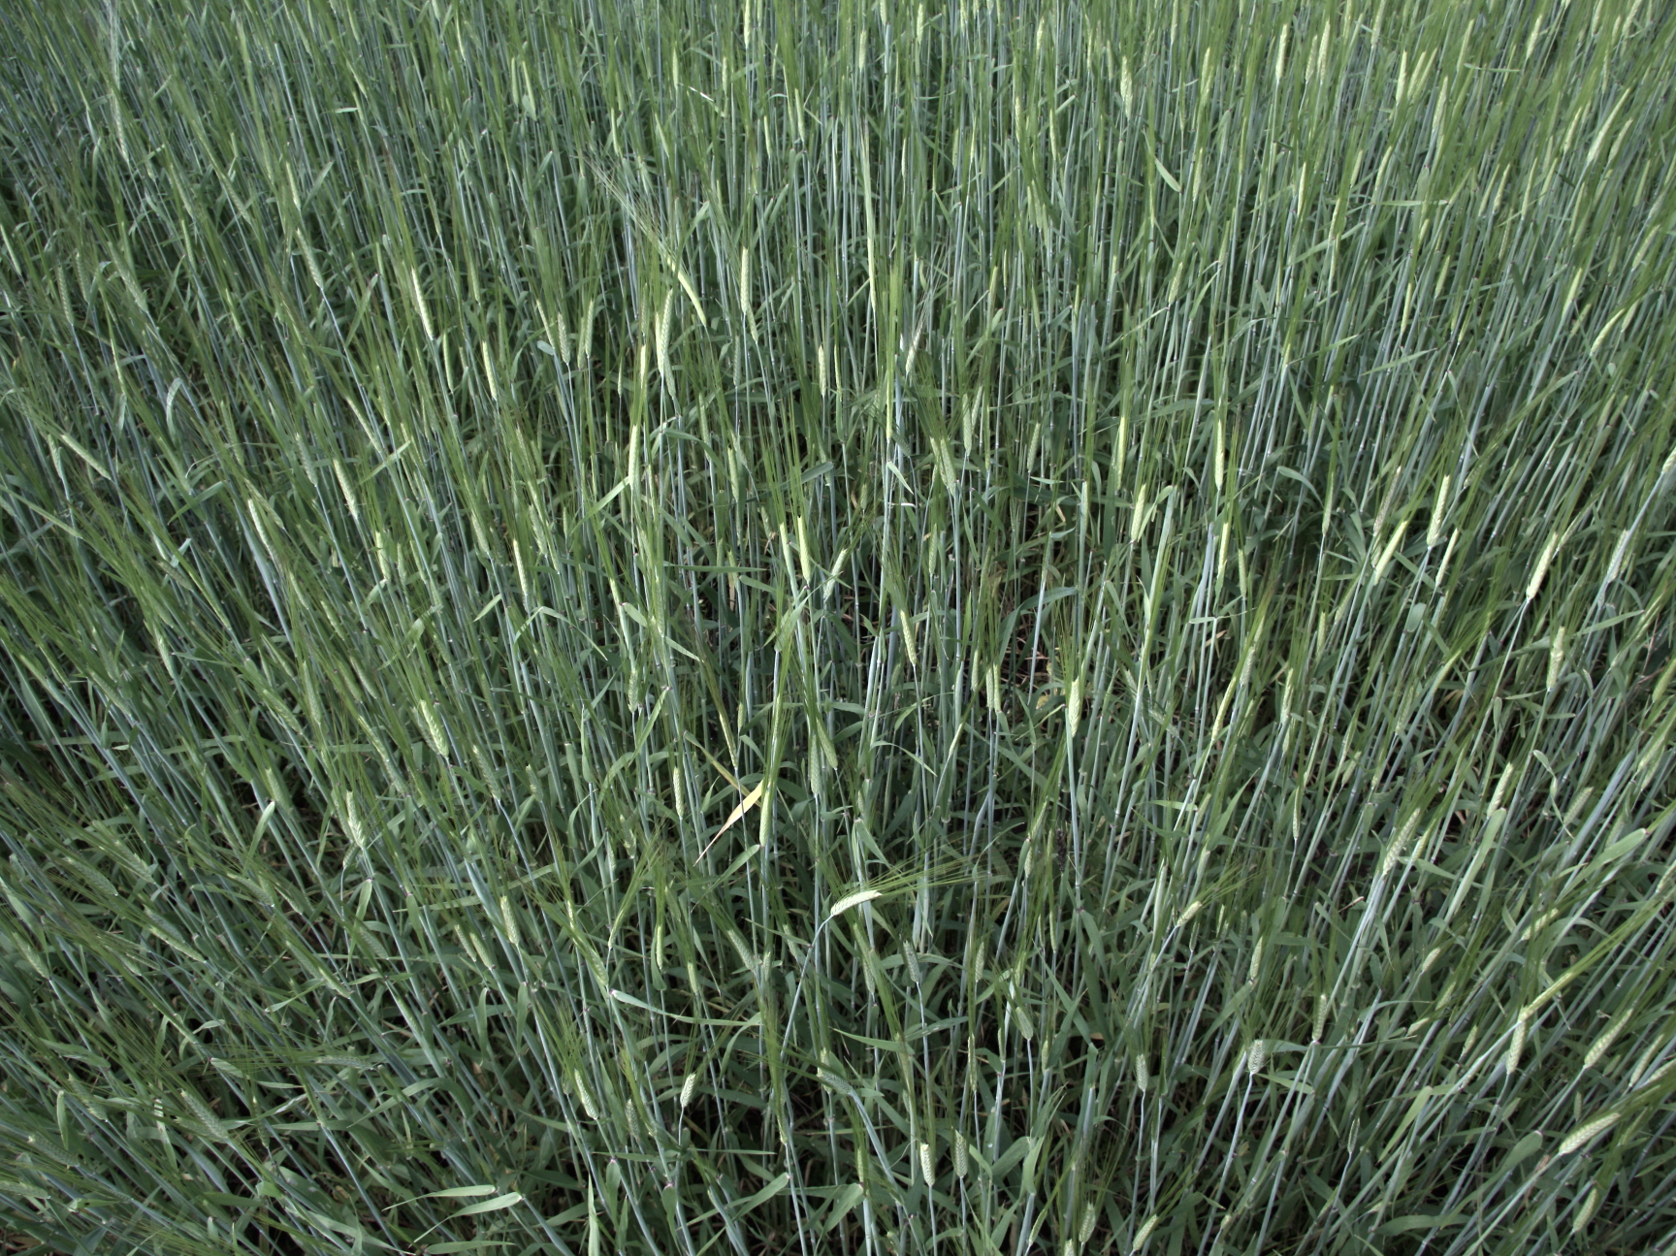
People:
Anete Keiša, Ilva Nakurte, Līga Kāle, Dagnija Tupiņa, Laura Kunga
Collaborations:
Andris Kleinhofs (Washington State University)
Funding:
European Social Fund, Latvian Council of Science
Further information and contacts:
http://plantgenetics.lu.lv/

Slide 43
http://plantgenetics.lu.lv/
PhD from University of Latvia 1999
Postdoc – Washington State University 2000 – 2003
Postdoc – Scottish Crop Research Institute 2003 – 2006
Senior researcher – University of Latvia 2006 – present

