Slide 1
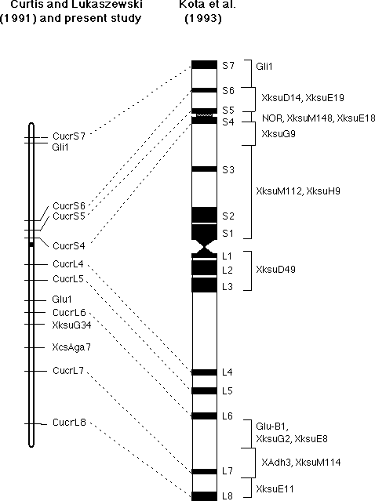
Physical mapping
Physical localisation on a chromosome
http://wheat.pw.usda.gov/cgi-bin/graingenes/report.cgi?class=image;name=1B+physical+vs.+genetic+maps

Slide 2
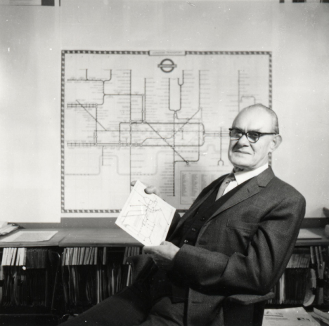
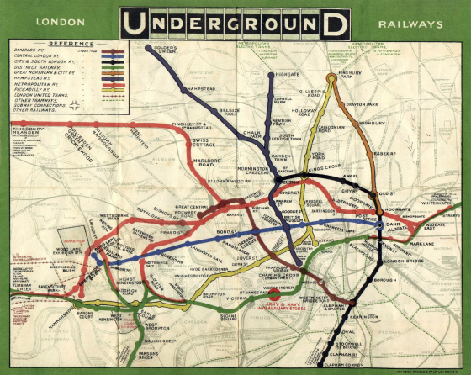
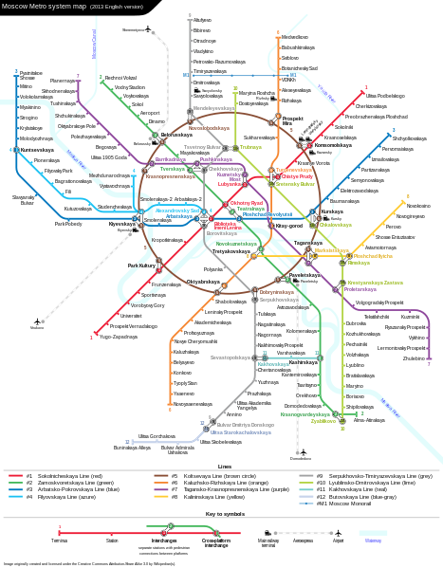
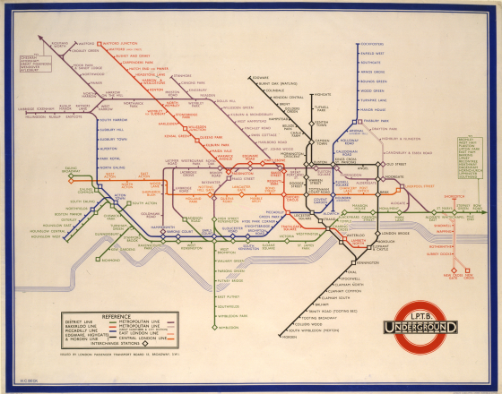
Maps and diagrams
Harry Beck
(1902-1974)
London metro, 1909
London metro, 1933
Moscow metro, 2013

Slide 3
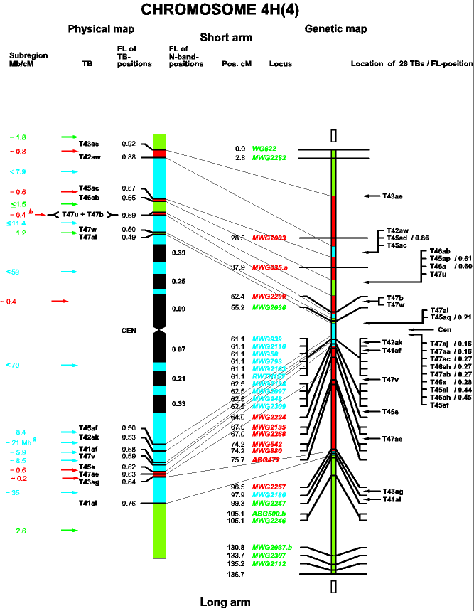
Relationship between genetic and physical maps
Oder of genes is identical.
2. Relative distances could differ.
http://www.crpmb.org/mlo/maps.htm

Slide 4
Physical mapping
Localization of the particular genetic sequence on chromosome
Cytogenetics
in situ hybridization
binding with visible chromosome structures

Slide 5
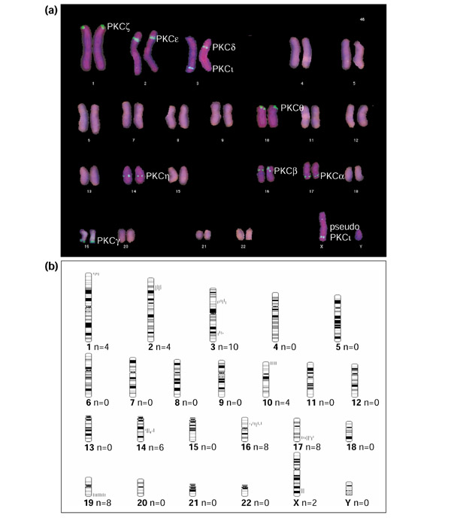
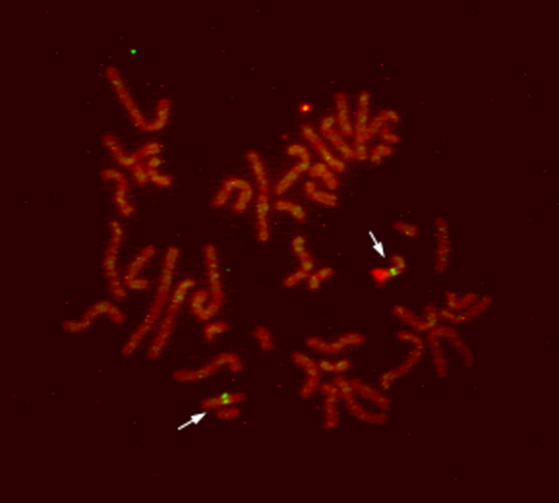
FISH – fluorescent in situ hybridization
Localization of the transglutaminase gene TG2 on the human chromosome 15q15
Localization of the protein kinase genes (PKC) in the human genome
Grenard et al., J. Biol. Chem., 2001, 276 , 33066-33078
Kofler et al., Genome Biology, 2002, 3

Slide 6
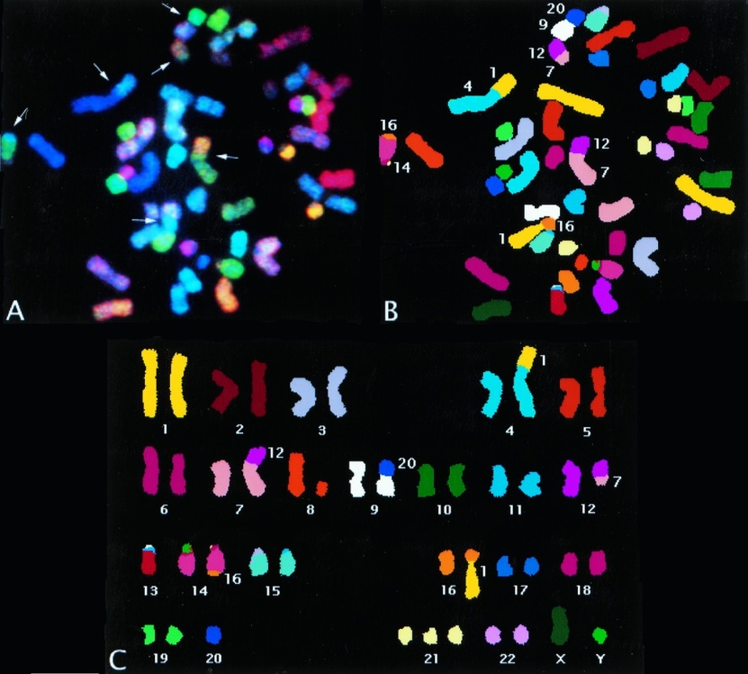
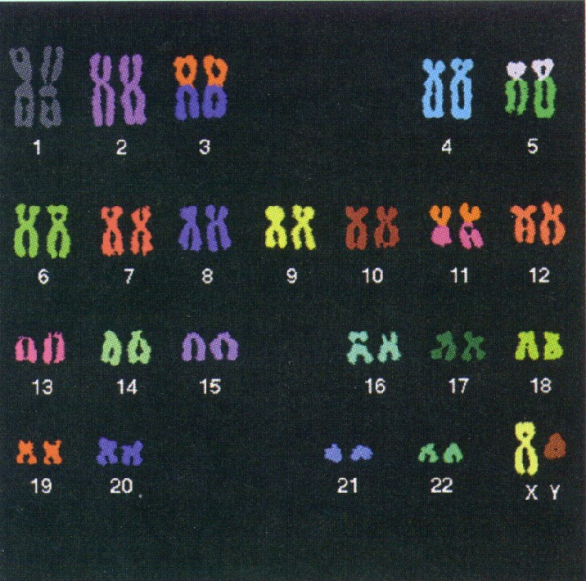
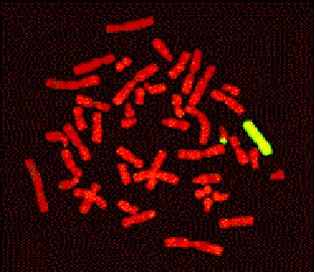
GISH – genomic in situ hybridization (chromosome painting)

Slide 7
Cytological analysis
Karyotype – a set of chromosomes in a cell
karyotype of a species
typical set, diploid karyotype
gametes, haploid karyotype
individual karyotype

Slide 8
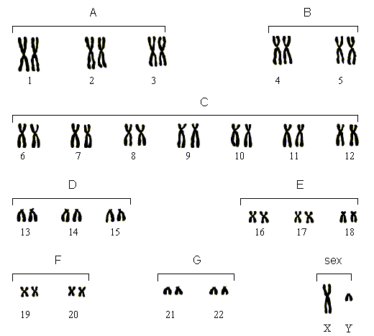
Human karyotype
Karyotype – set of metaphase chromosomes arranged in order of size

Slide 9
Chromosome banding
G-banding is a pattern obtained with Giemsa stain
Q-banding is a fluorescent pattern obtained using quinacrine for staining
C-banding stains centromeres
R-banding is the reverse of C-banding and stains non- centromeric regions
Idiogram – species specific chromosome banding

Slide 10
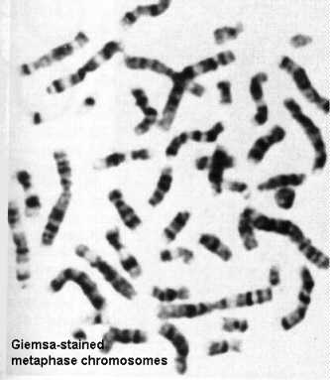
G-banding of human chromosomes

Slide 11
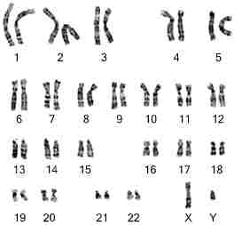
Human karyotype

Slide 12
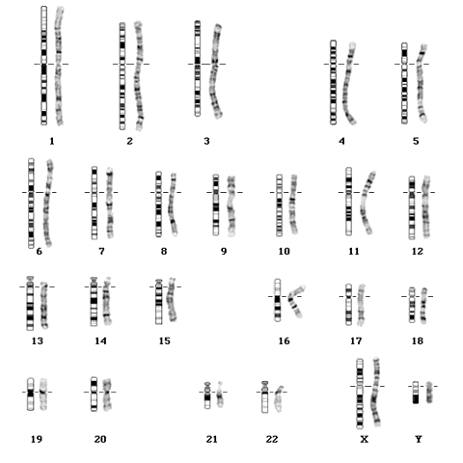
Idiogram of human chromosomes

Slide 13
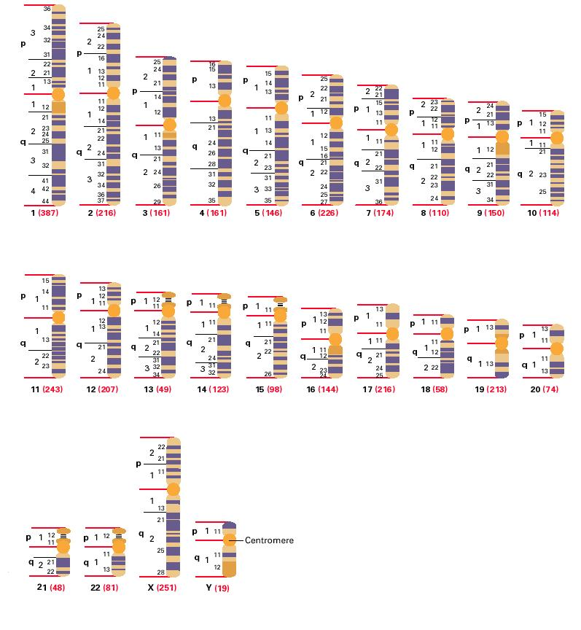
Idiogram of human chromosomes (G-banding)

Slide 14
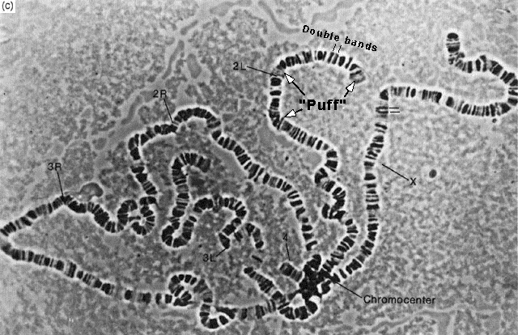
Polytene chromosomes
found in salivary glands of Diptera
consist of 100 or more copies of DNA, arranged side by side
origin by endoreduplication
Feulgen staining reveals alternating highly and moderately dense regions: bands and interbands
Polytene chromosomes of Drosophila

Slide 15
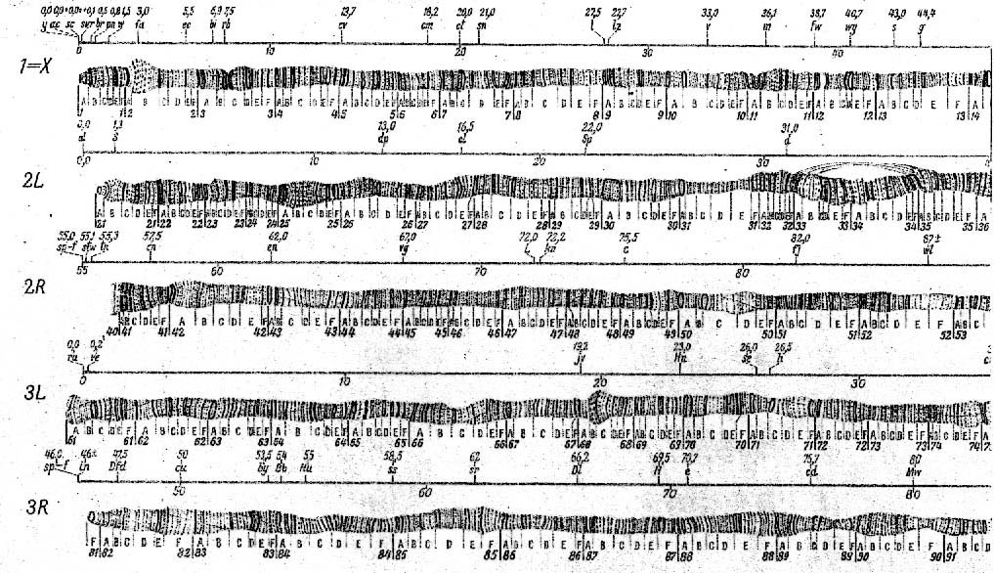
Polytene chromosomes of Drosophila

Slide 16
Polytene chromosomes
chromatin of interbands is less condensed and corresponds to euchromatin of normal interphase nuclei
bands correspond to the condensed heterochromatin
expanded length of polytene chromosomes allows a much higher resolution mapping of morphological chromosome features than is possible with G- or Q-banding.

Slide 17
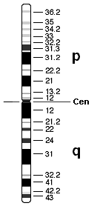
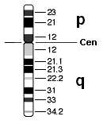
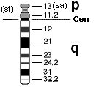
Type of chromosomes
metacentric
submetacentric
acrocentric
telocentric
2 chr., metacentric
9 chr., submetacentric
14 chr., acrocentric

Slide 18
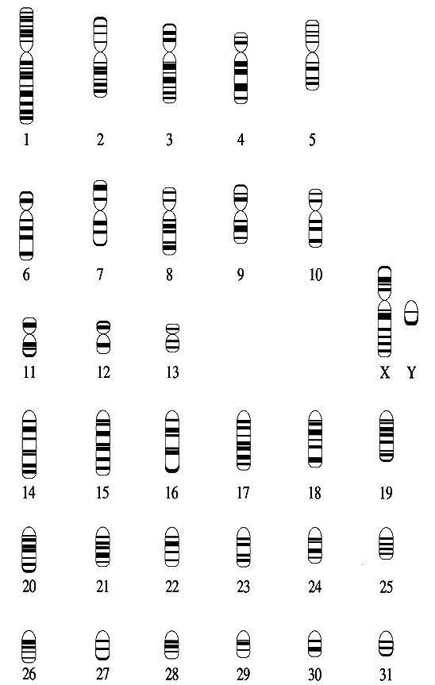
Horse idiogram

Slide 19
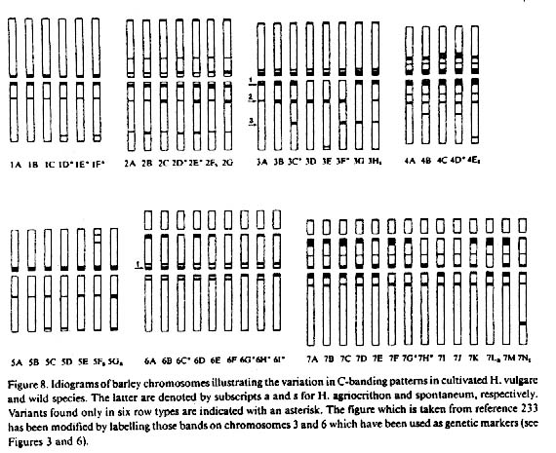
Barley chromosomes: idiogram

