Slide 1
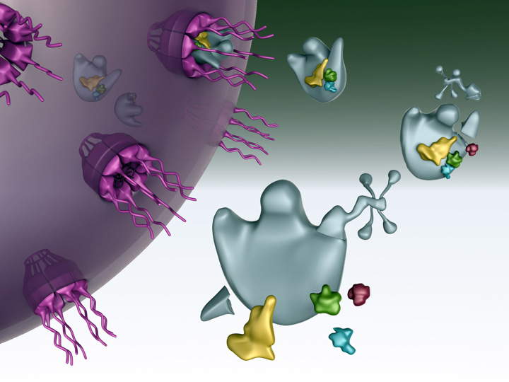
Translation

Slide 2
Translation
Translation is the process by which a protein is synthesized from the information contained in a molecule of mRNA.
During translation, an mRNA sequence is read using the genetic code.
The genetic code defines how an mRNA sequence is to be translated into the 20-letter code of amino acids, which are the building blocks of proteins.

Slide 3
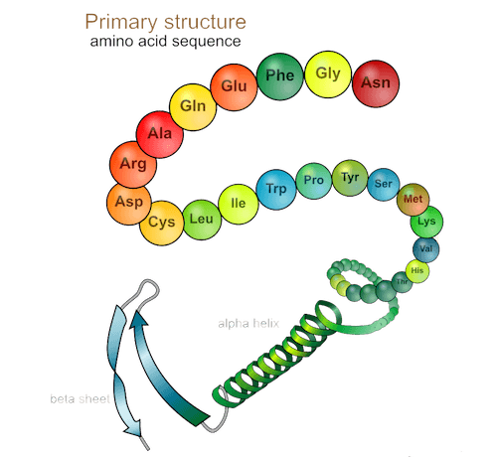
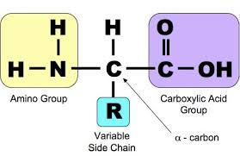
Proteins
Proteins are polymers constructed out
of 20 different amino acids (AA).
Amino acid structure

Slide 4
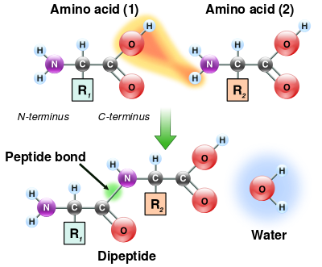
Proteins
Individual amino acids are linked together
in linear chains by covalent amide bonds,
called peptide bonds.
Peptide bond formation between the
amino group of one AA and the
carboxyl group of another AA results in
the release of a water molecule
(dehydration reaction).

Slide 5
Proteins
A short chain of AA linked by peptide bonds and having a defined
sequence is called a peptide.
Peptides generally contain fewer than 20-30 AA.
Longer AA chains are referred to as polypeptides.
Polypeptides are often 200- 500 AA residues long.
The longest protein described today is the muscle protein titin
with more than 35.000 amino acid residues.
Titin provides elasticity and stabilizes myosin.

Slide 6
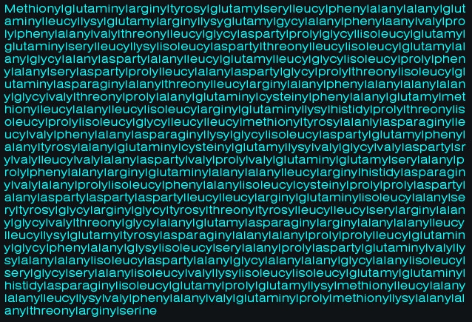
The longest word in English is the full chemical name of the protein titin
189,819 letters

Slide 7
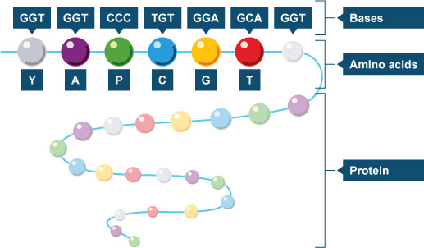
Genetic code
The genetic code is a three- letter code.
There are 4 possible bases to choose from
at each of the 3 base positions in a codon.
There are 4³ = 64 possible codons.
But there are only 20 major types of amino acid.

Slide 8
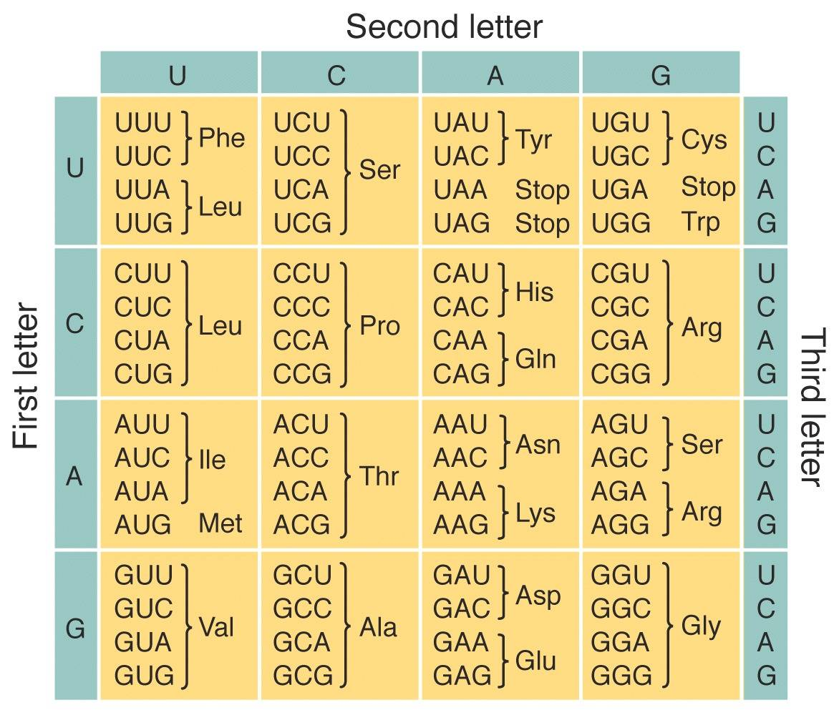
Genetic code
The genetic code is a
degenerate code:
each amino acid is specified
by multiple codons
(on average about
3 different codons).
Only two amino acids have
a single codon:
Met (methionine)
Trp (tryptophan)
Leucine (Leu), Serine (Ser) and arginine (Arg) are each specified by 6 different codons.

Slide 9
Genetic code
Synthesis of all polypeptide chains
begins with the amino acid
methionine (Met).
The codon specifying the amino-
terminal Met
AUG is a start codon.
The three codons
UAA, UGA and UAG are stop
(termination) codons.
Stop codons do not specify AA.

Slide 10
Reading frame
The sequence of codons that runs from a specific start codon to a stop codon
is called a reading frame.
Gene sequence:
AGGTCATGTCTAGGTATGCCC
Frame 1:
AGG TCA TGT CTA GGT ATG CCC
Arg Ser Cys Leu Gly Met Pro
Frame 2:
A GGT CAT GTC TAG GTA TGC CC
Gly His Val ---- Val Cys Pro
Frame 3:
AG GTC ATG TCT AGG TAT GCC C
Val Met Ser Arg Tyr Ala
Because the genetic code is a
non-overlapping triplet code without divisions
between codons, a particular mRNA
could be translated in
3 different reading frames,
yielding 3 different peptides.

Slide 11
The genetic code is described as a universal code,
meaning that the same code is used throughout all life forms.
This is not strictly true because of alternative interpretation of codons.
The genetic code has been found to differ for a few codons in mitochondria,
chloroplasts or a single-celled plant (Acetabularia).
Differences between the universal and mitochondrial genetic codes.
Codon | Universal code | Human mitochondrial code
UGA | Stop | Trp
AGA | Arg | Stop
AUA | Ile | Met
AGG | Arg | Stop

Slide 12
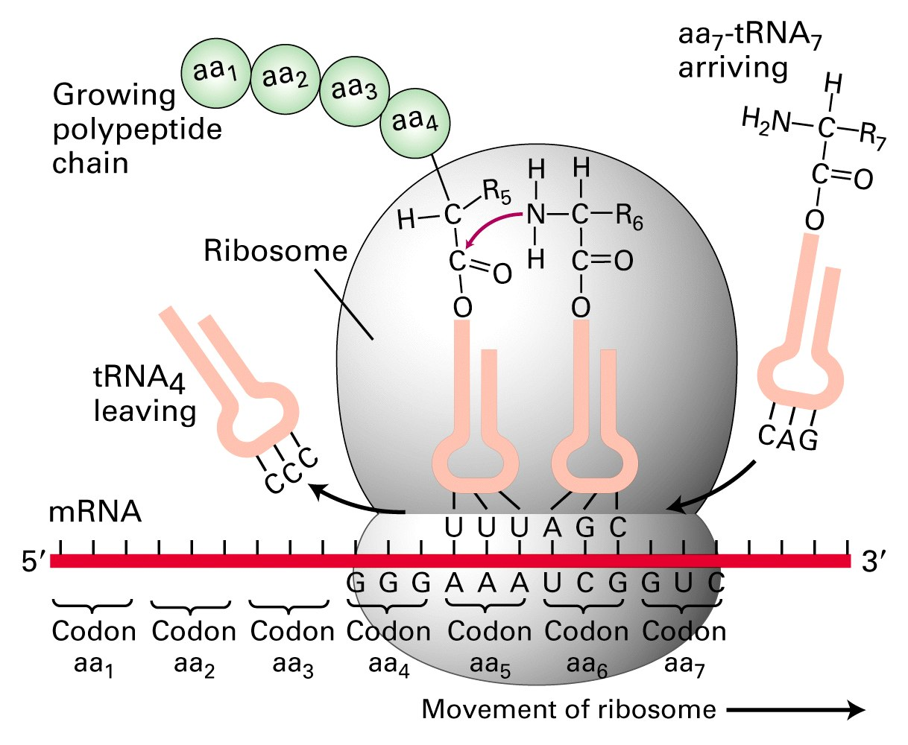
The major participants in protein synthesis
Messenger RNA (mRNA)- carries the information in DNA to the
ribosome for translation.
Aminoacylated tRNA- transports
a specific amino acid to the ribosome.
Ribosomes- a factories of protein synthesis.

Slide 13
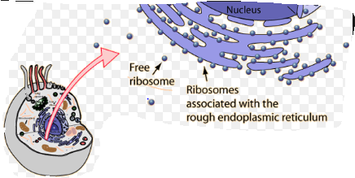
Ribosomes
Ribosomes are protein factories of the cell.
Each cell contains thousands of ribosomes.
Ribosomes carry out protein synthesis in two locations:
In the cytosol (free ribosomes).
On the outside of the endoplasmic reticulum
(ER) or the nuclear envelope
(bound ribosomes).

Slide 14
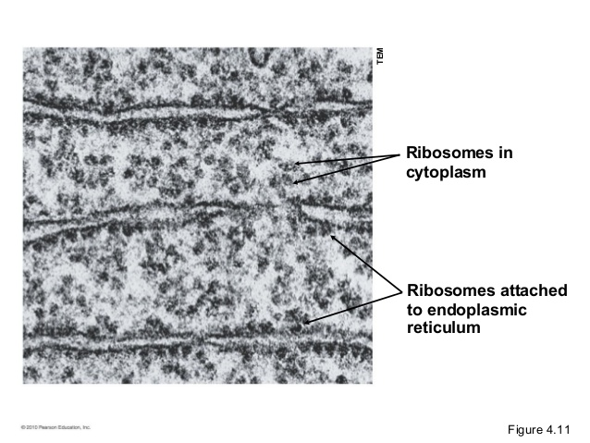
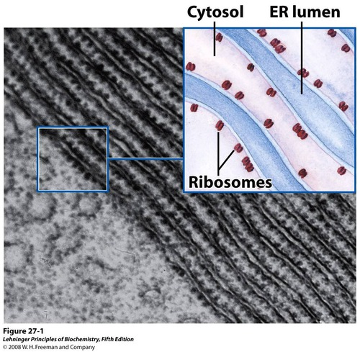
Look like small circular organelles.
Ribosomes
Ribosomes in the cytoplasm
make proteins for
use inside the cell
(enzymes, hormones).
Ribosomes attached to
endoplasmatic reticulum (ER)
make proteins
for export out of the cell or
for use in lysosomes.
Transmission electron microscopy (TEM) picture

Slide 15
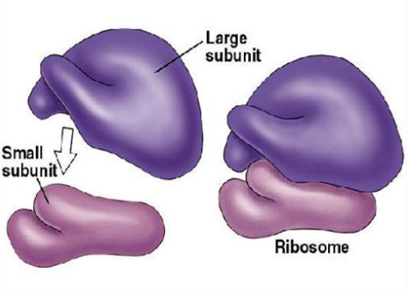
Ribosomes
Ribosoms are large RNA- protein complexes composed of two subunits.
60S
60S
40S
40S
S* - Svedberg units, a measure of sedimentation rate of macromolecules centrifuged under standard conditions.

Slide 16
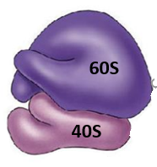
Ribosome subunits
Larger 60S subunit contains:
Smaller 40S subunit contains:
28S rRNA
(large RNA)
18S rRNA (small RNA)
5.8S rRNA
5S rRNA
over 30
ribosomal proteins
more than 50
ribosomal proteins
RNA components are predominantly responsible for the catalytic
function of the ribosome.
rRNA molecules constitutes about 60% of the mass of a ribosome.
The protein components enhance the function of the rRNA molecules.

Slide 17
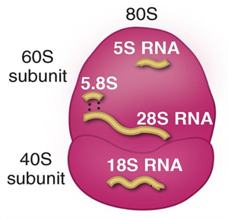
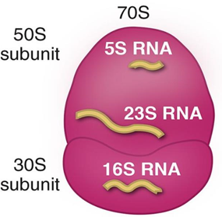
Ribosomes
Eukaryotic
Prokaryotic

Slide 18
Ribosome
The ribosome has an mRNA binding site and three sites for tRNA binding.
The tRNA binding sites are A, P and E.

Slide 19
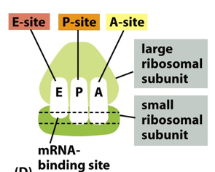
Ribosome
A-site
The aminoacyl or acceptor site
Receives the tRNA with the next amino acid
to be added to the chain.
P- site
The peptidyl or donor site
Holds on aa-tRNA and the growing chain of amino acids.
E-site
The exit site
Releases the used tRNA back into the cytoplasm.

Slide 20
During translation, a ribosome moves along mRNA chain, interacting with
various protein factors and tRNA and undergoing large conformational
changes.
The ribosome directs elongation of a polypeptide at a rate
of 3 to 5 amino acids added per second.
Small proteins of 100- 200 amino acids are made in minute or less.
It takes 2-3 hours to make the largest known protein, titin, which contains more than 35.000 amino acid residues.

Slide 21
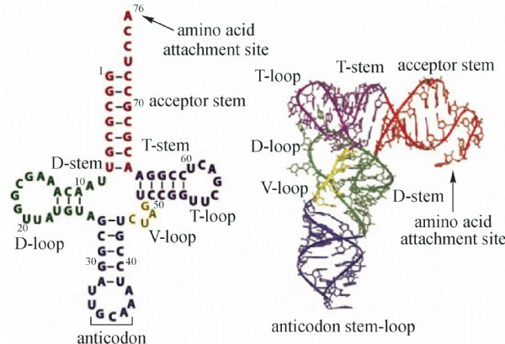
Transfer RNA (tRNA)
Transfer RNA (t RNA) show particularly high degrees of secondary structure (cloverleaf).
Transfer RNA are the smalest of three major
species of RNA molecules, containing
74-95 nucleotide residues.
They transfer the amino acids from cytoplasm
to the protein synthesizing machinery,
hence the name tRNA.
Involved in process of translation.
Each specific tRNA contains a three-nucleotide sequence, an anticodon, that can
base-pair with its complementary codon in the mRNA.

Slide 22
Wooble pairing
Although there are 64 codons, the corresponding number of tRNA molecules
with different anticodons is less, just over 30 types of cytoplasmic tRNA and
only 22 types of mitochondrial tRNA.
Many tRNA can recognize more than one codon.
The interpretation of all 64 codons is possible because the normal base pairing rules are relaxed in the case of codon- anticodon recognition.
The wobble (relaxed base-pairing) hypothesis states that pairing of codon and anticodon follows the normal A-U and G-C rules for the first two base positions in a codon.

Slide 23
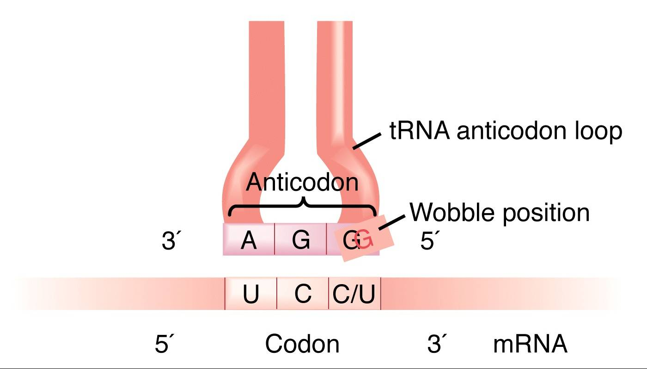
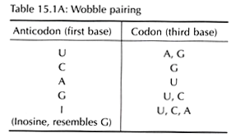
Wooble pairing
The exceptional woobles occur at the third position in a codon and
the first base of the anticodon.

Slide 24
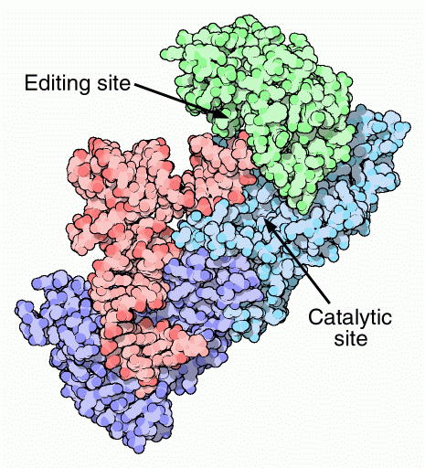
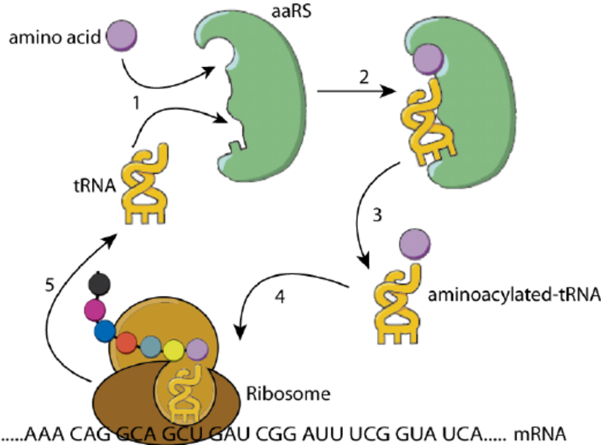
Aminoacyl-tRNA synthetases (ARS)
How does the amino acids become attached to its corresponding tRNA?
Amino acid + tRNA = aminoacyl- tRNA (aatRNA).
This process is catalyzed by the enzyme aminoacyl-tRNA synthetases.
tRNA molecule is reactivated many times (recycled).

Slide 25
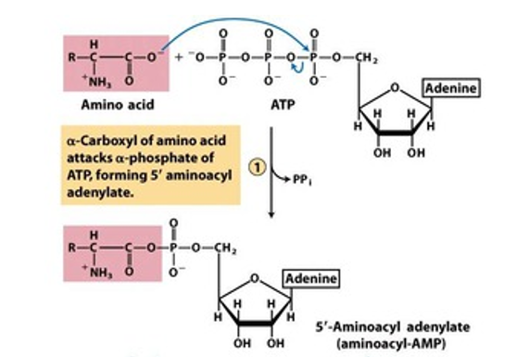
Aminoacylation of tRNA by aminoacyl-tRNA synthetases.
ARS catalyze covalent joining of amino acids to tRNA in two- step reaction.
Step 1 is formation
of an aminoacyl adenylate
(remains bound to
the enzyme active site).
Enzyme + amino acid + ATP
Enzyme (aminoacyl-AMP) + PPi

Slide 26
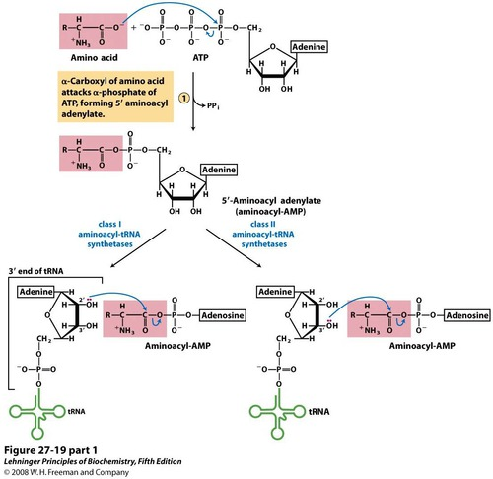
Aminoacylation of tRNA by aminoacyl-tRNA synthetases.
In Step 2 the aminoacyl group is transferred to tRNA.
Enzyme (aminoacyl-AMP) + tRNA
aminoacyl-tRNA+ Enzyme + AMP
For class I ARS enzymes, the aminoacyl group is transferred initially to the 2′-OH group of the 3′-terminal adenosine residue, then to the 3′-hydroxyl group by a transesterification reaction.
For class II ARS enzymes, the aminoacyl group is transferred directly to the 3′-OH of the terminal adenosine residue.

Slide 27
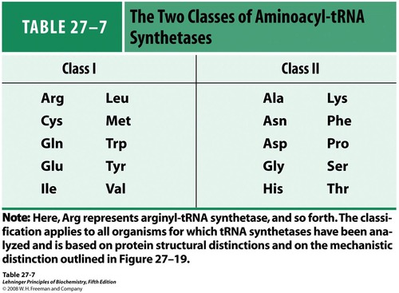
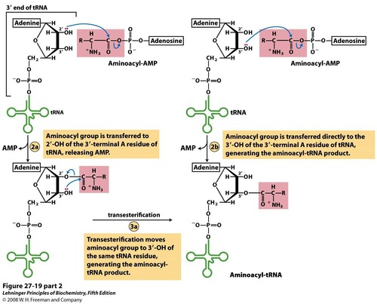
For class I ARS enzymes, the aminoacyl group is transferred initially to the 2′-OH group of the 3′-terminal adenosine residue, then to the 3′-hydroxyl group by a transesterification reaction.
For class II ARS enzymes, the aminoacyl group is transferred directly to the 3′-OH of the terminal adenosine residue.

Slide 28
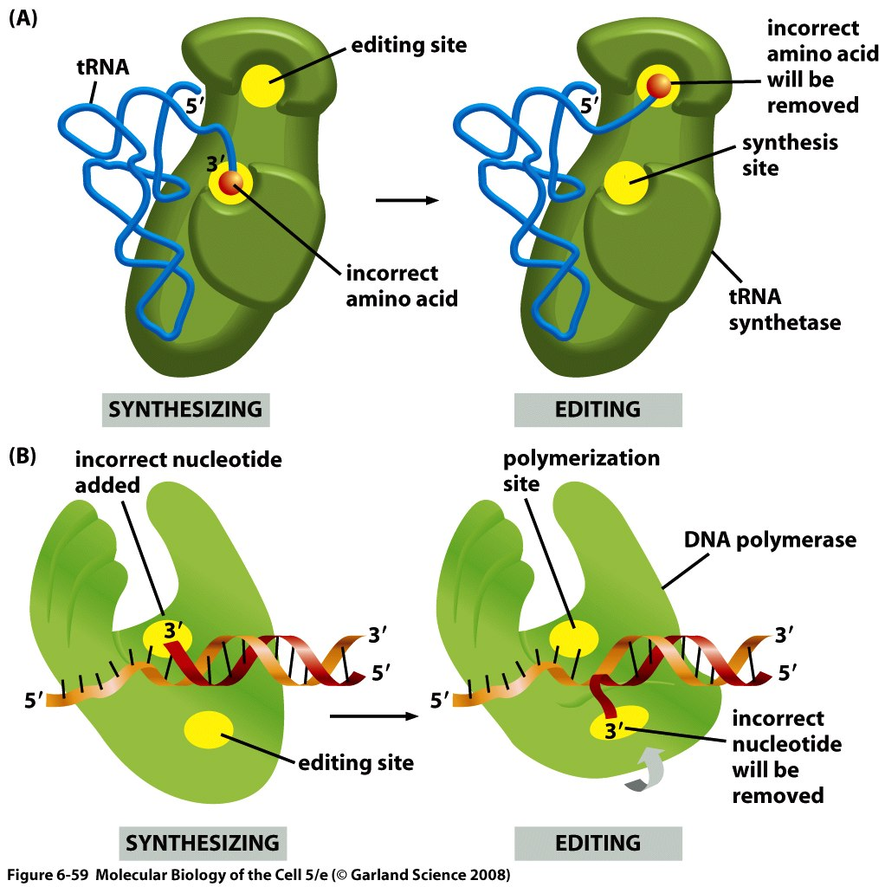
tRNA synthetases remove their own coupling errors
through editing of incorrectly attached amino acids.
The incorrect amino acid will be
removed by the editing site.

Slide 29
Translation process
Eukaryotic translation is similar to that of prokaryotes but a bit more complex.
Differences in the translation process is due to differences in transcript structure and location of translation.

Slide 30
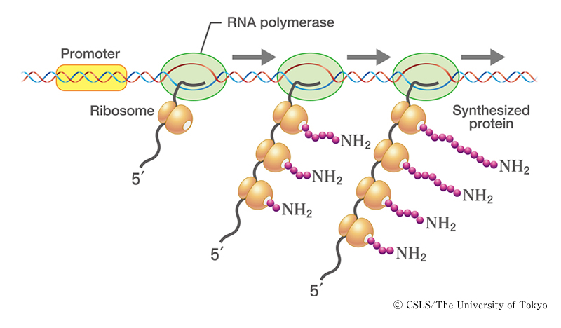
Cooperation between transcription and translation.
Prokaryotes
Protein synthesis in prokaryotes begins
when mRNA synthesis is still in progress.
In genomic DNA, synthesis of the next mRNA
molecule starts before the previous mRNA molecule is completely synthesized.
Protein synthesis is also initiated using the incompletely synthesized mRNA molecule.
Occasionally, mRNA degradation proceeds from the 5′terminus, while mRNA synthesis is still in progress at the 3′ terminus.
Thus, the half-life of mRNA in E. coli is generally short, lasting only a few minutes.

Slide 31
Cooperation between transcription and translation.
Eukaryotes
The synthesized pre-mRNA undergoes
post-transcriptional processing.
The completed mRNA is transported into the
cytoplasm from the nucleus.
mRNA
Once in the cytoplasm, it is not necessarily immediately used in protein synthesis.
In eukaryotes, the half-life of mRNA ranges from dozens of minutes to very long periods.
This spatial and temporal separation of transcription and translation is a major difference between eukaryotes and prokaryotes.

Slide 32
Steps in translation process
1. Initiation
2. Elongation
3. Termination

Slide 33
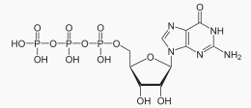
Molecules involved in translation initiation step
1. Mature mRNA
2. Ribosome
3. Eukaryotic initiation factors (eIFs)
4. Initiator tRNA (Met-tRNAi)
4. Guanosine triphosphate (GTP)

Slide 34
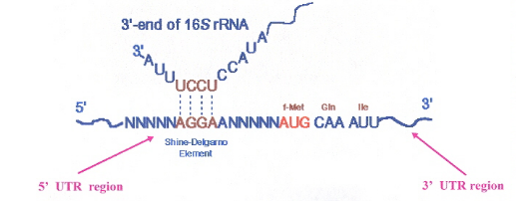
Differences between eukaryotic and prokaryotic translation initiation?
The prokaryotic mRNA has a ribosome binding site at its beginning just prior
(within 4-18 nucleotides ) to the initiation codon AUG.
This sequence is known as Shine- Delgarno sequence (SD region).
Shine- Delgarno sequence bind well with the 3’ end of 16S rRNA of the prokaryotic ribosome.

Slide 35
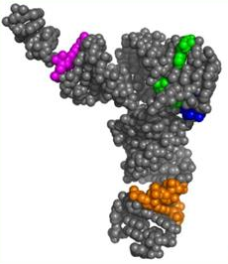
Initiation
The first step in eukaryotic translation is the assembly of the translation initiation complex which consists of:
an mRNA,
the small and large ribosomal subunits,
an initiator tRNA carrying methionine – Met-tRNA (the amino acid specified by the first codon, or start codon, of an mRNA coding sequence).

Slide 36
The eukaryotic initiation factors (eIFs)
The eukaryotic initiation factors (eIFs) play a role in bringing together the initiator tRNA, ribosome and mRNA.
These soluble proteins help stabilize the formation of the functional ribosome around the start codon and also provide regulatory mechanisms in translation initiation.
There exist many more eukaryotic than prokaryotic initiation factors reflecting the greater biological complexity of eukaryotic cells.
Eukaryotic translation requires at least 12 eukaryotic initiation factors.
Initiation factors help assemble the initiation complex using energy provided by hydrolysis of GTP (guanosine triphosphate, a energy storage molecule similar to ATP).

Slide 37
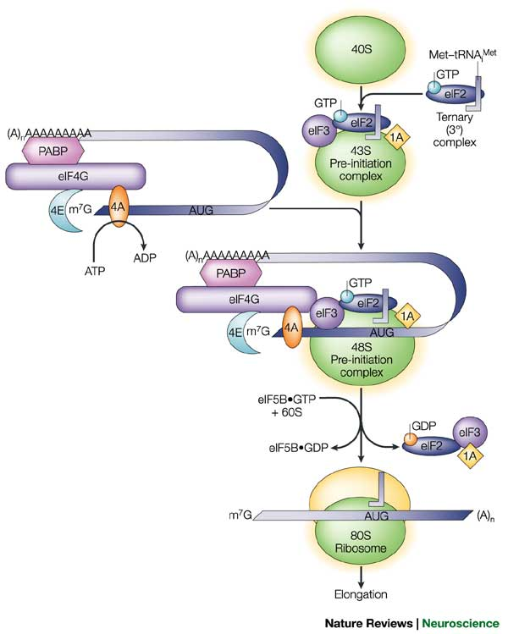
Initiation
Translation initiation complex.
Ribosomes occur in the cytoplasm in
dissociated condition,
their smaller and larger subunits separated.
Initiator tRNA (Met-tRNA) gets loaded
onto the 40S small ribosomal subunit.
Eukaryptic initiation factors (eIFs)
binds as well to the 40S ribosomal subunit.
A 43 S pre-initiation complex is formed
containing 40S- Met-tRNA- eIFs.
Only Met-tRNA can bind tightly to the small
ribosomal subunit without the assembly of the
entire ribosome.

Slide 38
Initiation
Translation initiation complex.
The pre-initiation complex binds to the
5’ cap end of the mRNA.
More eIFs binds to 5’ Cap end of the
mRNA.
A 48 S pre-initiation complex is formed
containing 40S- Met-tRNA- eIFs-mRNA.

Slide 39
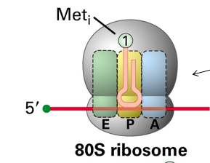
Initiation
Translation initiation complex.
The 48S pre-initiation complex moves
along the transcript in 5’- 3’ direction
in search for the first AUG.
When first AUG is found, eIFs dissociate.
The large ribosomal subunit (60S) binds
eIF6/eIF5 and assembles to the complex
at the start codon.
When the large ribosomal subunit binds
to the small subunit and the remaining eIF
are released, the initiation complex is complete.
The initiator tRNA is positioned in the
P- site of the ribosome and the A-site is
available to receive the next charged tRNA.

Slide 40
Differences between eukaryotic and prokaryotic translation initiation?
Prokaryotic cell has modifed the initiation amino acid –formylated metionine.
So in the prokaryote, there are two types of tRNA for metionine:
tRNA^{formylMet} for initiation carrying formylated metionine.
tRNA^{Met} for carrying normal metionine to growing polypeptide.
The initiation of protein synthesis consists in the recruitment of a ribosome·initiator tRNA complex to the initiation codon of a messenger RNA.
In prokaryotes, this process involves the direct interaction of the ribosomal RNA
with the mRNA.
In contrast, eukaryotes have evolved a sophisticated mechanism that relies mostly on protein-RNA and protein-protein interactions.

Slide 41
Elongation
Molecules involved in elongation step of translation
1. Aminoacyl-tRNAs.
2. A set of proteins known as elongation factors (EFs).
3. An mRNA:80S ribosome:peptidyl-tRNA complex
(peptidyl-tRNA in the P site).
4. Guanosine triphosphate (GTP).

Slide 42
This bond is catalyzed by the
enzyme peptidyl transferase.

Slide 43
Termination
Elongation continues until 80S ribosome encounters one of the stop codons,
UAA, UAG, or UGA, which signals chain termination and positioned in the
ribosomal A-site.
There are no aminoacyl tRNA molecules that recognize these sequences.
Proteins known as eukaryotic release factors (eRF) recognize the stop codon at the A site and promote polypeptide release from the ribosome.
These release factors closely mimic the shape and charge distribution of tRNAs such that they can bind to the ribosome, but they lack an amino acid.
Therefore, the ribosome can no longer extend the growing chain of amino acids, causing the peptide chain to be released.

Slide 44
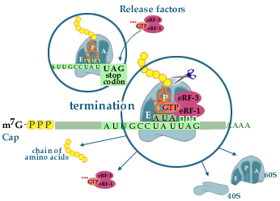
Termination
Stop codons are recognized by a protein, eRF-1 (eukaryotic release factor 1).
The activity of eRF-1 is stimulated by eRF-3, which is
a GTP-binding protein that forms a complex with eRF-1.
This complex binds to ribosomes having
a stop codon in the A-site.
The ribosome-bound complex stimulates the cleavage of the bond (ester bond) between the peptide and the tRNA (peptidyl-tRNA) thereby releasing the new protein from the ribosome.
The factors are released from the ribosome following GTP hydrolysis.
The ribosome can now start a new translational cycle. In most cases the ribosome initiates a new round of translation on the same mRNA.

Slide 45
Polysome
Translation of a single eukaryotic mRNA molecule to yield a typical-sized
protein takes 1-2 min.
The efficiency of translation is significantly increased by
the simultaneous translation of a single mRNA by multiple ribosomes,
rapid recycling of ribosomal subunits after they disengage from the 3’ end of
mRNA.

Slide 46
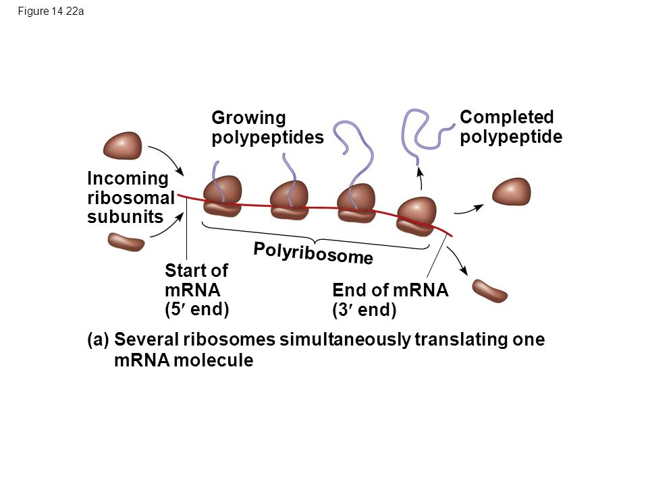
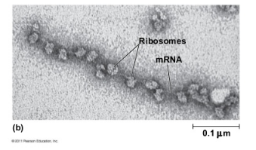
Polysome
Polyribosomes or polysomes- a cluster of ribosomes linked together
by a mRNA and simultaneously translating the same transcript.
Polysomes could be seen as
beads on a string in electron micrographs.

Slide 47
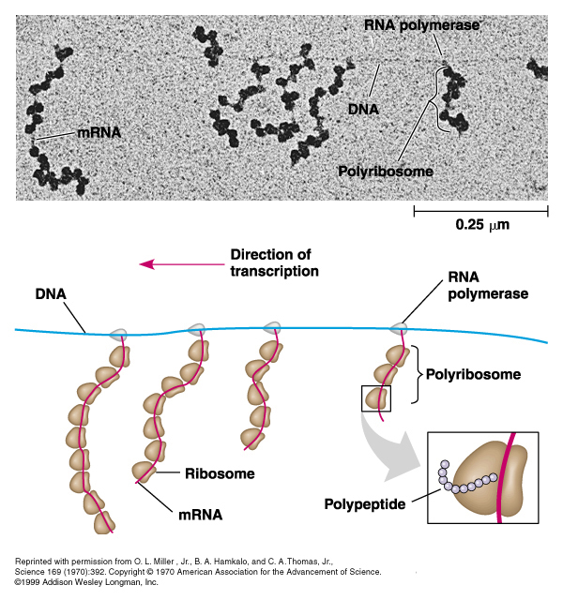
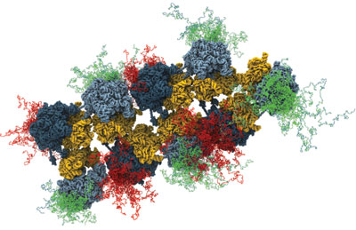
Polysomes in prokaryotes
Transcription of gene and translation of
mRNA occur simultaneously.
The three-dimensional structure of the polysome has been elucidated in bacteria.

Slide 48
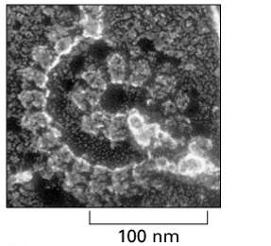
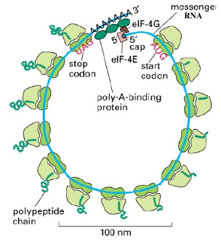
Circular polyribosome in eukaryotic cells
Multiple copies of the poly(A)-binding protein (PABP)
interact with both an mRNA poly (A) tail and the
eukaryotic initiation factor eIF4 subunit 4 (eIF4G).
Since the eIF4 subunit E (eIF4E) binds to the cap
structure on the 5’ end of an mRNA, the two
ends of mRNA molecule are bridged by the
interventing proteins, forming a circular mRNA.

Slide 49
Circular polyribosome in eukaryotic cells
Because two ends of a polysome are relatively
close together, ribosomal subunits that disengage
from the 3’ end are positioned near the 5’ end,
facilitating re-initiation by the interaction of the
40S subunit and its associated initiation factors
with eIF4 boung to the 5’ cap.
Circular structure of eukaryotic mRNA increases translation efficiency by
facilitating ribosome recapture on circularized mRNAs.

Slide 50
Ribosome life cycle
The ribosome subunits cycle between 80S complexes and a pool of free subunits.
The ribosome subunits cycle rapidly through protein synthesis.
80% of ribosomes are engaged in protein synthesis at any instant.
When 80S ribosome dissociates from mRNA, it separates into free 60S and 40S subunits.
Intact 80S ribosomes are inactive in translation, because only 40S subunit can
interact with initiation factors.

Slide 51
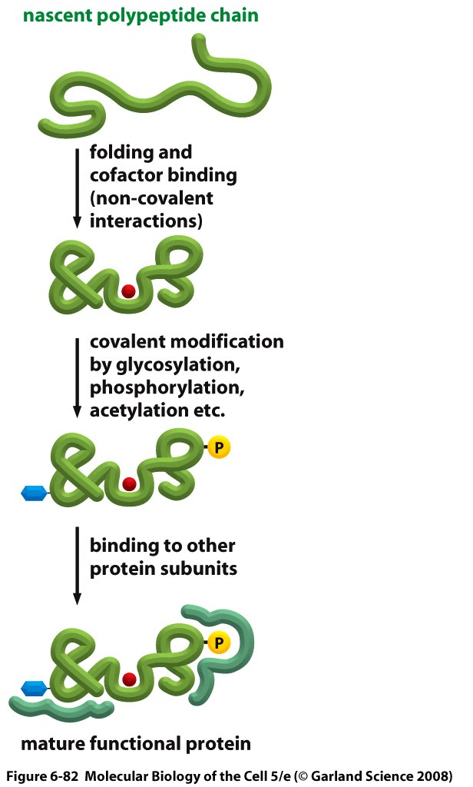
Post-tanslational modifications
The translation of an mRNA sequence into an amino acid sequence on the ribosome is not the end of the process of forming a protein.
To function, the completed polypeptide chain must fold correctly into its three-dimensional conformation, bind any cofactors required.
Many proteins also require covalent modifications of selected amino acids.
Although the most frequent modifications are protein glycosylation and protein phosphorylation, more than 100 different types of covalent modifications are known.

Slide 52
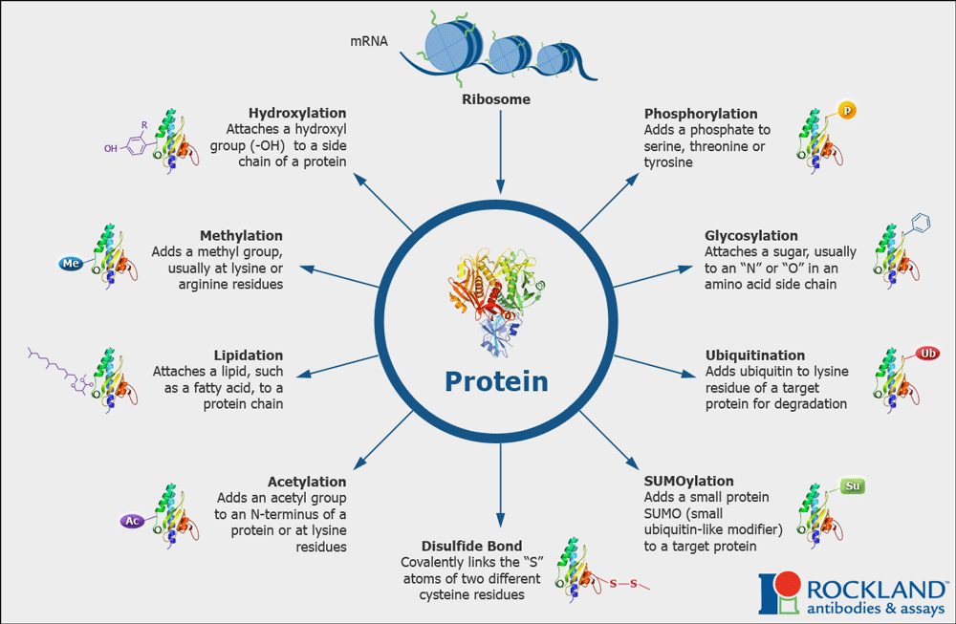

Slide 53
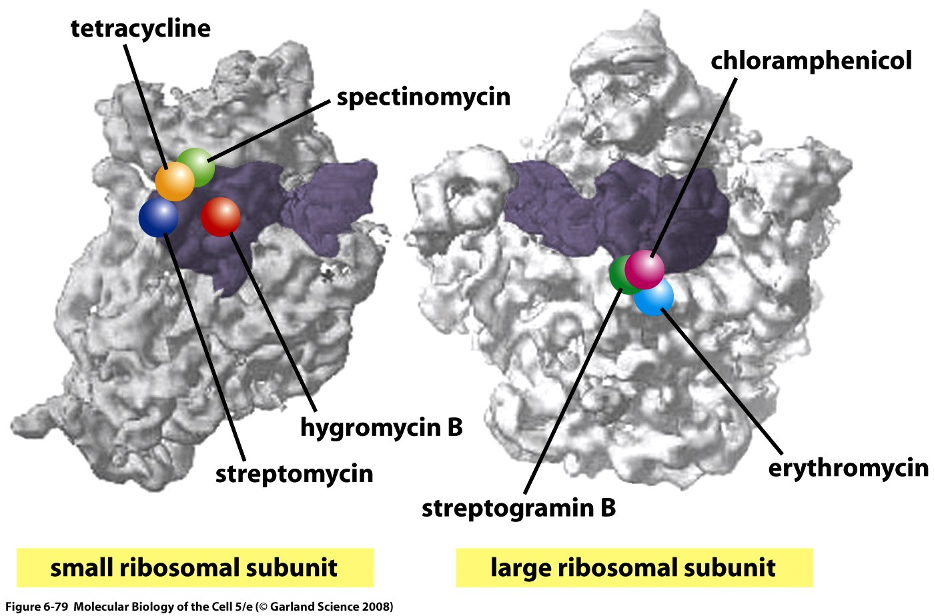
Antibiotics inhibit mRNA translation in bacteria
Notes:
Figure 6-79 Binding sites for antibiotics on the bacterial ribosome. The small (left) and large (right) subunits of the ribosome are arranged as though the ribosome has been opened like a book; the bound tRNA molecules are shown in purple (see Figure 6-64). Most of the antibiotics shown bind directly to pockets formed by the ribosomal RNA molecules. Hygromycin B induces errors in translation, streptomycin blocks the translocation of the peptydil-tRNA from the A-site to the P-site, and streptogramin B prevents elongation of nascent peptides. Table 6-4 lists the inhibitory mechanisms of the other antibiotics shown in the figure. (Adapted from J. Poelsgaard and S. Douthwaite, Nat. Rev. Microbiol. 3:870-881. ith permission from Macmillan Publishers Ltd.)

Slide 54
Could you translate
the small eukaryotic mRNA:
5’- GCUGAAGGAUGCAUAAGUCAGGCUAAGCUCCCAAAAAA -3’
3 ’- UTR
5’- UTR

Slide 55
Could you translate
the small eukaryotic mRNA:
5’- GCUGAAGG AUG CAU AAG UCA GGC UAA GCUCCCAAAAAA -3’
Met His Lys Ser Gly
5’- UTR
3 ’- UTR

Slide 56
Regulation of translation
Gene expression is regulated not only on the transcription level but
it is also regulated in translational level.
Translational control of gene expression can permit a more rapid response to
altered environmental stimuli than the alternative of activating transcription.
As with other types of regulation, translation control typically functions at the level
of initiation.

Slide 57
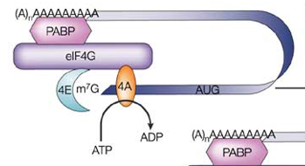
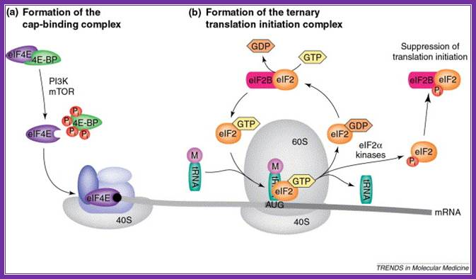
Global regulation of gene translation
Global regulation of translation can involve regulation of translation initiation factors and occurs by two main mechanisms:
disruption of the closed loop containing mRNA, eIF4 complex and PABP
decreased ternary complex formation

Slide 58
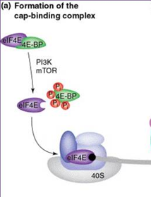
Global regulation of gene translation
Disruption of the closed loop
is achieved by a group of inhibitor proteins that compete with eIF4G for a binding site on eIF4E, thereby preventing this critical interaction.
This group of eIF4E-binding proteins, called 4E-BP1, 4E-BP2 and 4E-BP3, are regulated by phosphorylation, in a pathway downstream of the ‘mammalian target of rapamycin’ (mTOR) kinase.
Signalling through mTOR leads to the phosphorylation of 4E-BPs, which are then unable to bind eIF4E, allowing it to interact with eIF4G.

Slide 59
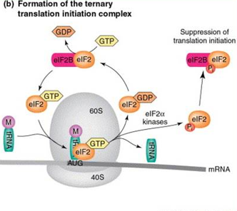
Global regulation of gene translation
Decreased ternary complex formation
The second major mechanism of global regulation is mediated by the phosphorylation of the eIF2 α-subunit on serine 51 by four eIF2α-kinases, GCN2, PERK, HRI and PKR.
Phosphorylation on serine 51 leads to increased affinity of the protein for eIF2B, preventing it from carrying out guanosine nucleotide exchange on other eIF2 molecules.
This results in a reduction in the levels of ternary complex and global inhibition of translation.
Global inhibition of translation occurs under conditions of cellular stress, such as amino acid starvation, viral infection and hypoxia and DNA damage.

Slide 60
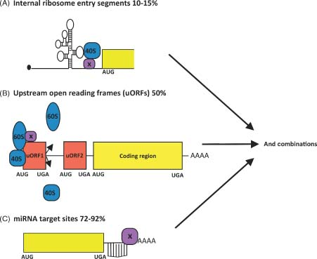
mRNA- specific regulation of translation
In addition to the global mechanisms of translation, there are other mRNA-specific mechanisms at work.
Most examples of message-specific regulation are dependent upon sequence elements, which may or may not be structured, within the 5′ and 3′ UTRs.
These are
Internal Ribosome Entry Segments- IRESs,
Upstream Open Reading Frames – uORFs and
micro RNA target sites- miR-binding sites.
They may function independently or in combination.

Slide 61
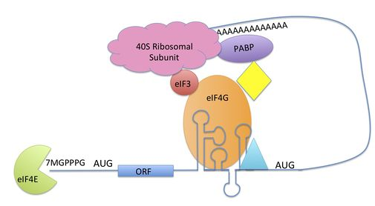
Elements in the 5′ or 3′ UTRs that regulate mRNA translation
Internal ribosome entry segments (IRES)
IRESs are typically highly structured RNA elements in the 5′ UTR that allow binding of ribosomes at or near the AUG start codon, independent of cap recognition.
Have been shown to activate or maintain translation following a range of cellular stresses that compromise the cap-binding complex.
They are assisted by proteins, IRES trans-acting factors (ITAFs), which bind to the IRES and modify its structure and/or interact with other elements of the translation machinery.
It is estimated that 10% of mRNAs contain IRES elements within their 5′ UTRs.
IRES

Slide 62
Elements in the 5′ or 3′ UTRs that regulate mRNA translation
Upstream Open Reading Frames – uORFs
Upstream open reading frames (uORFs) are sequences defined by an initiation codon in frame with a termination codon located upstream or downstream of the main AUG.
They are located in the 5′ UTR.
uORFs correlate with significantly reduced protein expression levels because
they reduce the efficiency of translation initiation of the main downstream ORF in unstressed conditions.

Slide 63
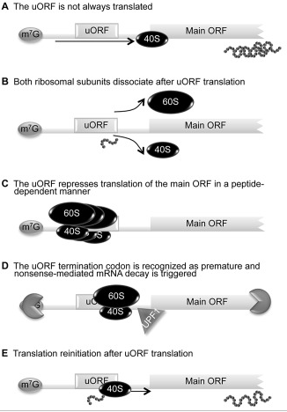
Upstream Open Reading Frames – uORFs
uORF-mediated translational control can occur through different mechanisms.
(A) The leaky scanning mechanism is dependent on the efficiency of uAUG recognition; sometimes the ribosome can translate the uORF, but other times the scanning machinery bypasses the uAUG, recognizing the downstream AUG and translating the main ORF.
(B) When a scanning ribosome recognizes and translates a functional uORF, there is synthesis of a small peptide; if translation termination of the uORF is efficient, both 60S and 40S ribosomal subunits might dissociate from the transcript and the main ORF is not translated.
(C) A uORF can repress translation of the main ORF in a peptide-dependent manner; in this case, the uORF-encoded peptide interacts with the translating machinery and promotes ribosome blockage.
(E) After translation termination of the uORF, the 40S ribosomal subunit can remain associated with the transcript, resume scanning, and recognize the downstream main AUG—a mechanism designated as translation reinitiation.

Slide 64
Elements in the 5′ or 3′ UTRs that regulate mRNA translation
Both IRESs and uORFs are examples of mRNA elements that drive translation under conditions in which global translation is inhibited.
However, other regulatory elements permit specific mRNA regulation under physiological conditions, such as the micro-RNA (miR) regulation pathway.

Slide 65
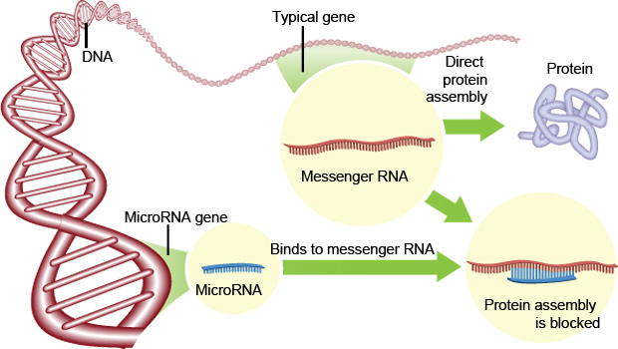
MicroRNAs (miRNA)
MicroRNAs are genomically- encoded, small single-stranded RNA molecules.
These miRNA are on average 20-25 nucleotides in length.
They can bind mRNA and degrade mRNA or block it’s translation.

Slide 66
miRNA
miRNA target sites are generally located in the 3′ UTRs of mRNAs.
Binding of the miRNA to its target site with imperfect complementarity inhibits protein synthesis at either the initiation stage of translation or a post-initiation event.
More than 1.400 miRNAs have been described in humans, each of which is predicted to regulate numerous different mRNAs.
This results in a highly complex regulatory network that is estimated to regulate around 30- 60% of all protein-coding genes.

Slide 67
Mutations in global translation factors
One of the best- characterized neurological diseases cause
by dysfunctional translational control is
leukoencephalopathy with vanishing white matter or
vanishing white matter disease (VWM).
VWM is an autosomal recessive disease.
Children most often suffer from genetic VWM.
The overall incidence of WMDs in children is ~1:1000, similar to that of Multiple Sclerosis (MS) in adults.
WM damage leads to motor, cognitive and behavioral dysfunction.
The affected cells are glia (astrocytes and oligodendrocytes) and myelin is either not formed or lost.
For most VWM no cure is available. Children with leukodystrophy die early.

Slide 68
Mutations in global translation factors
Mis-sense mutations in any one of the five subunits of eIF2B, the guanosine nucleotide-exchange factor responsible for recharging eIF2, can cause VWM.
eIF2B is one of the key regulators of translation initiation, being sequestered by phosphorylated eIF2α during conditions of cell stress, which leads to global translational inhibition.
It is notable that symptoms typically appear following mild infections or head trauma, indicating a role for cell stress in the pathology of this disease.

Slide 69
Translational errors
Errors arise at all steps of protein synthesis, from transcription to protein folding, and have widespread phenotypic consequences.
Amino-acid misincorporations during translation are estimated to occur once in every 1,000 to 10,000 codons translated.
At this error rate, 15% of average-length protein molecules will contain at least one misincorporated amino acid.
Polypeptide errors can induce protein misfolding, aggregation and cell death.
Misfolded proteins underlie a broad array of neurogenerative diseases and multiple sclerosis.

