Slide 1
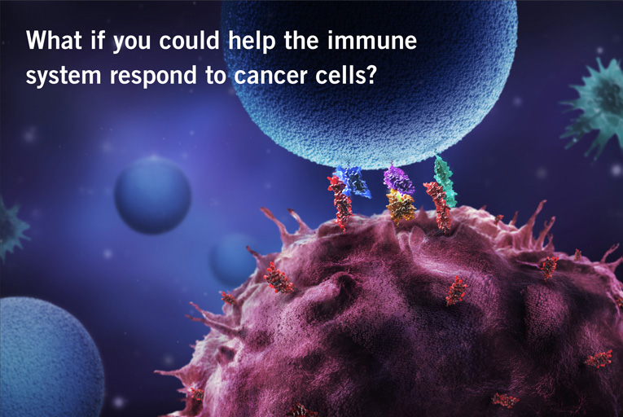
Pret-vēža imūnā atbilde un imunoterapija
Dr. Aija Linē

Slide 2
Vēža imūnās uzraudzības hipotēzes attīstība
1891. gadā William Coley mēģina ārstēt vēzi, injicējot audzējā baktērijas (Streptococcus pyogenes)
Pauls Ērlihs izsaka domu, ka imūnsistēma kontrolē/ierobežo karcinomu attīstību (~1909. g)
Veicot eksperimentus ar peļu audzēju transplantāciju, tika novērots, ka ne-radniecīgā pelē transplantēts audzējs tiek iznīcināts. MHC atklāšana parādīja, ka tas ir pateicoties nevis vēža-specifiskai imunitātei, bet allograftu atgrūšanai .
Macferlane Burnet un Lewis Thomas ~1950. gados izvirza imūnās uzraudzības (Immune surveillance) hipotēzi – nelieli audzēju šūnu sakopojumi veidojas bieži, bet imūnsistēma tos efektīvi iznīcina, bez klīniski detektējama audzēja pazīmēm. Celulārās imunitātes galvenā funkcija ir uzturēt audu homeostāzi.

Slide 3
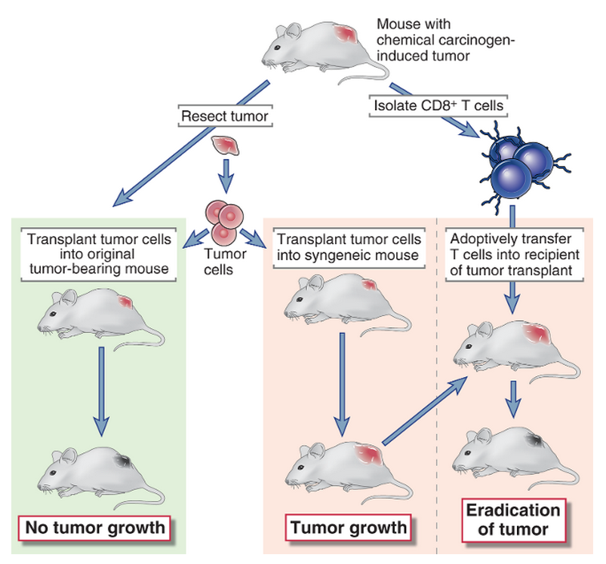
Eksperiments, kas pierāda pret-vēža imunitāti
Old L & Boyse EA Immunology of experimental tumors, 1964.
Klein G Tumor antigens, 1966
Abbas AK et al, Cellular and Molecular Immunology, 2012
Notes:
Mice that have been surgically cured of a chemical carcinogen (MCA)–induced tumor reject subsequent transplants of the same tumor, whereas the transplanted tumor grows in normal syngeneic mice. The tumor is also rejected in normal mice that are given adoptive transfer of T lymphocytes from the original tumor-bearing animal.

Slide 4
Vēža imūnās uzraudzības hipotēzes attīstība
Seko virkne eksperimentu, kuros tiek pētīts kā eksperimentāli izraisīta imunosupresija ietekmē audzēju veidošanos. Imunosupresija tiek panākta veicot neonatālu tīmektomiju, ievadot anti-limfocītu antivielas vai lietojot farmakoloģiskus imunosupresantus. Iegūtie rezultāti – pretrunīgi un neviennozīmīgi; dominējošais viedoklis: imunosupresijas rezultātā dzīvnieki kļūst jutīgāki pret infekcijām, to skaitā onkogēniem vīrusiem.
Stutman O et al. Ar MCA inducējot karcinoģenēzi nude (nu-/nu- pelēs ir ģenētisks defekts FOXN1 gēnā, kā rezultātā veidojas defektīvs tīmuss) un normālās pelēs, nenovēro būtiskas atšķirības audzēju incidencē (1973-1979); Rygeerd & Povlsen iekļauj pētījumā 10 800 nude peles – neatrod atšķirības spontāno audzēju veidošanā.
Secinājums: imūnajai sistēmai nav būtiskas lomas aizsardzībā pret vēzi...

Slide 5
Bet... Varbūt tomēr ir?
Līdz ~1995. gadam vēža imūnās uzraudzības hipotēze tiek noliegta.
Tomēr...
Nude pelēs tomēr ir daļēji funkcionējoša imūnā sistēma - zināms daudzums αβ-T šūnu un pilnībā funkcionējošas NK un γδT šūnas.
Eksperimentos izmantoto peļu šķirne ir ļoti jutīga pret MCA karcinoģenēzi; ja izmanto BALB/c peles - nude pelēs audzēji veidojas biežāk kā wt BALB/c.
Cilvēkiem ar imunodeficītu vai imunosupresiju paaugstinās risks saslimt ar vēzi; transplantēto orgānu recipientiem pieaug limfomu, melanomas u.c. audzēju incidence (gan ar onkogēnu vīrusu saistītu, gan nesaistītu audzēju)
Efektoro limfocītu (CTL, Th1) infiltrācija un IFN γ produkcija audzējos ir saistīta ar labvēlīgu prognozi
Gadījumi, kuros melanomas metastāzes ir pārnestas no orgānu donora uz imunosupresēto recipientu.

Slide 6
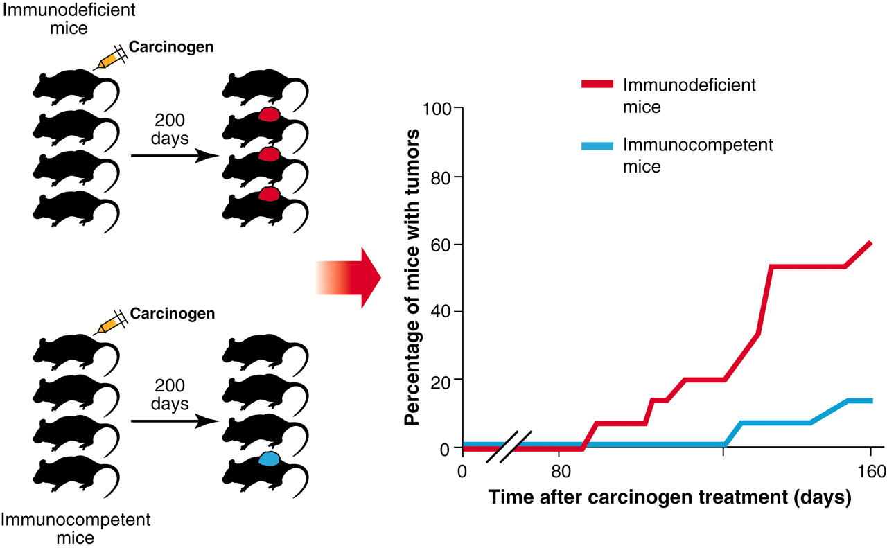
Pelēs, kurās, izmantojot neitralizējošas antivielas tiek inaktivētas CD4+, CD8+ šūnas vai IFNγ, vai arī ir mutācija IFNγ receptorā ir ievērojami augstāka MCA-inducētu audzēju incidence kā kontroles pelēs.
R D Schreiber et al. Science 2011;331:1565-1570
Notes:
The immune status of mice is a critical determinant of their susceptibility to tumors induced by chemical carcinogens. Over the past two decades, numerous studies have established that immunodeficient mice are more tumor prone than are immunocompetent mice after treatment with carcinogens such as MCA. The immunodeficient mice tested in such experiments include gene-targeted mice on pure genetic backgrounds with deficits of innate or adaptive immunity as well as wild-type mice rendered immunodeficient by chronic administration of monoclonal antibodies that, for example, deplete CD4⁺ and CD8⁺ T cells or interferon-γ. Immunodeficiency has also been found to increase the susceptibility of untreated mice to spontaneously arising tumors and to increase the incidence of tumor formation in mouse genetic models of cancer. Schematic is based on experiments described in (13).

Slide 7
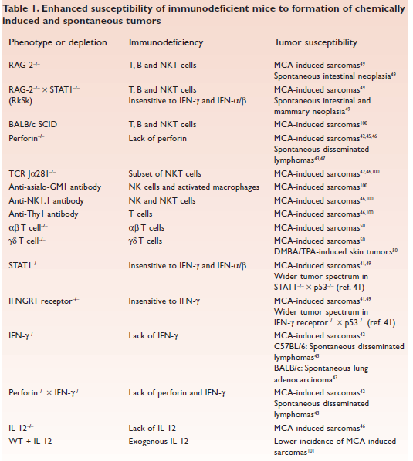
Virkne eksperimentu pierāda, ka ģenētiska, imunoķīmiska vai funkcionāla imūnsistēmas komponentu iznīcināšana, noved pie paaugstinātas ķīmiski-inducētas vai spontānas vēža veidošanās
Dunn et al, Nat Immunol, 2002

Slide 8
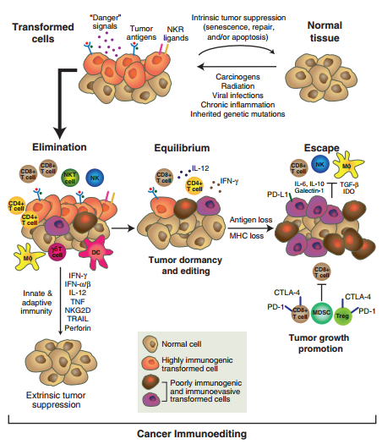
Mūsdienu imūnās rediģēšanas hipotēze
Screiber et al, Science, 2011
Notes:
The cancer immunoediting concept. Cancer immunoediting is an extrinsic tumor suppressor
mechanism that engages only after cellular transformation has occurred and intrinsic tumor suppressor
mechanisms have failed. In its most complex form, cancer immunoediting consists of three sequential
phases: elimination, equilibrium, and escape. In the elimination phase, innate and adaptive immunity
work together to destroy developing tumors long before they become clinically apparent. Many of the
immune molecules and cells that participate in the elimination phase have been identified, but more work
is needed to determine their exact sequence of action. If this phase goes to completion, then the host
remains free of cancer, and elimination thus represents the full extent of the process. If, however, a rare
cancer cell variant is not destroyed in the elimination phase, it may then enter the equilibrium phase, in
which its outgrowth is prevented by immunologic mechanisms. T cells, IL-12, and IFN-g are required to
maintain tumor cells in a state of functional dormancy, whereas NK cells and molecules that participate in
the recognition or effector function of cells of innate immunity are not required; this indicates that
equilibrium is a function of adaptive immunity only. Editing of tumor immunogenicity occurs in the
equilibrium phase. Equilibriummay also represent an end stage of the cancer immunoediting process and
may restrain outgrowth of occult cancers for the lifetime of the host. However, as a consequence of
constant immune selection pressure placed on genetically unstable tumor cells held in equilibrium, tumor
cell variants may emerge that (i) are no longer recognized by adaptive immunity (antigen loss variants or
tumors cells that develop defects in antigen processing or presentation), (ii) become insensitive to
immune effector mechanisms, or (iii) induce an immunosuppressive state within the tumor microenvironment.
These tumor cells may then enter the escape phase, in which their outgrowth is no longer blocked
by immunity. These tumor cells emerge to cause clinically apparent disease.

Slide 9
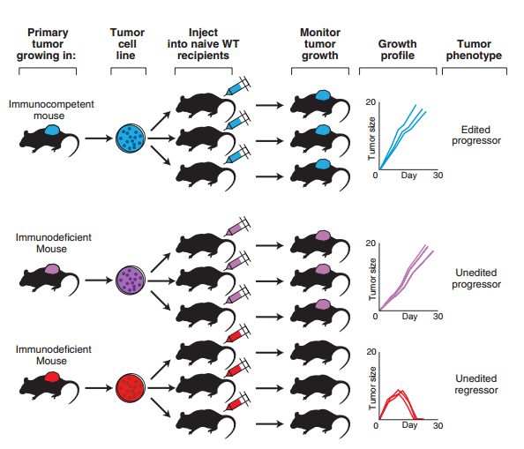
Eksperiments, kas pierāda imūnās rediģēšanas hipotēzi
Screiber et al, Science, 2011
Notes:
Tumors in immunocompetent mice are qualitatively different from tumors in immunodeficient
mice. This observation, which led to the formulation of the cancer immunoediting hypothesis, is based on
comparative analyses of carcinogen-induced tumors harvested from immunocompetent and immunodeficient
mice. In these experiments, tumor cell lines were established from tumors arising in each group
of mice, and these cells were then injected into immunodeficient recipient mice or immunocompetent
wild-type (WT) recipient mice. Tumor cells from carcinogen-treatedWT mice formed progressively growing
tumors in both immunodeficient mice (not shown) and naïve syngeneic immunocompetent mice (blue)
100%of the time. In contrast, although tumor cells from carcinogen-treated immunodeficient mice grew
progressively when transplanted into immunodeficient mice (not shown), only half of the tumor cell lines
were capable of forming progressively growing tumors in naïve syngeneic immunocompetent recipients
(purple), whereas the other half of the cell lines were rejected by the recipients (red). Thus, tumors from
immunodeficient mice are termed “unedited” and further designated as “progressor” or “regressor” to
denote their growth phenotypes after injection into naïve WT recipients. Carcinogen-induced tumors from
immunocompetent mice are termed “edited” because they are less immunogenic and show only a
progressor growth phenotype.

Slide 10
Audzēju antigēni
jeb kā adaptīvā imūnsistēma pazīst vēža šūnas?
Strukturāli izmainīti antigēni (neoepitopi)
Mutācijas (aa nomaiņas) (Ras, p53)
Splaisinga defekti (TACC1, SPAG17)
Hibrīdie proteīni (BCR-ABL)
Post-translacionālas modifikācijas (mucīni)
Ekspresijas līmeņa izmaiņas
Pārproducēti normāli proteīni (HER2/neu)
Cancer-testis antigēni (NY-ESO1, MAGEA, SSX)
Onkofetāli/diferenciācijas antigēni (CEA, tirozināze)
Onkogēnu vīrusu epitopi (Papilomas vīrusa E6, E7;EBV)
Ne-proteīnu dabas antigēni (gliproteīni, glikolipīdi u.c.)

Slide 11
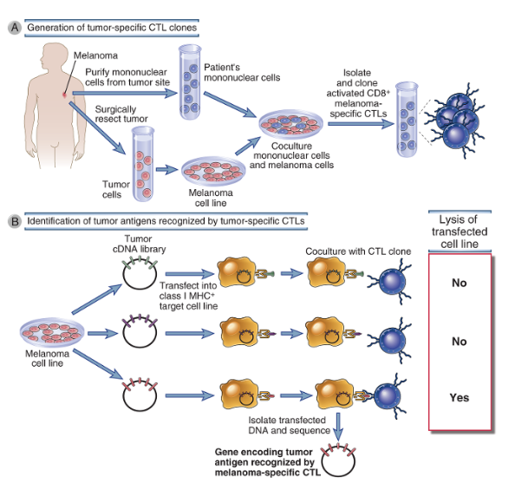
T šūnu antigēnu identificēšanas metodika
Notes:
CD8⁺ T cells isolated from blood, lymph nodes, or tumors of patients with melanoma are propagated in culture by stimulating them with melanoma cell lines derived from the patient’s tumor. Single T cells from these cultures are expanded into clonal CTL lines. B, DNA from melanoma gene libraries is transfected into class I MHC–expressing target cells. Genes that sensitize the target cells for lysis by the melanoma-specific CTL clones are analyzed to identify the melanoma protein antigens recognized by the patient’s CTLs.

Slide 12
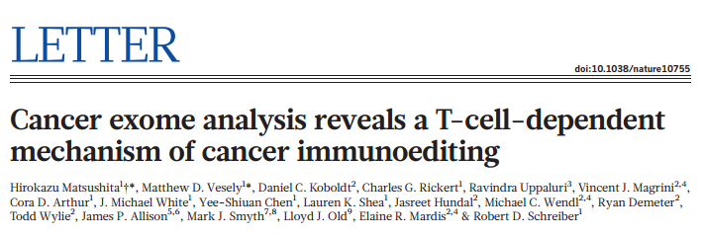
Kā audzēju antigēnu profils atšķiras pirms un pēc imūnās rediģēšanas?
Sekvenē eksomu MCA-inducētās sarkomas šūnu līnijās, kas iegūtas Rag-/- pelēs (ne-rediģēts audzējs)
Atrod 3737 ne-sinonīmas mutācijas (to skaitā Kras, TP53)
Transplantējot wt pelēs, ~20% gadījumu izveidojas audzēji, pārējos gadījumos atgrūž.
Klonos, kas wt pelēs regresē atrod mutāciju spektrīna β-2 gēnā; tajos klonos, kas aug – mutācijas nav.
Identificē mutāciju saturošo peptīdu, kas spēj aktivēt CTL – pierāda T šūnu atkarīgu imunoselekciju.

Slide 13
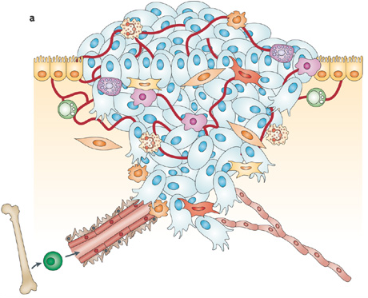
Audzēju mikrovide

Slide 14
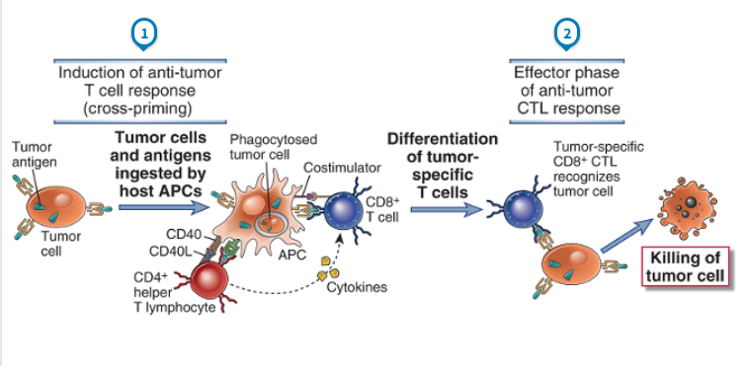
Efektorie mehānismi pret-vēža imūnajā atbildē: (I) CTL
Pašlaik uzskata, ka galvenā loma vēža šūnu iznīcināšanā ir CTLiem. Lai tie aktivētos, nepieciešamas DCs, kas uzņem audzēja antigēnus, aktivējas, migrē uz LN, prezentē antigēnu CD8+ T šūnām un nodrošina ko-stimulāciju.
Lai CTLi darbotos, nepieciešams, lai audzēja šūnas prezentē audzēju antigēnus uz MHC I. CTLi nogalina vēža šūnas, sekretējot perforīnu/granzīmu vai aktivējot Fas vai TRAIL receptorus uz audzēja šūnām un producē IFNγ, kas inhibē vēža šūnu proliferāciju, angiģenēzi un aktivē makrofāgus.
Notes:
CD8⁺ T cell responses to tumors may be induced by cross-priming (cross-presentation), in which the tumor cells or tumor antigens are taken up, processed, and presented to T cells by professional antigen-presenting cells (APCs). In some cases, B7 costimulators expressed by the APCs provide the second signals for differentiation of CD8⁺ T cells. The APCs may also stimulate CD4⁺ helper T cells, which provide the second signals for CTL development.

Slide 15
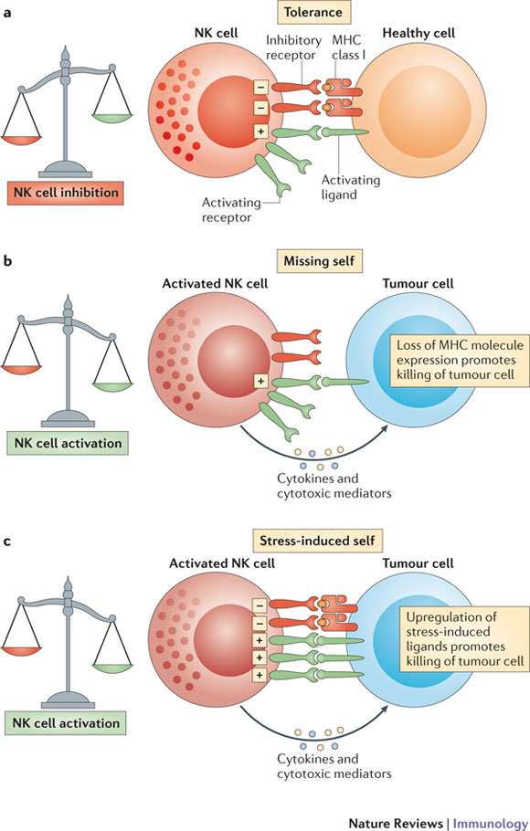
Efektorie mehānismi pret-vēža imūnajā atbildē
(II) NK šūnas
NK šūnas nogalina vēža šūnas, kas neekspersē MHC vai ekspresē NK šūnu aktivējošo receptoru ligandus (Stresa-inducētas molekulas: MIC-A, MIC-B u.c.)
Notes:
Natural killer (NK) cells are tolerant to healthy host cells, as the strength of the activating signals they receive on encountering these cells is dampened by the engagement of inhibitory receptors (tolerance). b | Tumour cells may lose expression of MHC class I molecules. NK cells become activated in response to these cells, as they are no longer held in check by the inhibitory signal delivered by MHC class I molecule engagement. This is known as 'missing-self' triggering of NK cell activation. c | In addition, NK cells are selectively activated by 'stressed' cells, which upregulate activating ligands for NK cells and thereby overcome the inhibitory signalling delivered by MHC class I molecules. This is known as 'stress-induced self' triggering of NK cell activation. In both conditions, NK cell activation leads to tumour elimination directly (through NK cell-mediated cytotoxicity) or indirectly (through the production of pro-inflammatory cytokines, such as interferon-γ).

Slide 16
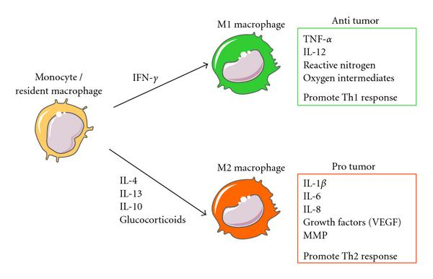
Efektorie mehānismi pret-vēža imūnajā atbildē
(III) Makrofāgi

Slide 17
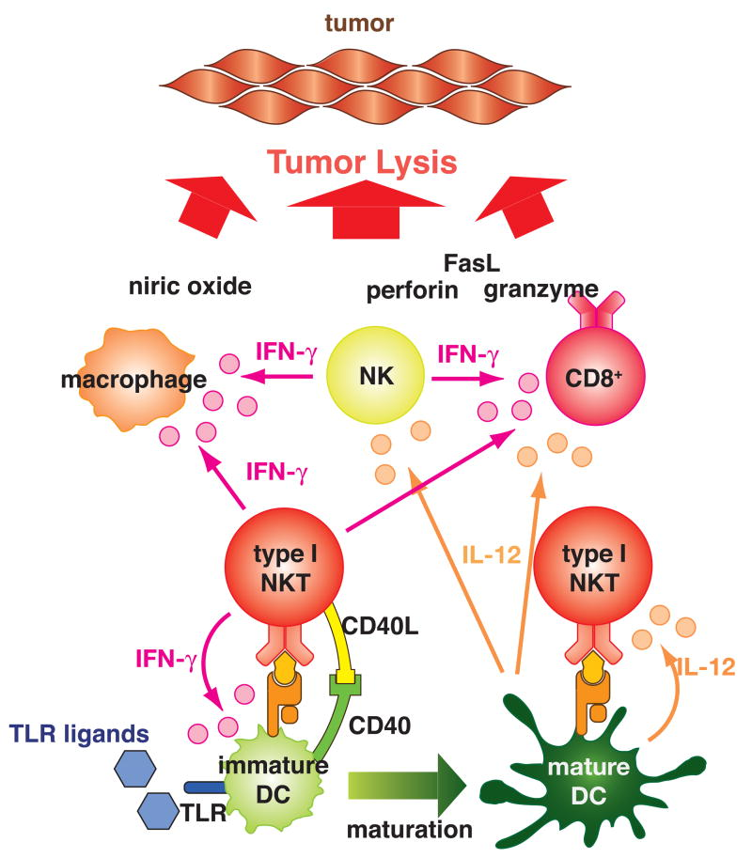
Efektorie mehānismi pret-vēža imūnajā atbildē
(IV) NKT šūnas
NKT – T šūnas, kurām ir TCR , kas pazīst nevis peptīdus, bet lipīdus, kas prezentēti uz CD1d (neklasiskā MHC). Var būt gan efektora, gan regulatora loma.
Aktivētas I tipa NKT producē IFNγ, IL-12, kas aktivē NK, CD8+ T šūnas un makrofāgus.
II tipa NKT (CD4+), producē IL-13, kas stimulē M2 makrofāgu polarizāciju un stimulē mieloīdās supresor šūnas producēt TGFβ, kas supresē CTLus.
Notes:
NKT cells are a relatively newly recognized member of the immune community, with profound effects on the rest of the immune system despite their small numbers. They are true T cells with a T cell receptor (TCR), but unlike conventional T cells that detect peptide antigens presented by conventional major histocompatibility (MHC) molecules, NKT cells recognize lipid antigens presented by CD1d, a nonclassical MHC molecule. As members of both the innate and adaptive immune systems, they bridge the gap between these, and respond rapidly to set the tone for subsequent immune responses. They fill a unique niche in providing the immune system a cellular arm to recognize lipid antigens. They play both effector and regulatory roles in infectious and autoimmune diseases. Furthermore, subsets of NKT cells can play distinct and sometimes opposing roles. In cancer, type I NKT cells, defined by their invariant TCR using Valpha14Jalpha18 in mice and Valpha24Jalpha18 in humans, are mostly protective, by producing interferon-gamma to activate NK and CD8(+) T cells and by activating dendritic cells to make IL-12. In contrast, type II NKT cells, characterized by more diverse TCRs recognizing lipids presented by CD1d, primarily inhibit tumor immunity. Moreover, type I and type II NKT cells counter-regulate each other, forming a new immunoregulatory axis. Because NKT cells respond rapidly, the balance along this axis can greatly influence other immune responses that follow. Therefore, learning to manipulate the balance along the NKT regulatory axis may be critical to devising successful immunotherapies for cancer.
Type I NKT cells promote tumor immunity. When type I NKT cells are activated by α-GalCer or endogenous glycolipids (may be tumor derived) presented by CD1d on immature dendritic cells (DCs), they produce interferon-γ (IFN-γ). The type I NKT cells may also interact with the immature DCs through CD40-CD40L. This interaction and IFN-γ induce maturation of the DCs. The mature DCs produce IL-12, which augments IFN-γ and IL-2 production by type I NKT cells. IFN-γ and IL-2 from the type I NKT cells and IL-12 from the mature DCs activate NK cells, CD8⁺ T cells, and macrophages. Exogenous IL-12 may bypass the process of DC maturation induced by the activated type I NKT cells. Providing exogenous Toll-like receptor (TLR) ligands may strengthen the cytokine production. Cross-presentation of tumor antigens by antigen presenting cells to CD8⁺ T cells when activated by the type I NKT cells may enhance induction of tumor antigen-specific CD8⁺ T cells. These activated T cells lyse tumor cells by employing multiple effector mechanisms including perforin, granzyme, FasL, and nitric oxide.
Type II NKT cells suppress tumor immunity. When type II NKT cells (mostly CD4⁺) are activated by tumor-derived glycolipids presented by CD1d, they produce IL-13. Together with TNF-α in the microenvironment signaling through TNF-receptor (TNFR) and NF-κB, IL-13 signals through a type II IL-4 receptor (IL-4R), a heterodimer of an IL-4Rα and an IL-13Rα1, and STAT6 to induce expression of the IL-13Rα2 on a CD11b⁺Gr-1⁺ myeloid cell. The IL-13Rα2 binding to IL-13 transduces a signal through AP-1, which induces expression of TGF-β. TGF-β suppresses activation of tumor specific CD8⁺ T cells, which mediate regression of tumors. In some tumor settings, IL-13 may induce M2 macrophages that also suppress CD8⁺ T cells. Blockade of either IL-13 by an IL-13 inhibitor such as soluble IL-13Rα2, or TGF-β with anti-TGF-β antibodies, or TNF-α with a TNF-α antagonist can remove the suppression.

Slide 18
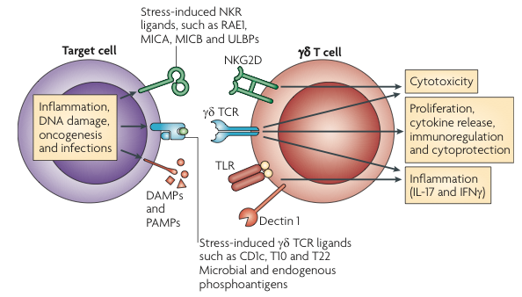
Efektorie mehānismi pret-vēža imūnajā atbildē
(V) γδT šūnas
T šūnas, kuru TCR veido δ un γ ķēdes; nav MHC restrikcijas – var pazīt lipīdu antigēnus un stresa-inducētus antigēnus. γδ T šūnas var aktivēties arī TCR-neatkarīgā ceļā caur NKG2D vai TLR receptoriem.

Slide 19
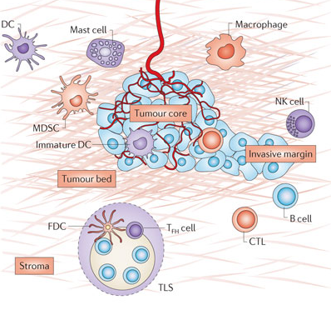
Efektorie mehānismi pret-vēža imūnajā atbildē
(VI) B šūnas
Peļu eksperimenti liecina, ka B šūnas stimulē audzēju veidošanos; turpretī cilvēku audzējos tās biežāk ir asociētas ar labvēlīgu prognozi.
B šūnām audzēja mikrovidē var būt antivielu atkarīgas un neatkarīgas efektorās funkcijas.
Antivielu atkarīgās:
Saistās pie vēža šūnu receptoriem
Opsonizē vēža šūnas
Opsonizē antigēnus un stimulē to uzņemšanu DC vai makrofāgos; stimulē DC aktivāciju
Komplementa vai antivielu atkarīgā celulārā citotoksicitāte
Antivielu neatkarīgās:
Prezentē antigēnus
Producē citokīnus un hemokīnus, kas veicina terciāro limfoīdo struktūru veidošanos audzējā
Fridman WH, NatRevCancer, 2012

Slide 20
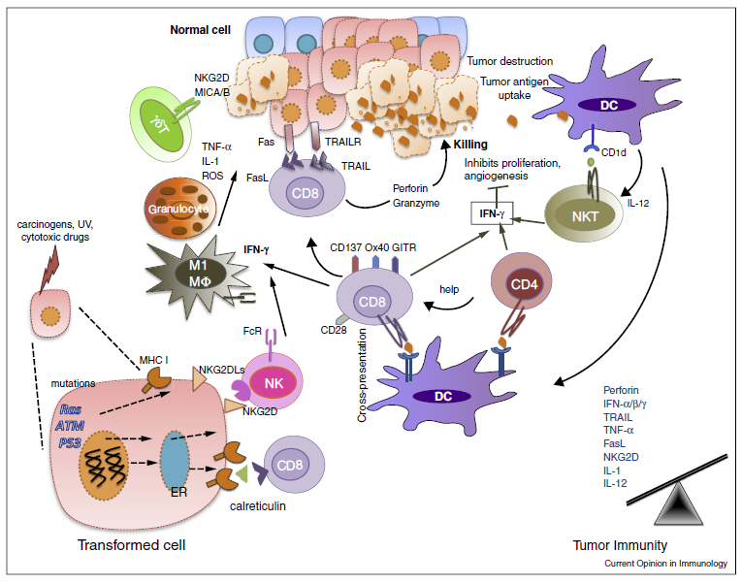
Imunostimulējoša audzēju mikrovide
Mittal et al, Current Opinion in Immunology, 2014
Notes:
Elimination is a phase of cancer immunoediting where both the innate and adaptive immune system together detect and destroy early tumors before they become clinically visible. Normal cells (blue) are transformed into tumor cells by carcinogens and other genotoxic insults along with the failure of intrinsic tumor suppressor mechanisms (e.g. p53, ATM). These tumor cells express stress-induced molecules such as surface calreticulin, tumor antigens in context of MHC class I molecules, and/or NKG2D ligands recognized by CD8+ effector cells and NK cells, respectively. DCs can also take up and cross-present tumor antigens to T cells including NKT cells (glycolipid antigens presenting via CD1d). These activated effector cells release IFN-g that can mediate anti-tumor effects by inhibiting tumor cell proliferation and angiogenesis. CD8+ T cells can induce tumor cell apoptosis by interacting with Fas and TRAIL receptors on tumor cells, or by secreting perforin and granzymes. Effector T cells express co-stimulatory molecules such as CD28, CD137, GITR, OX-40 that enhance their proliferation and survival. gd T cells can also recognize and kill tumors expressing NKG2D ligands (MICA/B in humans). Innate immune cells such as macrophages (M1) and granulocytes also contribute to anti-tumor immunity by secreting TNF-a, IL-1, IL-12 and ROS. In the Elimination phase, the balance is towards anti-tumor immunity due to an increase in expression of tumor antigens, MHC class I, Fas and TRAIL receptor on tumor cells and perforin, granzymes, IFN-a/b/g, IL-1, IL-12, TNF-a in the tumor microenvironment.

Slide 21
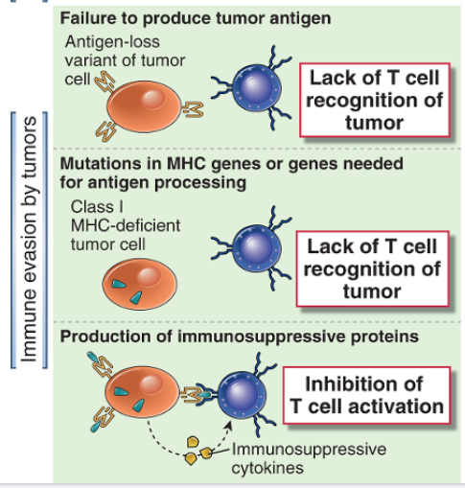
Vēža šūnu iekšējie “escape” mehānismi
Iespējams, ja antigēns nav svarīgs vēža šūnu izdzīvošanai
Visbiežāk, pazemina MHC I ekspresiju, β₂M vai antigēnu procesēšanas mašinērijas komponentus;
Kļūst neredzams T šūnām, taču mērķis NK šūnām.
TGF β, IL-10 u.c

Slide 22
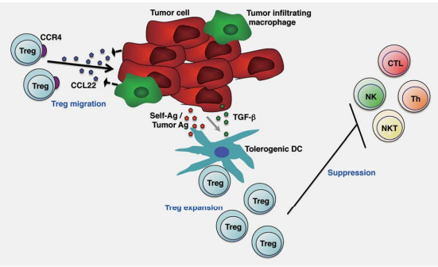
Ārējie imunosupresijas mehānismi
M2 makrofāgu polarizācija
T reg infiltrācija:
Notes:
. Tregs suppress antitumor immune responses. CCL22 produced by tumors and tumor inﬁltrating macrophages recruit CCR4-
expressing Tregs (Treg migration). Tregs accumulated via CCR4-CCL22 recognize tumor-associated immunogenic self-antigens (self-Ag) and
proliferate (Treg expansion). Tolerogenic dendritic cells (DCs) induced by TGF-b derived from tumor cells further enhances Treg expansion.
These Tregs suppress antitumor effector cells. Although this ﬁgure focuses on tumor sites, Treg expansion also occurs in the draining
lymph nodes. NK: natural killer cells; NKT: NK T cells; CTL: CD8þ cytotoxic T lymphocytes; Th: CD4þ helper T cells; Ag: antigen.

Slide 23
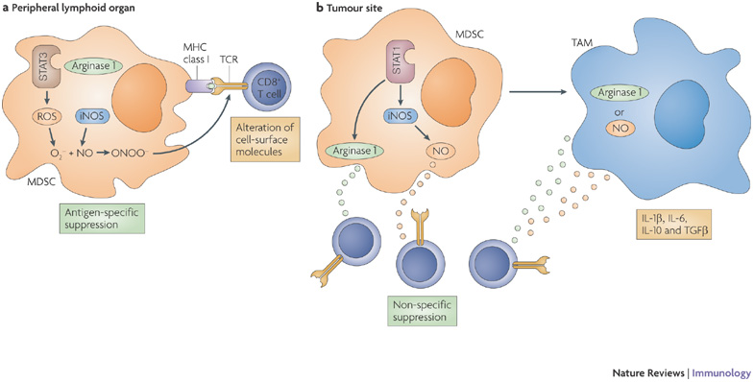
Ārējie imunosupresijas mehānismi
M2 makrofāgu polarizācija
T reg infiltrācija
Mieloīdās supresor šūnas (Myeloid-derived supprressor cells):
Argināze 1 samazina CD3 zeta ķēdes ekspresiju un inhibē T šūnu proliferāciju
Notes:
Myeloid-derived suppressor cells (MDSCs) are a heterogeneous population of cells that are defined by their myeloid origin, immature state and ability to potently suppress T cell responses. They regulate immune responses and tissue repair in healthy individuals and the population rapidly expands during inflammation, infection and cancer. Several therapeutic strategies are now being developed to target MDSCs to promote antitumour immune responses or to inhibit immune responses in the setting of autoimmune disease or transplant rejection.
Myeloid-derived suppressor cells (MDSCs) migrate to tumour sites and peripheral lymphoid organs. a | In peripheral lymphoid organs, MDSCs produce high levels of reactive oxygen species (ROS), including peroxynitrite (ONOO⁻), and upregulate signal transducer and activator of transcription 3 (STAT3) activity. This is associated with a moderate increase in arginase 1 activity and low levels of nitric oxide (NO) production. MDSCs can take up, process and present antigens to antigen-specific CD8⁺ T cells. During this close cell–cell contact, peroxynitrite produced by MDSCs causes nitration and nitrosylation of different amino acids on the T-cell receptor (TCR) and CD8 molecules on the surface of T cells, which causes the T cells to become unresponsive to antigen-specific stimulation. However, these cells retain the ability to respond to antigen-non-specific stimulation with CD3- and CD28-specific antibodies. b | By contrast, MDSCs that migrate to the site of the tumour upregulate STAT1 activity, produce high levels of inducible nitric oxide synthase (iNOS), NO and arginase 1; this is associated with low levels of ROS. The high levels of arginase 1 and NO that are released by MDSCs inhibit CD8⁺ T-cell function in a non-specific manner. MDSCs at the tumour site can also differentiate into tumour-associated macrophages (TAMs). In contrast to MDSCs, TAMs upregulate the expression of either arginase 1 or iNOS, depending on the nature of the tumour microenvironment (see Ref. 91), but not of both proteins. TAMs acquire the ability to produce several suppressive cytokines, such as interleukin-1 (IL-1), IL-6, IL-10 and transforming growth factor- (TGF). Together with MDSCs, TAMs contribute to antigen-non-specific T-cell suppression in the tumour microenvironment.
arginase I, which decreases the expression of the T-cell receptor CD3zeta chain and impairs T-cell responses.

Slide 24
Ārējie imunosupresijas mehānismi
M2 makrofāgu polarizācija
T reg infiltrācija
Mieloīdās supresor šūnas (Myeloid-derived supprressor cells)
Audzēju mikrovidē producētās imunosupresīvās molekulas:
IDO (indoleamine-2,3-dioxygenase) – enzīms, kas metabolizē triptofānu; samazina trp pieejamību vidē; T šūnas ir īpaši jutīgas pret trp samazināšanos – šūnas cikla arests un apoptoze
CD73 (ekto 5’ nukleotidāze) – producē ekstracelulāru adenozīnu – inhibē T, NK, makrofāgus un DCs
Ekstracelulārā pH regulācijas sistēma – audzēju mikrovidē ir pazemināts pH – inhibē CTLs un IFNγ produkciju

Slide 25
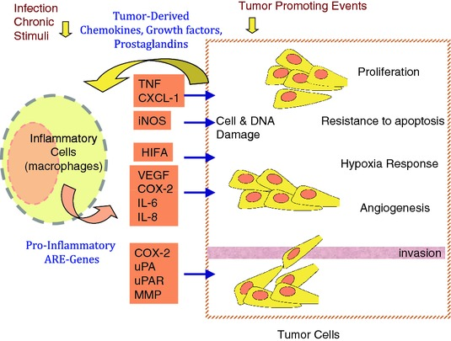
Hronisks iekaisums stimulē audzēja veidošanos
Hronisks iekaisums ir daudzu audzēju priekš-vēža stāvoklis (piemēram, hronisks atrofisks gastrīts ir kuņģa vēža priekš-vēža stāvoklis, aknu ciroze – aknu vēzis, hronisks kolīts – kolorektālais vēzis). Hroniska iekaisuma gadījumā imūnsistēmas šūnas (makrofāgi, neitrofili, daļēji diferenciētas mieloīdās šūnas u.c.) var producēt: augšanas faktorus, apoptozes inhibitorus, angioģenēzes stimulatorus, ekstracelulāro matriksu modificējošus enzīmus u.c, kas veicina vēža šūnu proliferāciju, izdzīvošanu, invazivitāti un metastazēšanu un angioģenēzi. Turklāt, iekaisuma procesos tiek producētas mutagēnas vielas, piemēram ROS, iNOS.

Slide 26
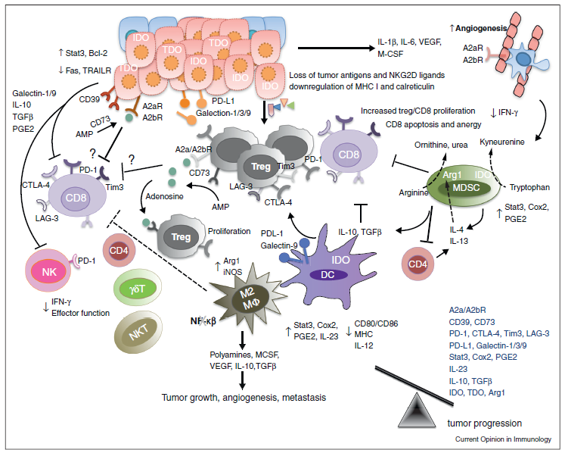
Imunosupresējoša audzēju mikrovide
Mittal et al, Current Opinion in Immunology, 2014
Notes:
During the Escape phase of cancer immunoediting, the immune system fails to restrict tumor outgrowth and tumor cells emerge causing clinically apparent disease. In this phase, tumor cells evade immune recognition (loss of tumor antigens, MHC class I or co-stimulatory molecules), express molecules of increased resistance (STAT-3), survival (anti-apoptotic molecule bcl2) and immunosuppression (IDO, TDO, PD-L1, galectin-1/3/9, CD39, CD73, adenosine receptors) and secrete cytokines VEGF, TGF-b, IL-6, M-CSF that enhance angiogenesis. Furthermore, MDSCs, M2 macrophages and DCs may also express immunoregulatory molecules such as arginase, iNOS and IDO and secrete immunosuppressive cytokines IL-10 and TGF-b that can inhibit CD8+ proliferation or induce apoptosis. MDSCs and IDO expressing DCs also induces the generation of regulatory T cells. IDO, arginase, CD39 and CD73 are immunoregulatory enzymes whereas IDO catabolize tryptophan to kyneurenine, arginase catabolize L-arginine to ornithine and urea, CD39 metabolise ATP to AMP which can further be metabolised to adenosine by CD73. Adenosine can bind to adenosine receptors — A2aR and A2bR expressed on tumor cells, endothelial cells and immune cells. T cells including Tregs may express inhibitory receptors such as PD-1, CTLA-4, Tim-3 and LAG3 that suppresses anti-tumor immune response and favor tumor outgrowth. In the Escape phase, the balance is skewed towards tumor progression due to the presence of immunosuppressive cytokines and molecules such as IL-10, TGF-b, VEGF, IDO, PD-L1.

Slide 27
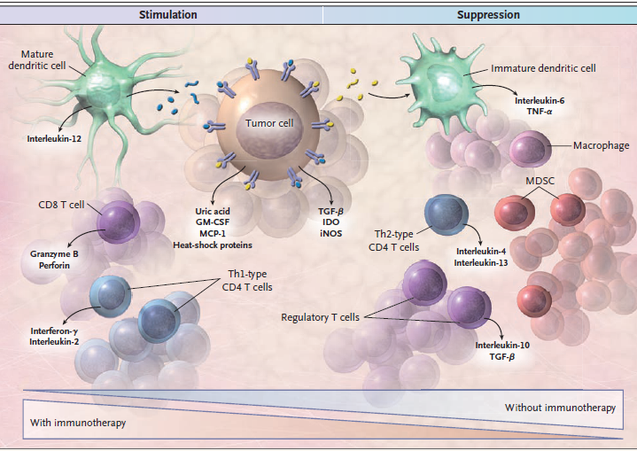
Imunoterapijas mērķis: novirzīt balansu imunostimulējošas vides virzienā un stimulēt efektīvu pret-vēža imūno atbildi
Olivera J Finn, N Engl J Med, 2008

Slide 28
Imunoterapijas stratēģijas
Nespecifiskie imunomodulatori (citokīni (IL-2, IL7, IL-12, IFNγ,TNFα), adjuvanti (CpG)
Monoklonālās antivielas
pret audzēja šūnu virsmas receptoriem
Opsonizē audzēja šūnu & stimulē ADCC
Konjugētas ar zālēm vai toksīnu
Bloķē vēža šūnai svarīgu signālceļu (piem, Herceptīns)
Imunostimulējošas antivielas pret imūnšūnu aktivējošiem vai inhibējošiem receptoriem
bloķē inhibējošos signālus (CTLA4, PD-L1)
stimulē aktivējošos signālus (CD40, OX40) uz T šūnām
Vakcīnas:
Citokīnus vai ko-stimulatorus producējošas, apstarotas vēža šūnas vai lizāts
Audzēju Ag vakvīnas
Dendrītisko šūnu vakcīnas
Adoptīvā šūnu pārnese: TIL, TCR,CAR

Slide 29
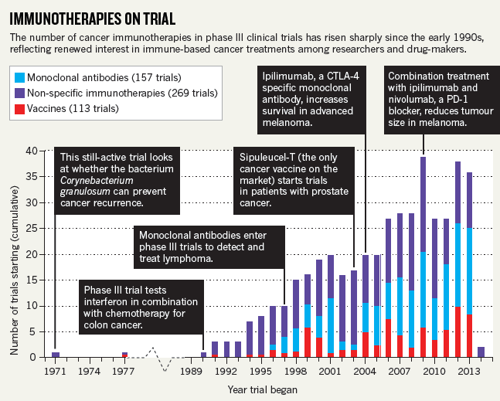

Slide 30
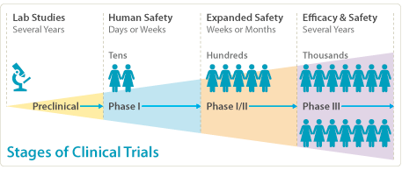
https://www.aimatmelanoma.org

Slide 31
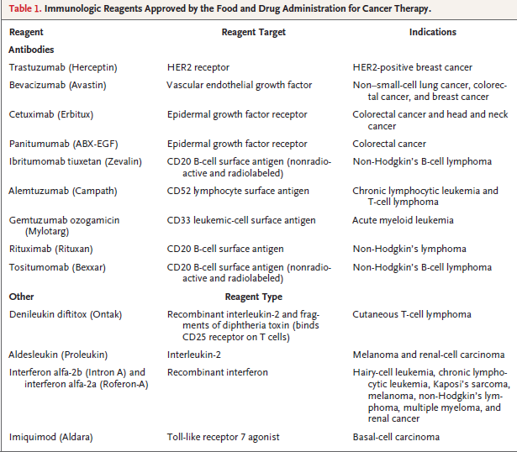

Slide 32
Audzēju antigēnu vakcīnas
Antigēni: zināmi audzēju antigeni, piemēram, NY-ESO-1, MAGEA, survivin, tyrosinase, telomerāze, TP53 u.c. vai peptīdu kokteilis (eluēti no audzēja MHC I)
Īsi (MHC –saistības peptīdi) vs gari peptīdi vs DNS vs vīrusu vektori
Glikānu modificēti peptīdi vai proteīni (glikāni mērķē peptīdu uz APCs)
Imunizācijas shēmas
I un II fāzes klīniskie izmēģinājumi rāda, ka šīs pieejas ir drošas, taču response rate – 5-15%
Viens no pašlaik persepktīvākajiem mēģinājumiem: MHC peptīdu kokteilis + cikofosfamīds: RCC, III fāzē, survival benefit

Slide 33
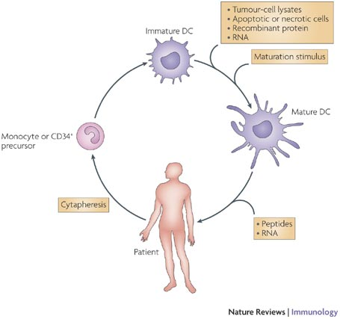
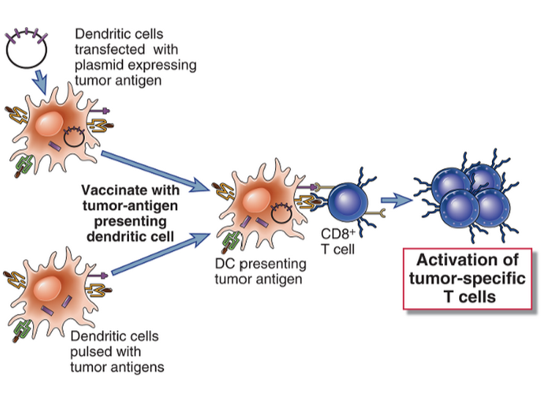
Dendrītisko šūnu vakcīnas
Notes:
The recognition that dendritic cells (DCs) are important regulators of immune responses, together with the development of techniques to obtain large numbers of DCs in vitro from isolated monocytes, has stimulated research on DC-based vaccination strategies, with the first clinical study being published in 1996 (Ref. 109). Most DC-based vaccines currently explored in clinical trials consist of mature antigen-loaded autologous DCs that are administered to patients with the intention of inducing antigen-specific T- and B-cell responses. The DCs used for these studies are derived from monocytes or CD34⁺ precursors that are isolated from patient blood by cytapheresis, as illustrated in the figure. These cells are cultured in the presence of various cytokine mixtures to produce immature DCs, and loaded with antigen either before or following DC maturation.
These first clinical trials have provided valuable information on DC-based therapy. First, the therapy is safe and well tolerated, side effects are constrained to induration of the skin at the injection site and a mild fever. Second, they emphasize the importance of the quality of DCs, especially their migratory capacity and ability to induce potent T-cell responses. Notably, only a small percentage of the DCs injected in current trials actually migrate from the injection site into the draining lymph node to present the antigen to T cells. This might be due to suboptimal maturation protocols and could be enhanced by preconditioning DCs with pro-inflammatory cytokines or Toll-like receptor agonists¹¹⁰. Third, they have resulted in the development of various immunomonitoring tools to study the mechanisms underlying successful vaccination that will help to shape future vaccine design. Finally, these studies have unequivocally demonstrated that DC vaccination can induce immunological responses in many of the patients. So far, studies have generally been pursued in patients with late-stage cancer with a poor prognosis. These patients probably suffer from immunosuppression as a result of a large tumour burden and prior radiation therapy or chemotherapy. This might be one of the reasons why, to date, clinical responses have only been observed in a minority of patients.

Slide 34
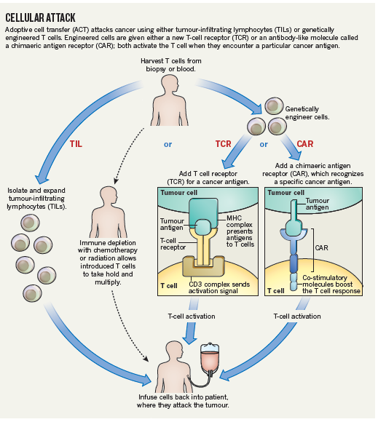
Adoptīvā šūnu pārnese
TCR – transficē T šūnas ar TCR pret audzēju antigēniem; problēma: TCRiem jāatbilst pacienta MHC.
CAR – himērie antigēnu receptori. Sastāv no antivielas daļas, kas saistās ar antigēnu, receptora daļa, kas aktivē T šūnu un molekulas, kas stimulē to proliferāciju un izdzīvošanu.

Slide 35
Provenge (Sipuleucel-T) – pirmā FDA apstiprinātā terapeitiskā pret-vēža vakcīna
Indikācija: asimptomātisks vai minimāli simptomātisks metastatisks, castrate-resistant prostatas vēzis
Princips: no pacienta asinīm izolē monocītu-bagātinātu šūnu frakciju (nenobriedušas APCs), ex vivo kultivē kopā ar PAP (prostatas skābā fosfatāze) un GM-CSF hibrīdo proteīnu. Targetē GM-CSF receptoru ekspresējošas APC - tās ex vivo aktivējas un nobriest (pieaug CD54 ), ievada atpakaļ pacientam.
Efektivitāte: paildzina dzīvildzi par 4.1 mēnesi, salīdzinot ar standarta terapiju
Ražotājs: Dendreon; 2010. gadā saņem FDA apstiprinājumu

Slide 36
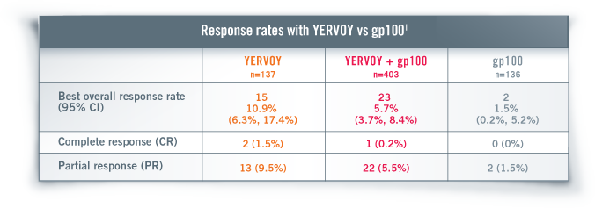
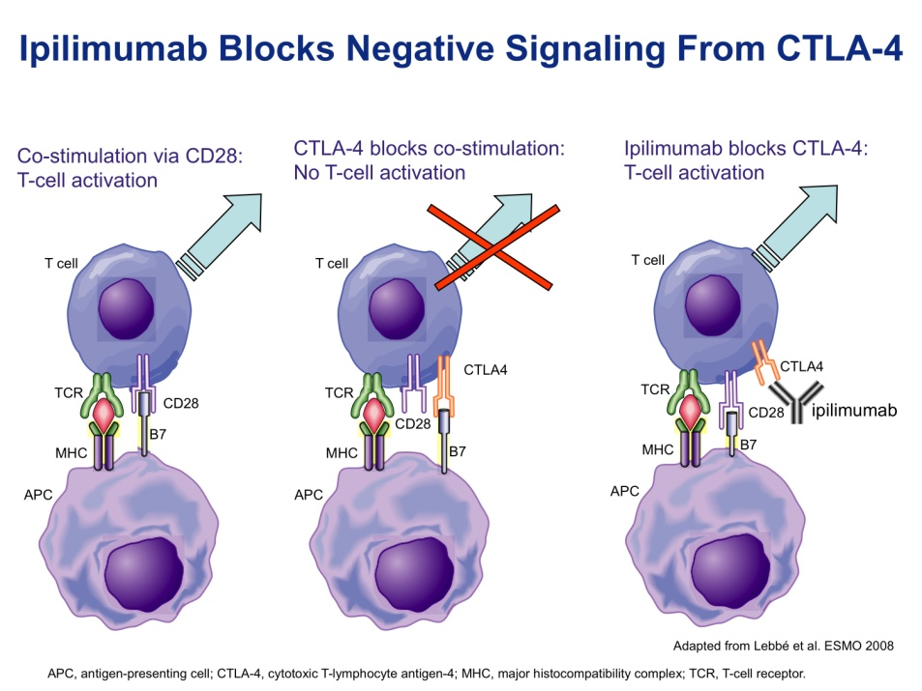
Ipilimumab (YERVOY) – pirmā FDA apstiprinātā imunostimulējošā antiviela
Indikācija: melanoma; pašlaik tiek mēģināta arī plaušu un prostatas vēža ārstēšanai
Princips: saistās pie CTLA-4 receptora, kas inhibē T šūnu aktivāciju: palīdz aktivēt T šūnas, bloķējot inhibitoru
Efektivitāte:

Slide 37
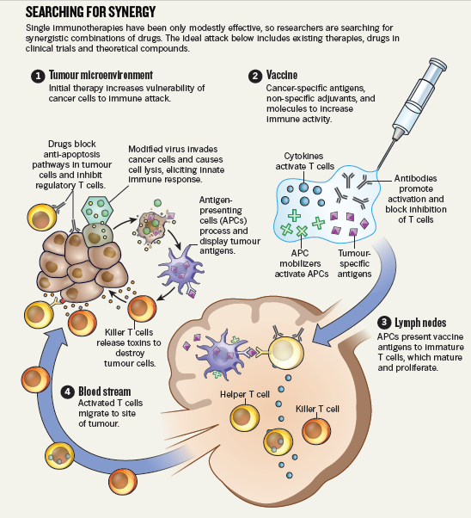
Pašreizējās imunoterapijas attīstības tendences: kombinācijas un sinerģijas meklēšana
Dažādu imunoterapijas pieeju kombinācijas
Imunoterapijas kombinācijas ar citotoksiskām zālēm (Treg eliminēšana un imunogēna šūnu nāve)
Imunoterapijas kombinācija ar molekulāri mērķētām zālēm

Slide 38
Cancer immunoediting: integrating immunity's roles in cancer suppression and promotion.
Schreiber RD, Old LJ, Smyth MJ. Science. 2011 Mar 25;331(6024):1565-70. doi: 10.1126/science.1203486. Review.
Cancer immunoediting: from immunosurveillance to tumor escape.
Dunn GP, Bruce AT, Ikeda H, Old LJ, Schreiber RD. Nat Immunol. 2002 Nov;3(11):991-8. Review.
Cancer immunology. Finn OJ. N Engl J Med. 2008 Jun 19;358(25):2704-15. doi: 10.1056/NEJMra072739. Review.
Cellular and Molecular Immunology, 7th edition, Abul K. Abbas, Andrew H. Lichtman, Shiv Pillai, Elsevier, 2012,

